Slide 1
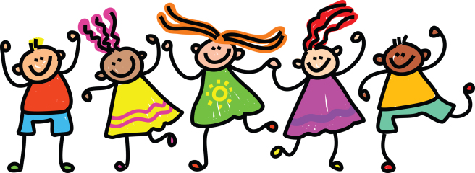
Wednesday 20th of May
Good morning primary 1!
Bonjour la class! Ca va?
https://www.youtube.com/watch?v=atNkI6QFZ50
L.I – I can say some simple greetings in French
Q.-Comment tu t’appelle?
(What is your name?)
Je m’appelle…….
(I am called ……..)
https://www.youtube.com/watch?v=6-32jNNr4pg
Practice asking you family their age in French.

Slide 2
Literacy
I can share ideas in pictures and print.
We are learning to recognise, read and make words containing the “ee” phoneme.
Sing and complete actions to jolly phonics alphabet songs
https://www.youtube.com/watch?v=U2HYM9VXz9k&t=630s
Break and blend ee words with alphablocks
https://www.youtube.com/watch?v=2Eunmvlex0c
Complete activities for day 3 in pack.
Elkonin box example
Please use a whiteboard pen to write on the polypocket so you are able to wipe it clean and use it again next week.
sh | ee | p

Slide 3
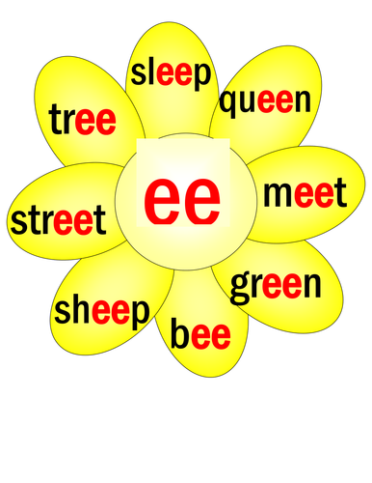
L.I – I can spell words containing the ee phoneme.
Task – Can you complete this phoneme flower in your jotter? Write a different ‘ee’ word in each petal and illustrate.
example
*Challenge
Choose an ‘ee’ word and write a super sentences in your jotter.
Using the link below practise spelling your ‘ee’ words
https://www.ictgames.com/mobilePage/forestPhonics/index.html
ee

Slide 4
Today’s Story – The Very Cranky Bear https://www.youtube.com/watch?v=1pyto2rBUp8

Slide 5
Todays Number Talk

Slide 6
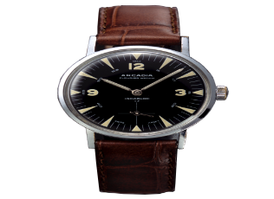
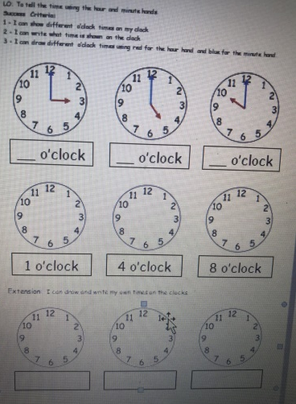
Time!
We are learning to read the time
on an analogue clock.
Watch
https://www.bbc.co.uk/bitesize/clips/zfn9jxs
o’clock time Quiz – 10minutes
Play
https://www.splashlearn.com/time-games
There are 3 times games you can choose from. Give them a try.
Activity
Recap o’clock times using PowerPoint attached to post.
Complete worksheet below

Slide 7
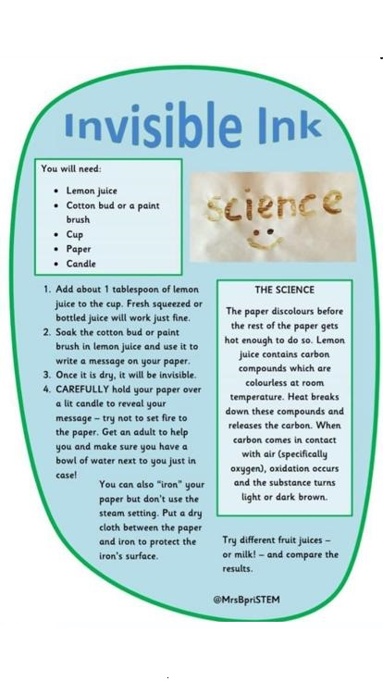
Science For Fun
This is a great experiment but it is better to be
carried out with a grown-up.
Let us know how it goes!

Slide 8
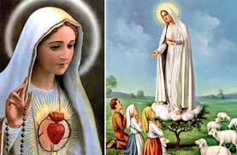
R.E.- Mary is Our Mother Mary appeared to children to show her love.
In 1858 while she was gathering firewood Bernadette was
visited by Mary. At first no one would believe that Our Lady
was visiting Bernadette. Our Lady appeared several times to
Bernadette and eventually she was believed. Now people
from all over the world go to Lourdes to visit the spot she
appeared at. They go to pray to Mary and ask for help.
In 1917 Our Lady visited three shepherd children in Fatima
Portugal. She visited them several times teaching them
special prayers. Once again they were not believed.
The children never changed their story and people began
to believe them and pray too. A church was also built on
the spot where Mary appeared and people visit to pray.
Remember Mary will always listen to your prayers.

Slide 9
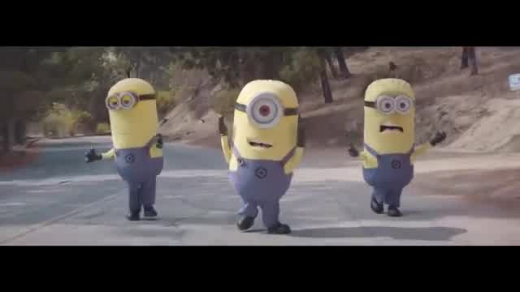
Health and Wellbeing. Let’s dance to one of our favourite songs.
https://www.youtube.com/watch?v=MOWDb2TBYDg

Slide 10
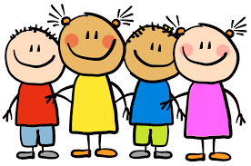
Enjoy the rest of your day Primary 1!

