Slide 1
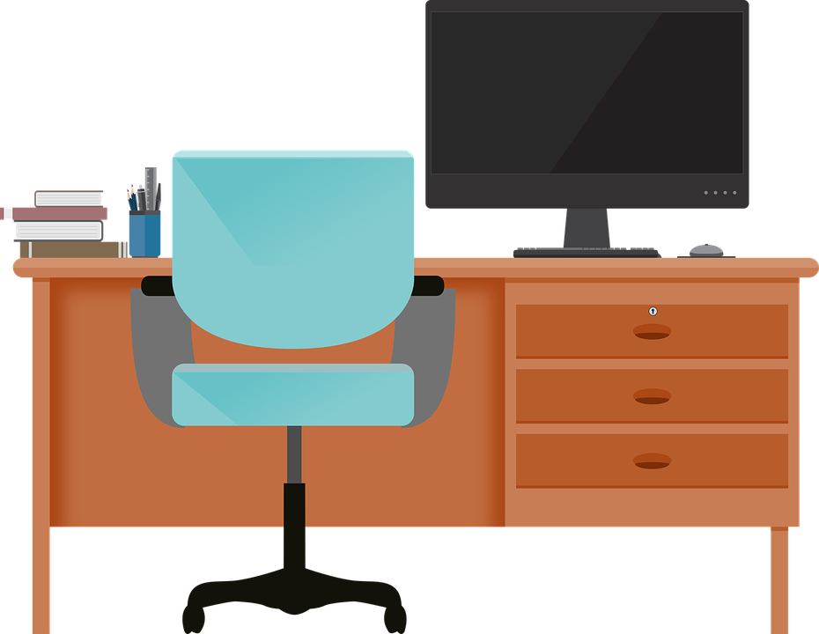
Good Morning P5/4
Week 9 Home Learning
Wednesday 20th May 2020

Slide 2
Aujord’hui c’est mercredi vingt mai.
Je suis content(e)
Je suis d’accord
Je suis mal
Il fait nuageux.

Slide 3
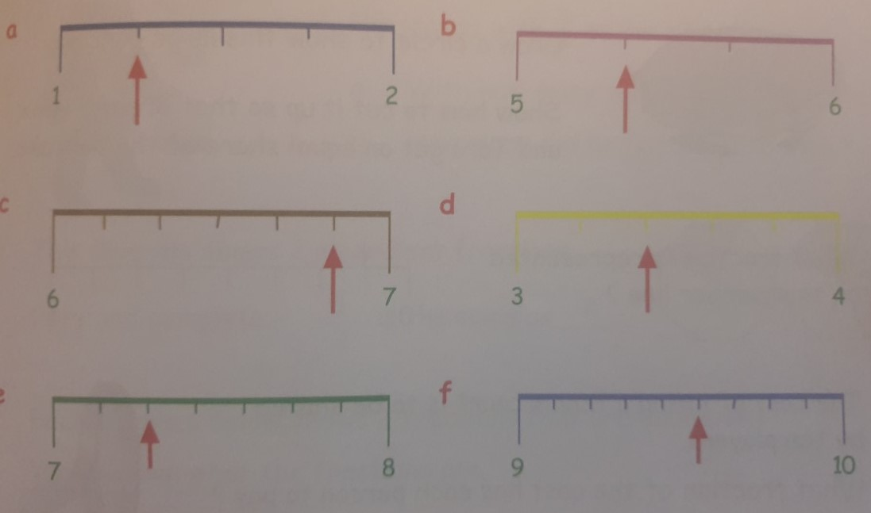
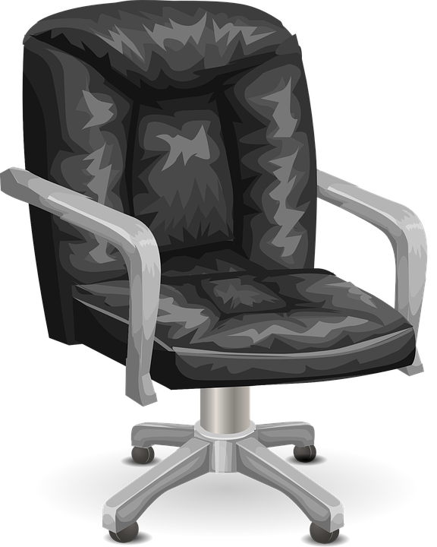
Morning Starter
There are twenty lollipops in a box.
a. How many lollipops would I have if I took half of them?
b. How many lollipops would I have if I took a quarter of them?
What number is each arrow pointing to?
For each of the following fractions, divide the numerator and the denominator by a number to simply the fraction: (Check that your answer can't be simplified further).
a. 15/18
b. 4/10
c. 6/18

Slide 4
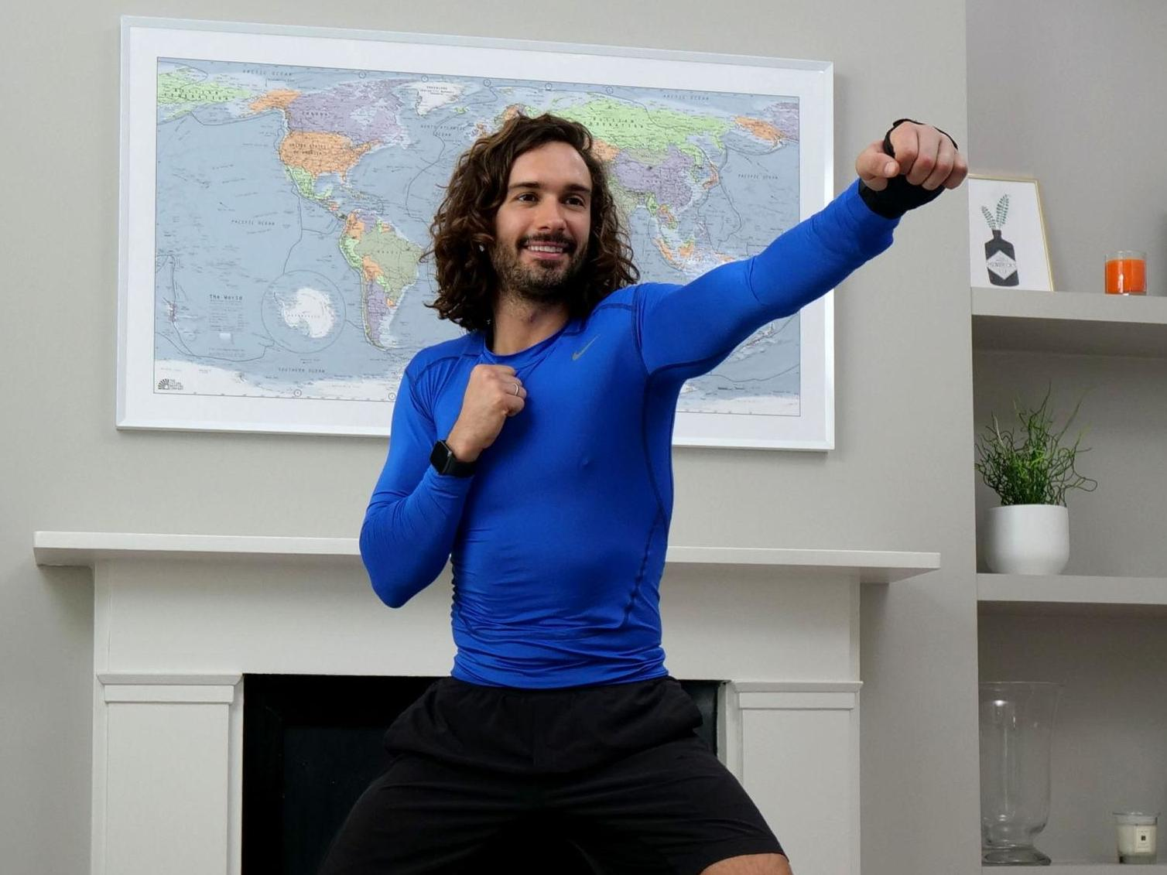
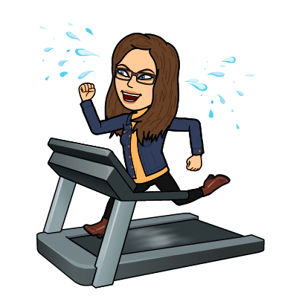
PE tasks
Wednesday is normally a PE day for us so here are some ways you can choose to get
active today:
(Some of these people are almost as fun as Mr Martin, but not quite!)
9am – Joe Wicks PE lesson –
11:30am – Dance Lesson with Oti Mabuse (Strictly professional) –
Any time – Cosmic Kids Yoga –

Slide 5
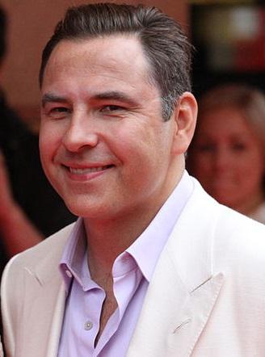
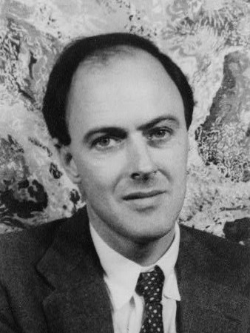
Spelling: Phonics Board
‘au’
Reading: New Book!
Task – Choose one or two of the home learning challenges.
Literacy Task Board
Spelling: 5 words, 5 strategies
Primary 4 – set 5
Primary 5 – unit 12
Reading:
Task – Comprehension Questions
Spelling: 5 words, 5 strategies
Primary 4 – set 5 Primary 5 – unit 12
Reading:
Task –
Metalinguistics

Slide 6
Maths Task Board
Click circle for teaching video
Simplifying Fractions
Websites for all groups to use:
Click triangle for teaching video
Counting in fractions
Click square for teaching video.
Fractions, Decimals and Percentages

Slide 7
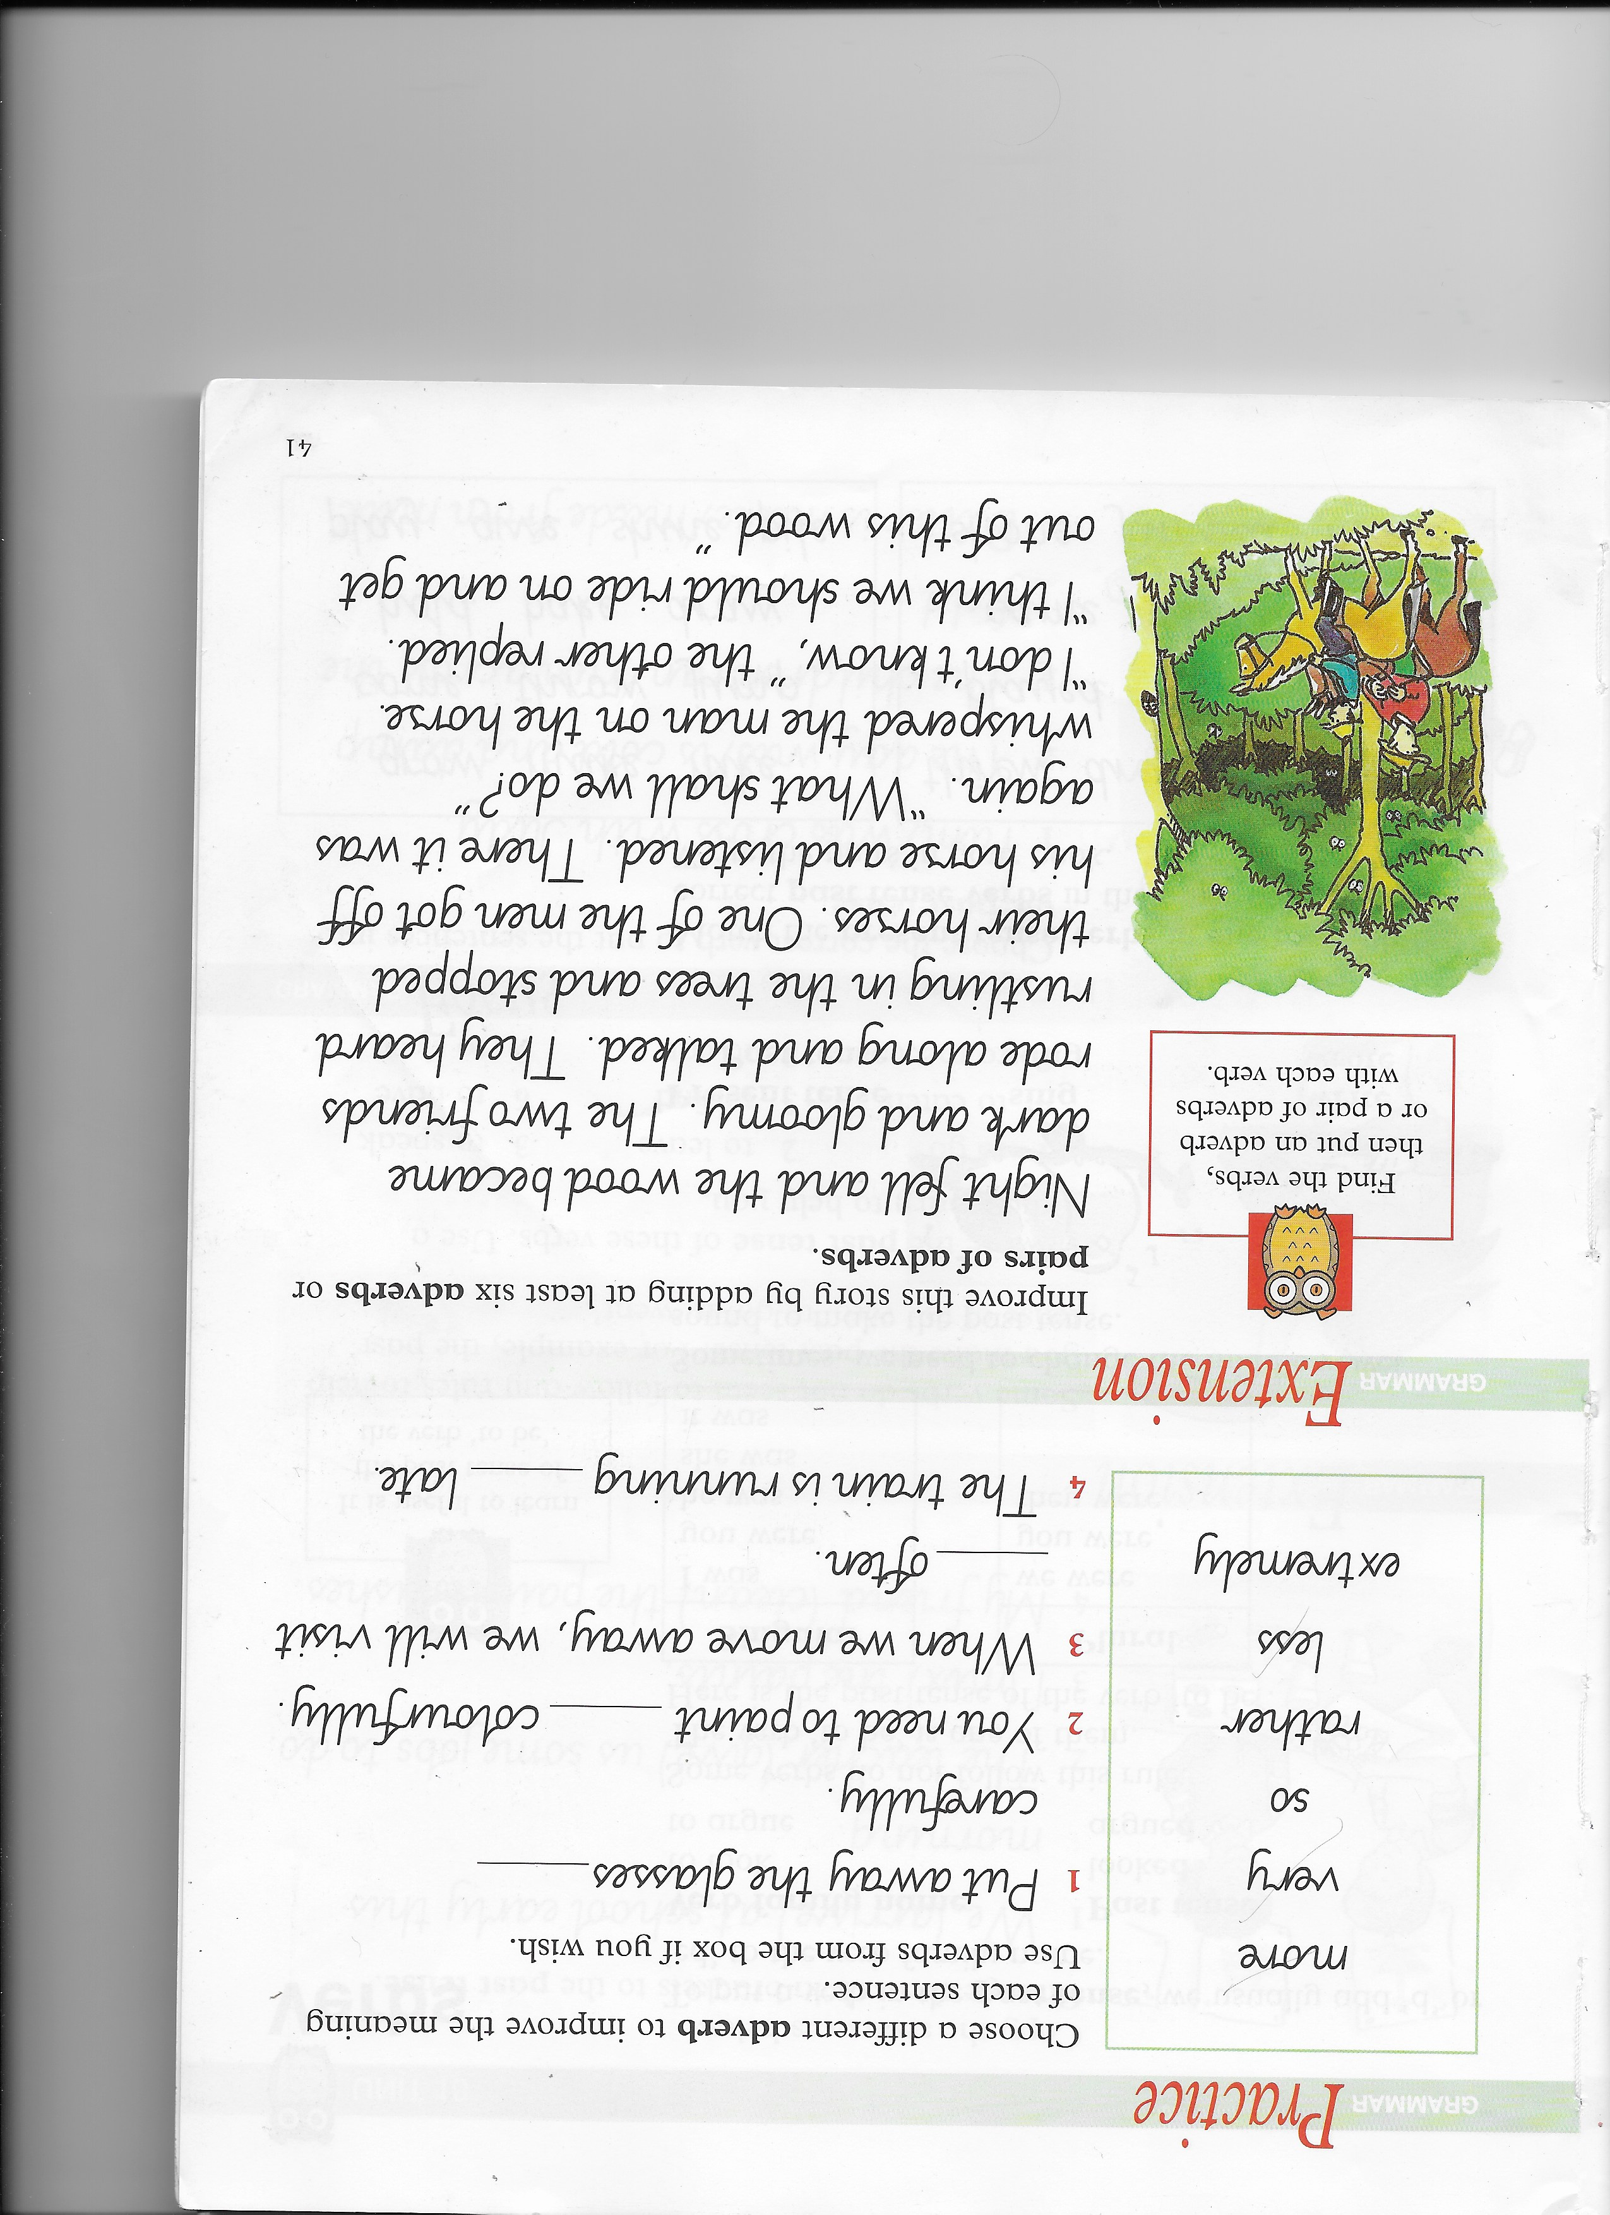
Grammar task – Group 1
Nelson Grammar Book 1 Unit 17.
L.I. I can revise pronouns.

Slide 8
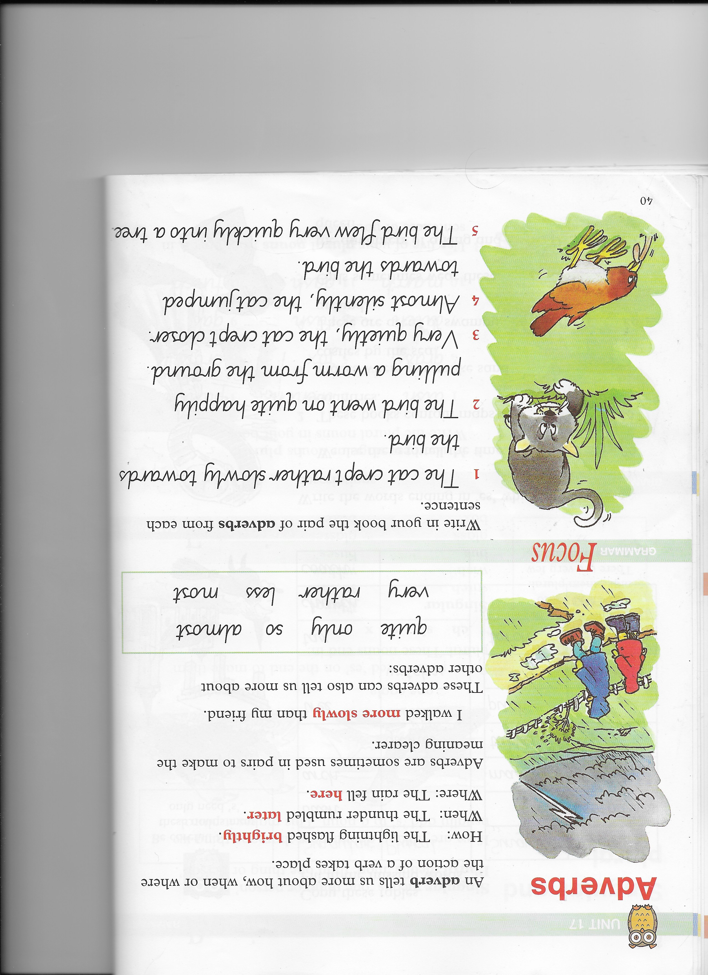
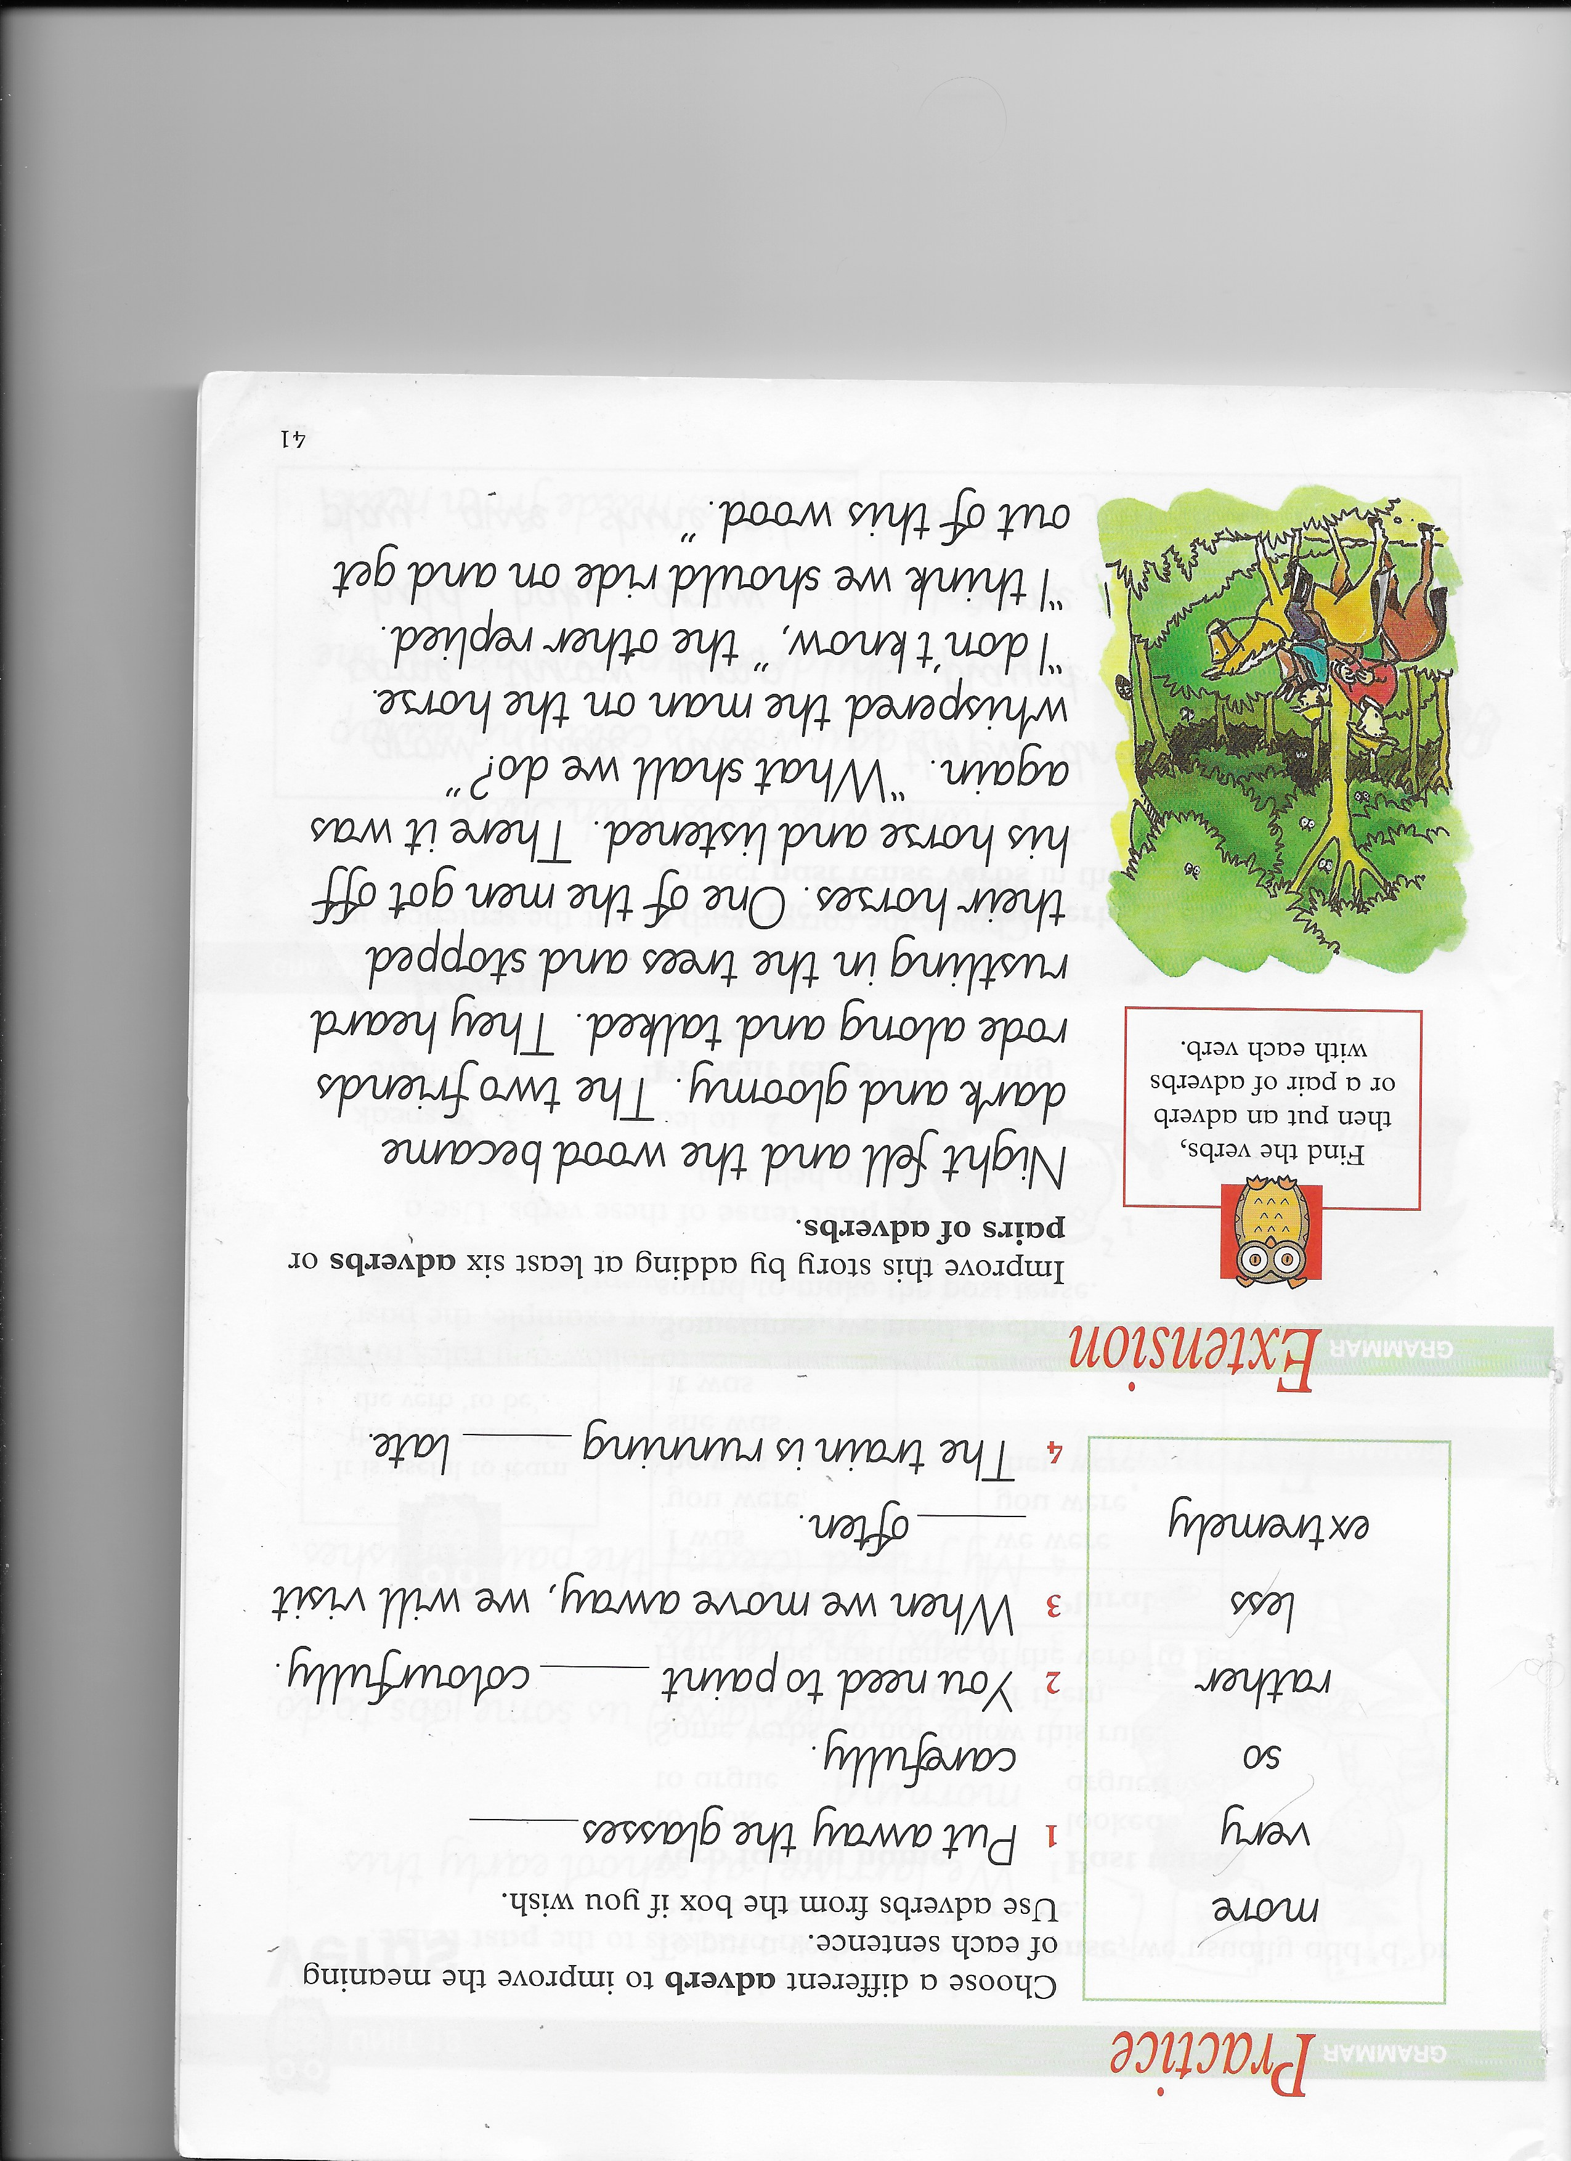
Grammar task – Group 2
Nelson Grammar Book 2 Unit 17.
L.I. I can revise adverbs.

Slide 9
Health and Wellbeing Task
This week we will be looking at the active part of SHANARRI. Today is about Healthy Lifestyles.
P4
Keep a record of how much time you spend every day being active.
P5
Prepare a two minute talk to deliver at home and to share on teams to support the idea that walking it or wheeling it to school can promote independence/ confidence/road safety awareness/ general health & wellbeing.

Slide 10
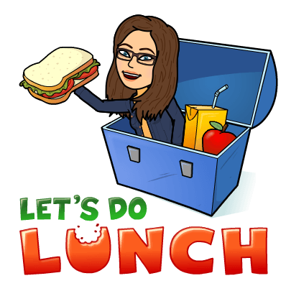
Mental Health Awareness Week
The 7 day Kindness Challenge:
Here is today’s challenge for you:
Help prepare some food/meal in your house.
This one you will need adult supervision for.
You could make a healthy snack for the people in your house or you could help prepare lunch or dinner.

