Slide 1
Wednesday 20th of May
Good Morning Primary 2/3!
French: Bonjour la class! Ca Va?
Aujourd’hui cest Mercredi 20th Mai 2020
L.I- To know simple greetings in French
https://www.youtube.com/watch?v=atNkI6QFZ50
See if you can respond in french:
Bonjour! Comment ca va?
Ca va bien, comme ci, comme ca
2. Comment tu t’appelle?
Je m’appelle ________

Slide 2
Literacy
LI: We are learning to read and spell this weeks common words.
Sing with Mr Mac- Boom shake the Alphabet https://www.youtube.com/watch?v=Emb2yvwAHtc
Common words:
Stage 2 words- Father, head, Mother, jump
Stage 3 words- put, different, light, sentence, stop
Write your words out and underline the vowels in red.
Choose a couple of your words and write a sentence for each one.

Slide 3
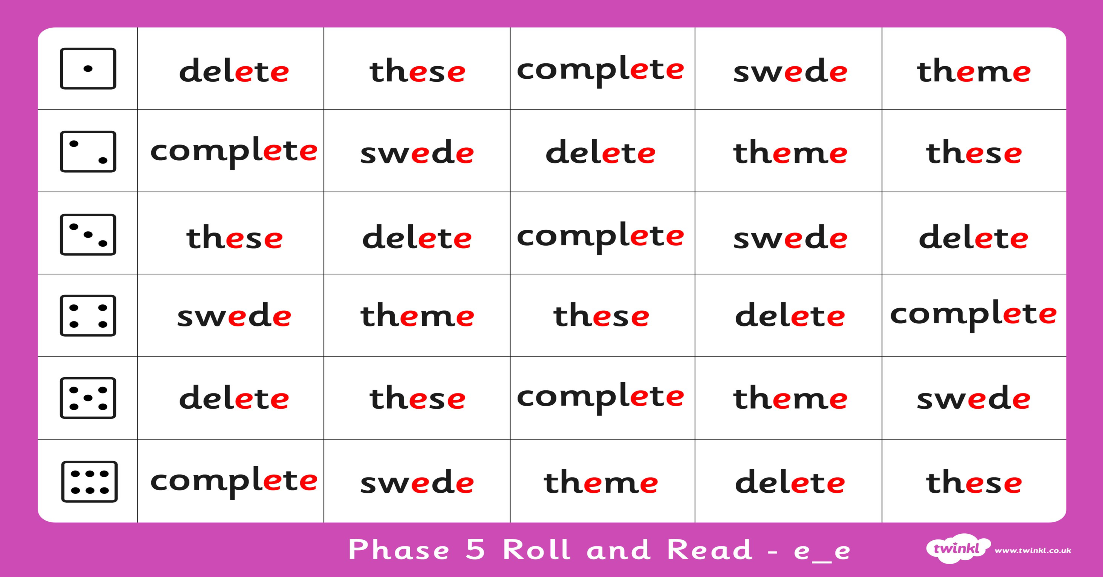
Stage 2- Roll and Read
L.I -I can read words containing the ‘e-e’ phoneme.
Task: Roll the dice, read a word from the line of the number you rolled. First to get 4 in a row wins.

Slide 4
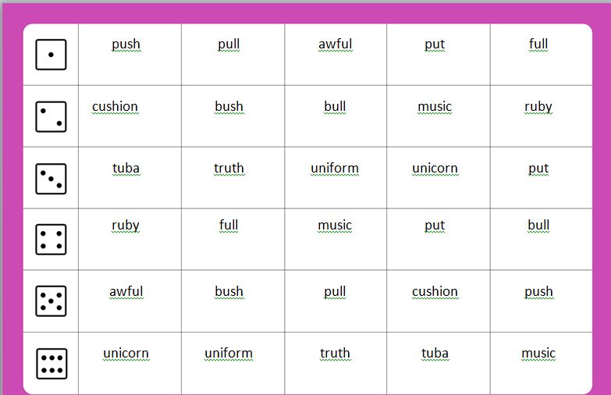
Stage 3- Roll and Read
L.I -I can read words containing the ‘u’ phoneme.
Task: Roll the dice, read a word from the line of the number you rolled. First to get 4 in a row wins.

Slide 5
Reading
https://www.oxfordowl.co.uk/?sellanguage=en&mode=hub username: stantsps password:homelearning
Use this week’s reading book:
Was this a fiction or a non- fiction book?
Turn to the page that best shows or describes the setting of the story. Describe the setting to your grown up.
Using this page and your imagination, draw your own picture of the story’s setting. (you might want to share this on twitter so I can see)

Slide 6
Story Time
https://www.youtube.com/watch?v=mj20MAmb1c4&list=PLv315_-qxKRv3XhNNMs9scvQ3QIdk4uLH&index=16

Slide 7
Numeracy – Warm Up
LI: To use mental strategies to solve maths problems and be able to explain my strategy
Cube Conversions

Slide 8
Numeracy – Warm Up
On the next slide you will see some shapes made of cubes.
You need to work out how many cubes make up the shape.
You also need to see how many different ways you can see the shape.
Maybe a cube shape made of 5 cubes you see as 3 and 2 cubes or 4 and 1 cubes to make the 5 cube shape.

Slide 9
How many unit cubes make up this structure? Explain how you know.
How else can you think about this structure? Is there another way to see it?
Are there even more ways you can picture or think about this structure?
You may have seen some groups like these:
It’s time to reveal the answer. Let’s find out the total number of unit cubes.
The Reveal
8 unit cubes
www.stevewyborney.com
Steve Wyborney

Slide 10
Before we see the answer, describe several different ways you can see this structure.
10 unit cubes
The Reveal
www.stevewyborney.com
Steve Wyborney

Slide 11
Before we see the answer, describe several different ways you can see this structure.
12 unit cubes
The Reveal
www.stevewyborney.com
Steve Wyborney

Slide 12
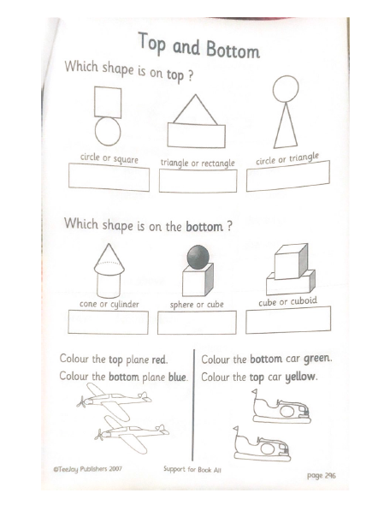
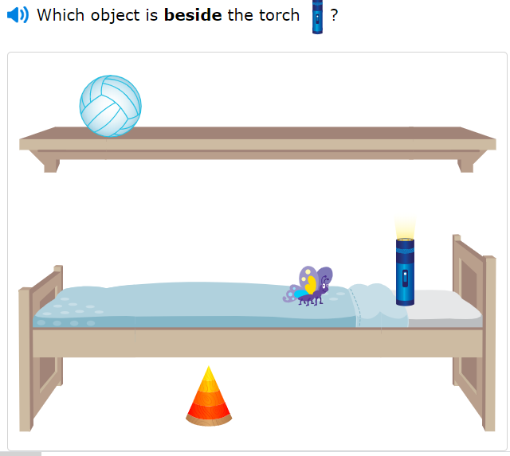
P2 Maths Activities
L.I – I can describe the position of an item using the correct language
Complete page 3 in your workbook
Play: IXL Maths https://uk.ixl.com/math/year-2/beside-and-next-to

Slide 13
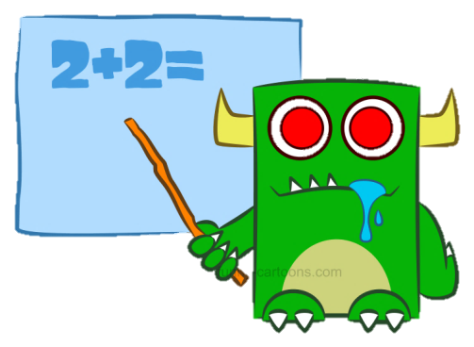
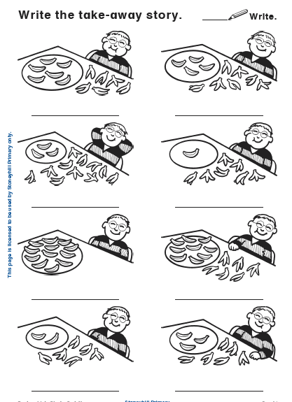
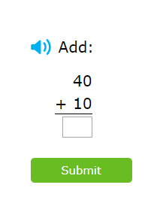
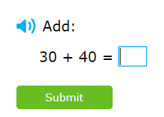
P3 Numeracy Activities
LI: To use counting on and addition strategies to find the total
Addition and Subtraction workbook
Please do the second page of your
booklet.
2. IXL Maths: Adding 2 multiples of 10 within 100
https://uk.ixl.com/math/year-2/add-two-multiples-of-ten

Slide 14
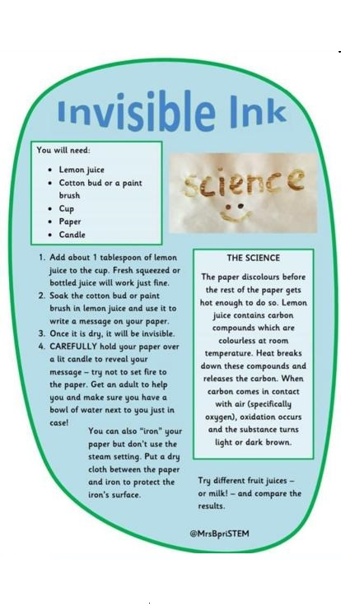
Science For Fun
This is a great experiment but it is better to be
carried out with a grown-up.
Let us know how it goes!
I’ve attached the full size sheet so you can read it more clearly

Slide 15
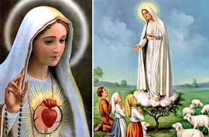
R.E.- Mary is Our Mother Mary appeared to children to show her love.
In 1858 while she was gathering firewood Bernadette was visited by Mary. At first no one would believe that Our Lady was visiting Bernadette. Our Lady appeared several times to Bernadette and eventually she was believed. Now people from all over the world go to Lourdes to visit the spot she appeared at. They go to pray to Mary and ask for help.
In 1917 Our Lady visited three shepherd children in Fatima Portugal. She visited them several times teaching them special prayers. Once again they were not believed. The children never changed their story and people began to believe them and pray too. A church was also built on the spot where Mary appeared and people visit to pray.
Remember Mary will always listen to your prayers.

Slide 16
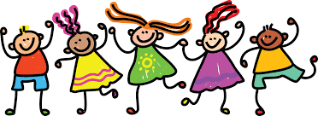
Leave a comment on the blog or upload a picture of what you have done or made today. Enjoy the rest of your day Primary 2/3!

