Slide 1
Tuesday 19th May
Good Morning Primary 4!
French: Bonjour la class! Ca Va?
Quelle est la date aujourd’hui?
Aujourd’hui cest Mardi 19th Mai 2020
Listen to the days of the week song!
https://www.youtube.com/watch?v=Lpwf5N0rfVE

Slide 2
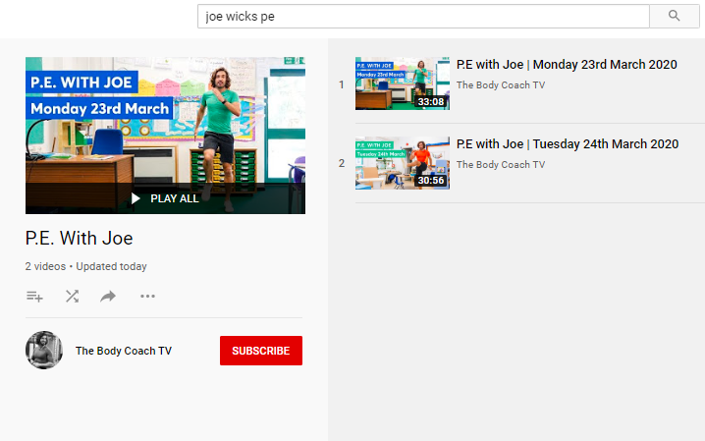
Health and Wellbeing
LI: We are learning to move our body well, exploring how to manage and control it, finding out how to use and share space.
P.E with Joe- Tuesday
19th May Video
(he is nearly as fun as Mr Martin, not quite, but nearly)
https://www.youtube.com/playlist?list=PLyCLoPd4VxBvQafyve889qVcPxYEjdSTl

Slide 3
Spelling slide 1 (Tom Fletcher & Roald Dahl groups)
LI: I can recognise and spell words that use the phoneme ‘oe’
Today, we are continuing to look at our new phoneme!
The ‘oe’ phoneme
(Don’t worry – we will move onto some new words soon!)
TASK= look at your ‘oe’ words list and use diacritical marking on them. See the next slide to remind yourself of how to diacritically mark!
EXAMPLES: whole
road

Slide 4
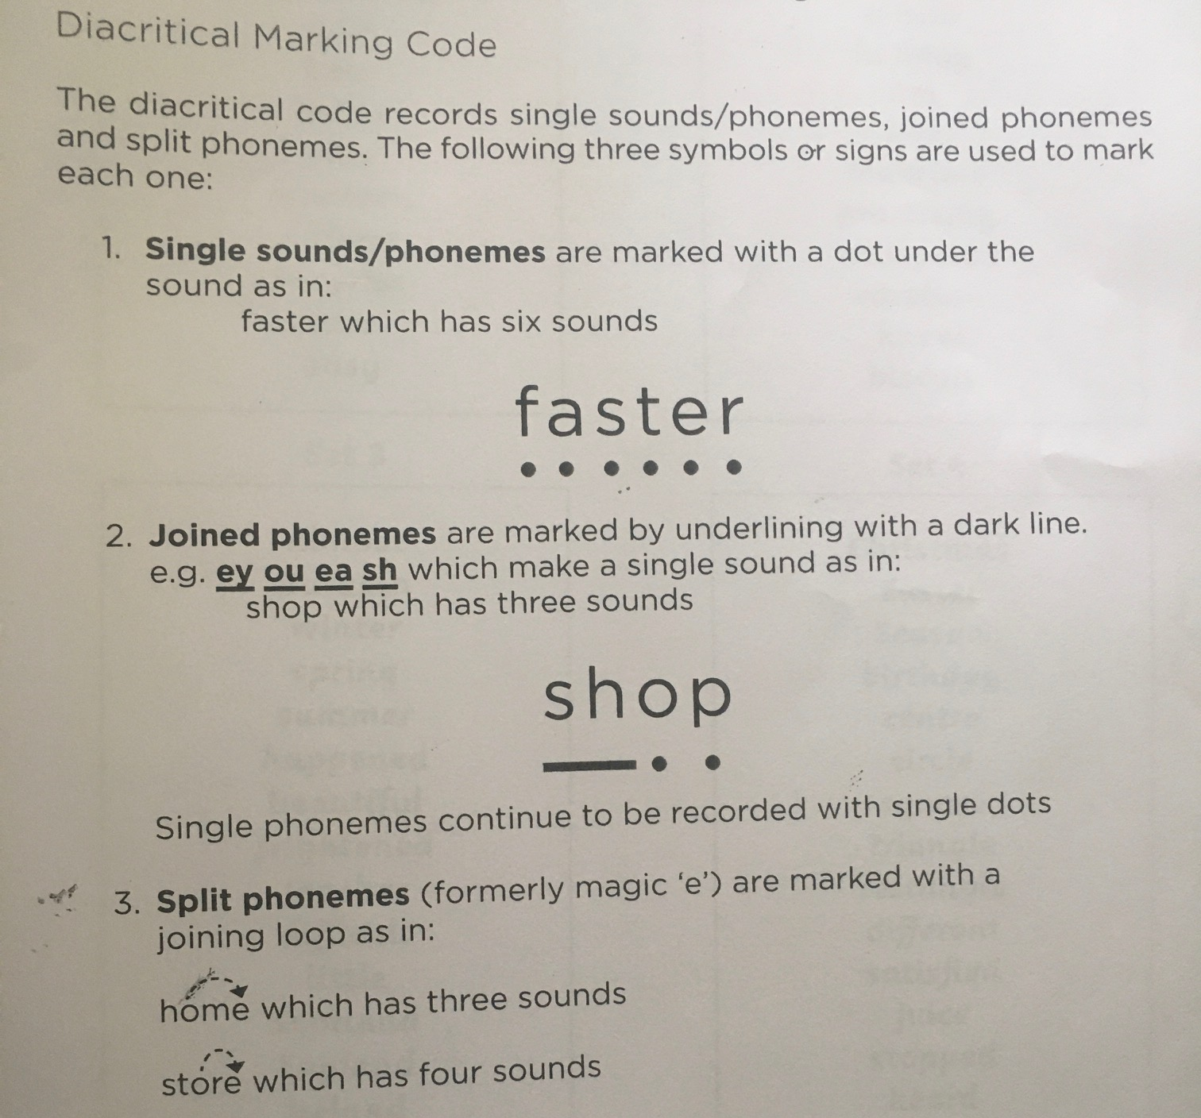
Spelling slide 2 (Tom Fletcher & Roald Dahl groups)
LI: I can recognise and spell words that use the phoneme ‘oe’

Slide 5
Spelling slide 3 (Tom Fletcher & Roald Dahl groups)
LI: I can recognise and spell words that use the phoneme ‘oe’
o-e | oa | ow | oe
whole | road | know | toe
alone | coast | bowl | goes
telephone | groan | shallow | potatoes
those | coal | tomorrow | tomatoes
wrote | soak | window | foe

Slide 6
Spelling (David Walliams Group)
L.I. I am learning to spell ‘ea’ words
You have worked really hard on your ‘ea’ words over the last couple of weeks. Lets have one last look at some different ‘ea’ words before we explore a new sound!
TASK: click on the link below to see some more words that use the ‘ea’ phoneme.
Click the green football at the bottom of the page and play some of the ‘ea’ online games!

Slide 7
Reading
L.I I am using different reading strategies to help me understand my book
David Walliams:
New book!: t-or-1117-the-zoo-vet-story-powerpoint_ver_2
Task – t-or-1114-the-zoo-vet-what-am-i-animal-powerpoint_ver_2
Roald Dahl: Chapter 14 – Visulisation
Tom Fletcher: Chapter 5 – Prior Knowledge

Slide 8
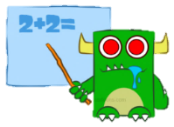
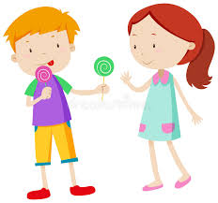
Maths (slide 1)
L.I. I am learning how to use division to find the fraction of an amount
I am at a friends house and we have 8 sweets.
As there are 2 of us, we need to share the sweets equally (so that we both have the same amount) by halving them!
So, we must find $\frac{1}{2} of 8$
We can do this simply by dividing 8 (the amount of sweets by 2 (the denominator, or bottom number, of the fraction!)
8 ÷ 2 = 4
Each person gets 4 sweets each!

Slide 9
Maths (slide 2)
L.I. I am learning how to use division to find the fraction of an amount
So, to half a number we always divide it by 2!
Have a look at the following slides to see some examples.

Slide 10
Finding Half (½)
To find half of a number of objects, you need to divide them by two.
Count the number of cakes.
There are 8 cakes.

Slide 11
Finding Half (½)
There are 8 cakes. Divide the cakes between the two children so that they have the same number each. The best way to do this is ‘one for me, one for you’.
How many cakes does each child have?

Slide 12
Finding Half (½)
How many cakes does each child have?
Each child has 4 cakes.
So half of 8 is 4.
½ of 8 = 4

Slide 13
Finding Half (½)
Now try another one. This time there are 12 cakes. If we divide them between two, how many cakes does each child have?

Slide 14
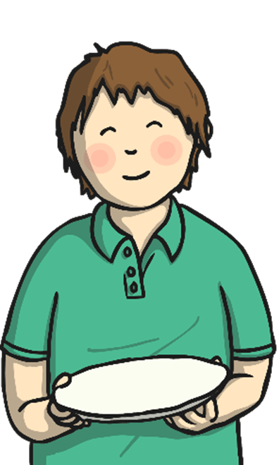
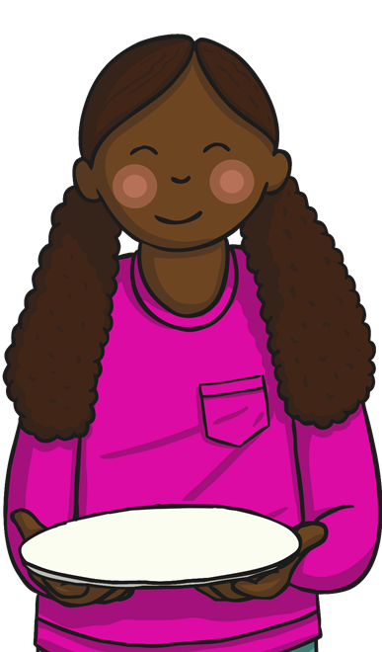
Finding Half (½)
How many cakes does each child have this time?
Each child has 6 cakes.
So half of 12 is 6.
½ of 12 = 6

Slide 15
Maths (slide 2)
L.I. I am learning how to use division to find the fraction of an amount
TASK: Download the fractions worksheet and answer the questions in your jotters.
The aim is to find $\frac{1}{2 }$ of lots of different amounts.
Good luck!

Slide 16
Religious Education
L.I. I am learning about how Jesus helped others.
Over the last few months, we’ve seen how important it is to help other people in times of need.
During Jesus’ lifetime, he helped many people in different ways.
This afternoon, we are looking at one such story.
The story is all about Jesus healing a Centurion’s servant.
Before you read the story, can you find out what a Centurion was?

Slide 17
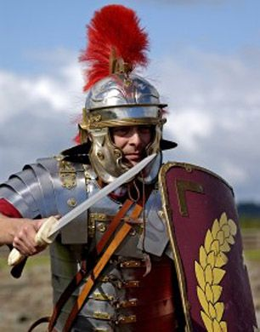
Religious Education
L.I. I am learning about how Jesus helped others.
A Centurion was a professional officer in the Roman Army!
See the next slides to read the story!

Slide 18
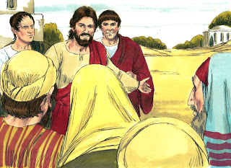
Religious Education
L.I. I am learning about how Jesus helped others.
When Jesus arrived in Capernaum, a centurion came to Jesus. A centurion is a Roman soldier, who is in charge of 100 men.

Slide 19
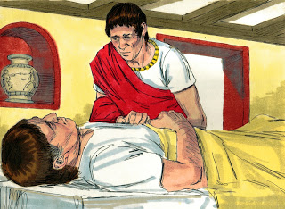
Religious Education
L.I. I am learning about how Jesus helped others.
The centurion explained to Jesus that he had a servant at home, who was paralysed, in a lot of pain and about to die.

Slide 20
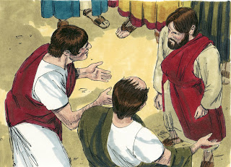
Religious Education
L.I. I am learning about how Jesus helped others.
Jesus told the centurion that He would come to his house and heal the servant. But, the centurion replied that all Jesus had to do was say the word and his servant would be healed. Jesus didn’t need to come to his house!
The centurion said, “I have soldiers under me and have the authority to tell them what to do. If I tell a soldier to go, he will go. If I tell another soldier to come, he comes. If I tell a soldier to do something, he will do it.”

Slide 21
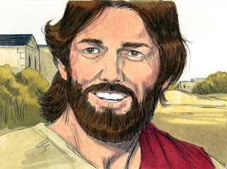
Religious Education
L.I. I am learning about how Jesus helped others.
When Jesus heard of the centurion’s faith in Him, he was amazed! Jesus told him that He had not seen such faith before! The centurion believed that Jesus could heal his sick servant and not even have to touch him!

Slide 22
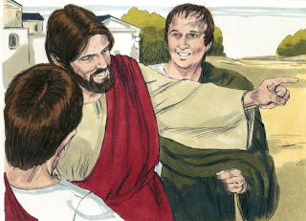
Religious Education
L.I. I am learning about how Jesus helped others.
Jesus told the centurion to leave and go home. The Centurion had so much faith that Jesus said his servant would be healed!

Slide 23
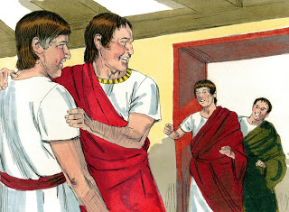
Religious Education
L.I. I am learning about how Jesus helped others.
And, his servant was healed right then, without Jesus even touching him! When the power of Jesus healed someone, it was called a miracle.

Slide 24
Religious Education
L.I. I am learning about how Jesus helped others.
What lessons do you think that the story is trying to teach?
How did you feel as you read the story?
TASK: Draw a picture of the Centurion talking to Jesus about his paralysed servant.

Slide 25
Feel free to leave comments / questions on Teams throughout the day and I will try my best to get back to you. Enjoy your day, Primary 4!

