Slide 1
Tuesday 19th of May
Good Morning Primary 3!
Bonjour la class! Ca Va?
Can you say todays date in French?
Aujourd’hui c’est (M…………) 19th (M…………) 2020
Watch ‘Quel temps fait il?” and see if you can describe todays weather.
Begin by saying - Aujourd’hui c’est …
https://www.youtube.com/watch?v=eBvJVOuBPXI

Slide 2
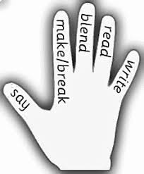
Literacy
LI: We are learning to recognise, read and make words containing the ‘u’ phoneme.
Sing ABC, abc and vowel song.
Read the phoneme story and highlight the phoneme words.
Click on the link below - Mr Thorne Does Phonics. Watch this short video to help you understand this weeks sound.
https://www.youtube.com/watch?v=jC0XpKQoJOQ
Complete the Phoneme word maker.
Can you read all these ‘u’ words?
pull, put, awful, full, cushion, push, bush, bull

Slide 3
Literacy – Reading
LI: We are learning to read fluently and answer simple questions about what we have read.
Oxford Owl Website – https://www.oxfordowl.co.uk/?sellanguage=en&mode=hub
Username – stantsps3
Password – primary3
Again, you can use a book you have at home also.
Here are some questions I would like you to answer about your book. You can write the answers in your jotter, or tell them to someone in your house.
What is the name of your book?
Who is the author?
Do you know the name of the illustrator?
What do you like about the book?
Is there anything you don’t like about the book?
Can you find one word in your book that you find tricky? What does this word mean?

Slide 4
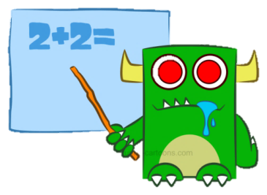
Numeracy – Warm Up
LI: We are learning to count in 2s, 5s and 10s.
https://www.youtube.com/watch?v=q_yUC1NCFkE
Jack Hartmann - Workout and Count

Slide 5
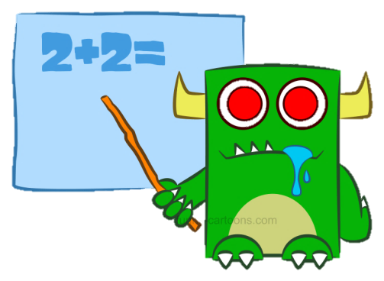
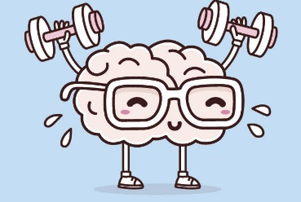
Number Talk
LI: We are learning to solve number problems mentally.
Remember – Number Talks are all about how you solve a task, mentally. For this activity, don’t use anything to help you, just use your brain!
20 + 19 =
21 divided by 7 =
18 – 11 =
3 times 5 =
What strategy did you use? Did your parent use the same one?

Slide 6
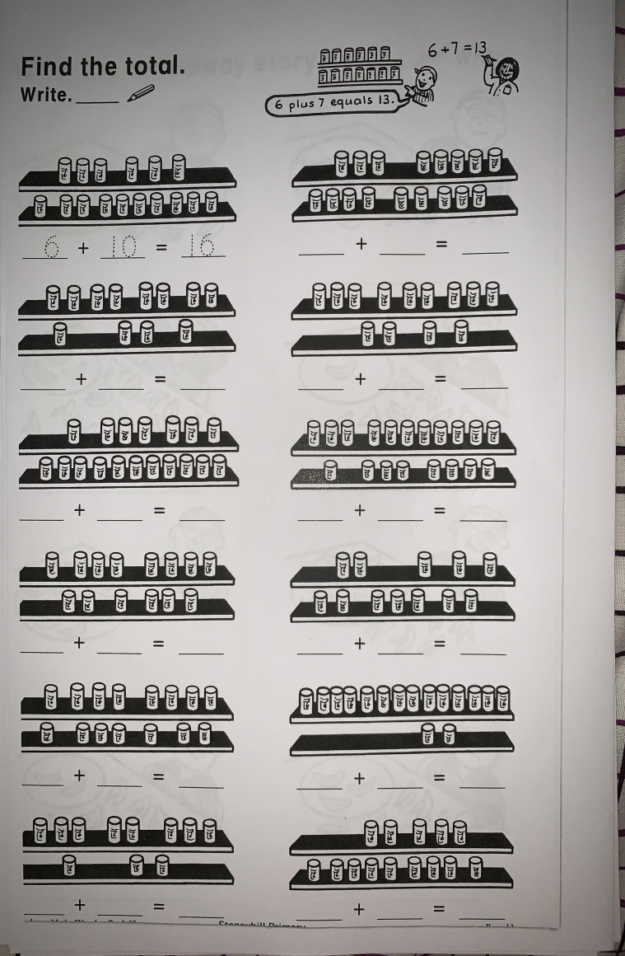
Numeracy Activities
LI: We are learning to develop a range of addition and subtraction strategies.
Today we are going to start our ‘Addition & Subtraction’ workbook.
Please complete Page 1
Game – IXL Maths, using doubles plus one.
https://uk.ixl.com/math/year-2/add-using-doubles-plus-one

Slide 7
Health and Wellbeing
LI: We are learning to use our words to make others feel happy.
This week is Mental Health Awareness Week!
For todays activity, we are going to spread some kindness and put a smile on our loved ones faces.
Think of people who are important to you.
Can you think of something kind to say about each person you have thought of? Our goal is to make them smile! ☺
Share this with them. You can do this by speaking to them, writing a short letter or (if your chosen person does not stay in you house) asking an adult to send your message to them. Have fun!

Slide 8
Great work P3! Enjoy the rest of your day! ☺

