Slide 1



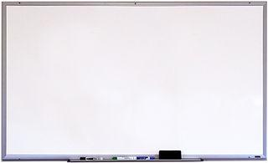








Good Morning P5/4
Week 9 Home Learning
Tuesday 19th May 2020

Slide 2



Aujord’hui c’est mardi dix-neuf mai.
Je suis content(e)
Je suis d’accord
Je suis mal
Il pleut.

Slide 3
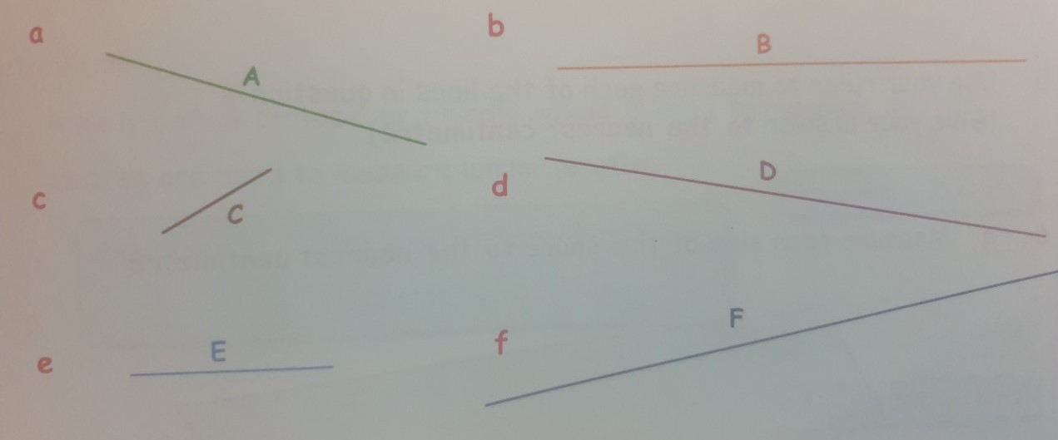

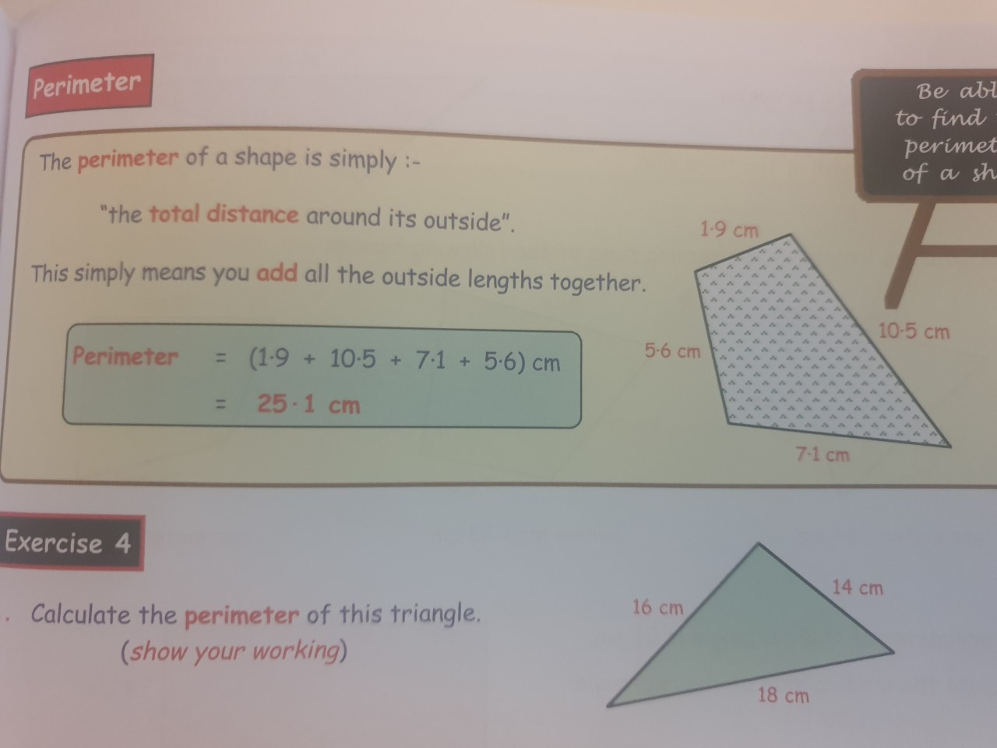

Morning Starter
Remember: 1 metre = 100 cm. How many cm in:
a. 1 m
2. 1/2 m
c. 1/4 m
Estimate (guess) the length of each line.
Give your answer to the nearest centimetre.
Calculate the perimeter of the green triangle.
Show your working.

Slide 4
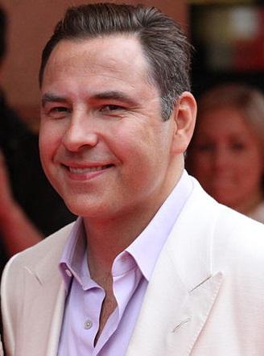
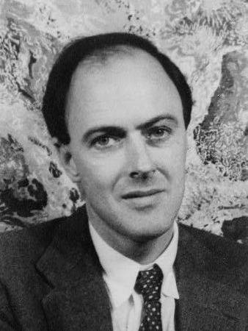
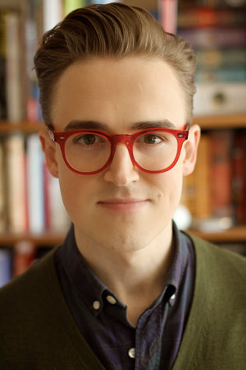

Spelling: Phonics Board
‘au’
Reading: New Book!
Task - Animal Riddles
Literacy Task Board
Spelling: 5 words, 5 strategies
Primary 4 – set 5
Primary 5 – unit 12
Reading:
Task - Visuliser
Spelling: 5 words, 5 strategies
Primary 4 – set 5
Primary 5 – unit 12
Reading:
Task -
Prior
Knowledge

Slide 5
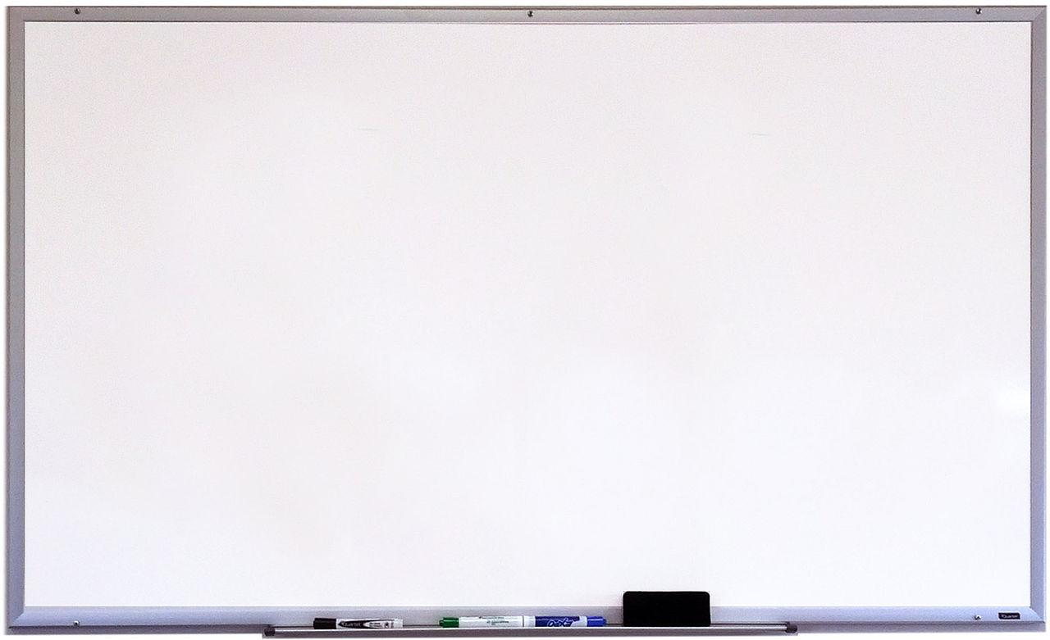


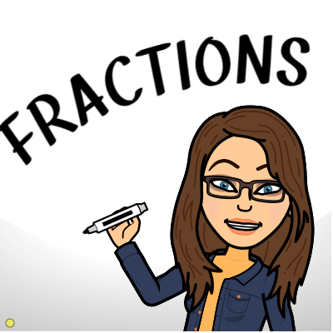


Finding a fraction - Teejay 1a - pg. 182 - 183
Fraction of a quantity - Teejay 1b - pg. 187
Websites for all groups to use:
Fraction of a quantity - Teejay 2a - pg. 103 - 104

Slide 6

Research capital cities of each European country - can you find them all?
See if you can find:
Name of the capital city
Any famous landmarks
Any famous people from that city
A reason why you would want to visit.
Extra Challenge
Some of you may be aware of the singing competition that takes place each year in Europe called Eurovision.
Due to Covid-19, this year’s competition did not take place. However, the songs that were meant to compete have been released.
As an extra challenge, do a bit of research into Eurovision, why did it start, how long as it been going on for, what does the winning country get, what is Britain’s history in it.
You could also listen to this years entries and rank your top 3 songs.

Slide 7

Mental Health Awareness Week
Watch this video
If you are feeling down - take some time today to do something for you, there are loads of ideas in the video that you can try.
If you are feeling great - you could maybe do something incase those around you are not, especially in the circumstances that we have currently.
The 7 day Kindness Challenge:
We are a day late due to the Monday holiday but here is today’s challenge for you:
Send someone you haven’t seen in ages a letter or card.

