Slide 1
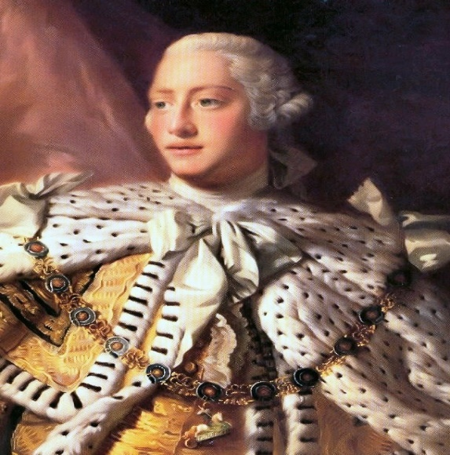
The Jacobites So what happened next?
In 1714 Queen Anne died and George, a Hanoverian [German], was crowned King of Great Britain.
George I was protestant. This was important to ensure the protestant religion remained dominant.
He only spoke a few words of English and was very unpopular.

Slide 2
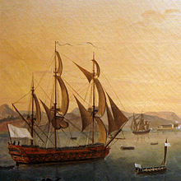
Prince James Edward Stuart
Shortly after George became King, Prince James Edward Stuart [son of King James VII] set sail from France for Scotland to start another rebellion.
King Louis XIV of France promised to send men and ships to support him.

Slide 3
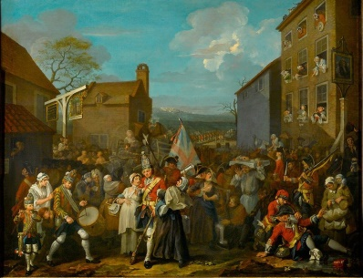
Why did support for the Jacobites rise?
Since the Act of Union, trade had been badly affected. Towns on the East coast of Scotland were prohibited from trading with France, their oldest trading partner.
Heavy taxes had been imposed on Scots and were very unpopular e.g. the malt tax.
The Scots had less representation at Westminster than Cornwall. In fact, the Act of Union was so unpopular there was an attempt to repeal it in 1713.
Presbyterians and Episcopalians felt their religion was under attack from the Crown.
Scots wanted the right to choose their own King or Queen.
Support for the Jacobites was seen as a way to restore Scotland as an independent country.

Slide 4
In Scotland….
Even before Prince James Edward Stuart arrived, Jacobite support had surged.
Ordinary people pledged their support to the Jacobites and a Jacobite army of thousands of men, was raised.
Support for the Jacobites was strong in the towns in the East coast of Scotland above the River Tay and all over the highlands.

Slide 5
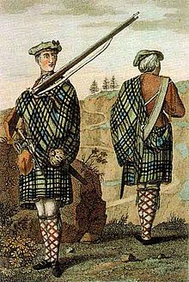
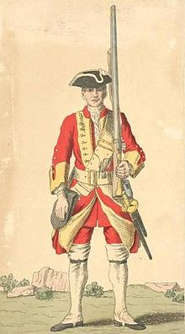
The Battle of Sheriffmuir
Jacobite forces met with British Government forces at The Battle of Sheriffmuir in 1715 [near Dunblane].
The Jacobite army was led by The Earl of Mar, a previous supporter of The Union.
The Earl of Mar, was a poor general and he failed to coordinate the uprising and take advantage of the strength of the Jacobite army. The battle is recorded as a draw but it was a missed opportunity for The Jacobites to take control.
Prince James Edward arrived in Peterhead, near Aberdeen, a month after the battle. The King of France had died and supplies and men had not been sent to support Prince James’ rebellion. His attempt to regain the throne had failed and he returned to France.

Slide 6
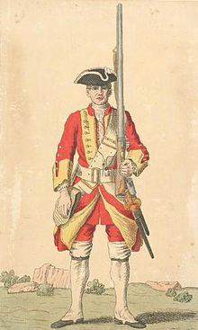
Your Task….
Your task is to draw and label pictures of a Jacobite soldier and a British government soldier[ also known as a redcoat]
I have attached a powerpoint to help you with this task.

