Slide 1
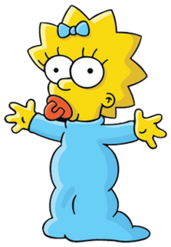
Tuesday 19-5-20
Good Morning Everyone!

Slide 2
Today’s Timetable
Morning Exercise
French
Morning Starter
Maths Lesson
Grammar
Literacy Task
Health and Well-being
Topic
Prayer

Slide 3
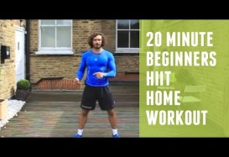
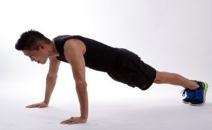
Daily Exercise
Try to do some form of exercise to start the day. This could be a walk or run with a family member or a work-out in the house. Check with your parents that it is ok for you to do this.
Why not try this workout:-
https://www.youtube.com/watch?v=L_A_HjHZxfI
Or join The Body Coach at 9am.

Slide 4
A little bit of French to start the day
Quelle est la date aujourd’hui? Comment a va?
e.g. C’est lundi vingt-huit mai Je suis content(e)
Je ne suis pas content(e)
Quel temps fait-il? Qu’est ce-que tu veux pour le
e.g. Il y a du soleil dejeuner? eg.
Il pleut / Il fait beau/ Il fait froid/ Je voudrais un sandwich au thon
Il fait mauvais/ Il y a des nuages/ Je voudrais un sandwich au fromage
Il y a du soleil/ Il fait du vent Je voudrais un sandwich au jambon
Je voudrais un sandwich aux oeufs

Slide 5
Morning Starter
Your morning starter today, is to think of as many ways to get the answer 73
You must use at least 2 mathematical calculations to get the answer.
e.g. (2 x 35) + 3 = 73
100 – 50 = 50
50 + 23 = 73
If you normally do IDL Maths, please do this also for 15-20mins.

Slide 6
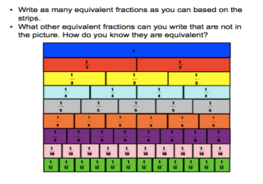
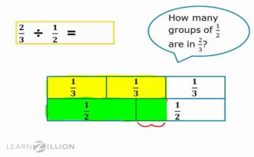
Maths Lesson
L.I. - We are learning about ratios.
S.C. – To understand what we mean by ratio.
- To know that ratios and fractions are related.
- To be able to calculate ratio problems.
Please watch this video first before you do your task. Watch it up until 6mins:-
https://www.youtube.com/watch?v=URMZHUnc8OQ
Task :- Please see the attached sheet for your task.
Circles, please do the first sheet, Squares, do the second sheet and triangles , the third sheet. The answers are listed at the end.
Please do the task first before looking at answers.

Slide 7
Grammar
Your task is to continue your challenge on Sumdog Grammar. Remember, this task lasts until Thursday.
Your task is set up according to your reading group.
Red Group – Group 1, Blue Group – Group 2
Green Group – Group 3
Remember to please let me know how you found it
e.g. too easy, too hard etc. by posting a message on
Teams.
SUMDOG

Slide 8
Literacy
Your task today is to listen to the next 2 chapters of ‘Wonder’. Listen up to 11mins 42secs.
https://www.youtube.com/watch?v=JlPV2bcfLsQ
Once you have listened to it, your task is to do a visualiser of one of the children, Jack, Julian or Charlotte.
L.I. - To be able to develop a good understanding of the characters.
S.C. – To be able to listen to the text being read.
- To be able to understand the characters
and identify different characteristics.
- To be able to complete a visualiser and find
quotes to back up your observations.
Circles : - Your task is to think of 6 words to describe one of the characters.
If you do IDL please do 15-20 mins today.

Slide 9
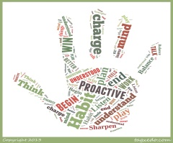
Health and Wellbeing
Today we are going to learn about habit 5.
This video gives some examples of how you can ‘seek first to understand, then to be understood’:-
https://www.youtube.com/watch?v=rxuspCGTDpI
Habit 5 is about empathy. It is about listening to others and understanding their viewpoint first before putting forward your own point of view.
Task:- .Your task is attached to the blog. Why not also try to implement this habit in your everyday life. Try to listen to others and understand their point of view before expressing your own.

Slide 10
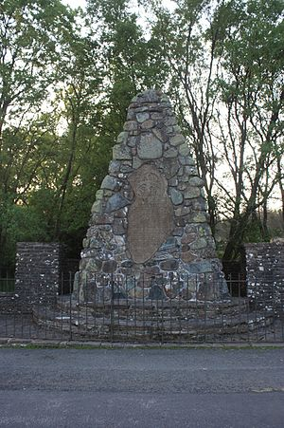
The Battle of Sheriffmuir
The next Jacobite uprising was in 1715. Ordinary people joined the Jacobite cause in their thousands. The Jacobites took control of towns north of the River Tay and met with British Government forces at The Battle of Sheriffmuir [near Dunblane] in 1715.
Task: - Read the attached powerpoint to learn more.
You will find the written task at the end of
the powerpoint.

Slide 11
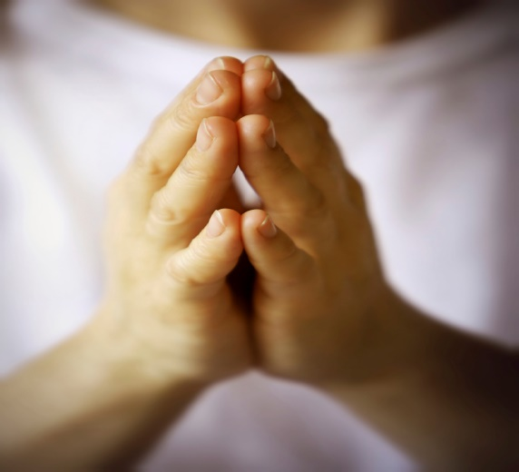
A prayer to end our day
Please take a few moments to say a prayer for all the doctors, nurses and care staff who are constantly working very hard to save lives.

Slide 12
Well done!
Well done for working hard today!

