Slide 1
Tuesday 19th May

Slide 2
Timetable
Daily exercise
French starter
Spelling
Reading – French task
Maths

Slide 3
Daily exercise
Try to do some form of exercise to start the day. This could be a walk or run with a family member or a workout in the house. Check with your parents that it is ok for you to do this.
Why not try a bit of disco enfrancais this morning :-
https://www.youtube.com/watch?v=KVhfIgghOPw

Slide 4
French Starter
Click on the link below to sing along to the months of the year song in French?
https://www.youtube.com/watch?v=7_u2SigckNQ
Can you write today’s date in French?
Quelleestla date aujourd’ hui?
C’est……………………..

Slide 5
Spelling – I am learning to use various spelling strategies.
Partner spell, have someone test you or you test them. Choose one column or a mixture from each.
Ch | Tch | T
Change Charge Challenge Chair Chance Cheese Chief Child Choose Scorch | Kitchen Catch Scratch Stretch Birdwatcher Blotchy Butcher Fetch Itchy Ketchup wretch | Picture Creature Signature Capture Temperature Furniture Culture Mature mixture

Slide 6
French continued
I know you should have been in Paris last week enjoying some of the sites.
I thought we could do some research in to the Mona Lisa. I have put up some information to help you answer the questions on the next slide.
1. What is the Mona Lisa also known as?
2. Which famous artist painted the Mona Lisa?
3. In which Parisian art gallery can the Mona Lisa be found?
4. Explain why it is difficult to know exactly who the woman is?
5. What happened to the painting in 1911?
6. What happened to the painting in 1956?
7. In your own words, explain why the Mona Lisa is protected by bullet proof glass.
8. Find 2 interesting facts about the artist Leonardo da Vinci.

Slide 7
Mona Lisa
The Mona Lisa was painted by the Famous Italian artist, Leonardo da Vinci in Florence Italy during what was known as the renaissance period.
It is considered one of the most famous paintings and is currently on show in the Louvre in Paris stored behind bullet proof glass.

Slide 8
Maths starter

Slide 9
Maths answers

Slide 10
Shapes – I am learning about 3d shapes and their properties.
On the next slide I have put together a mixture of 3d shapes.
Can you name them?
Once you have completed naming the shapes, there is a Sumdog challenge live.

Slide 11
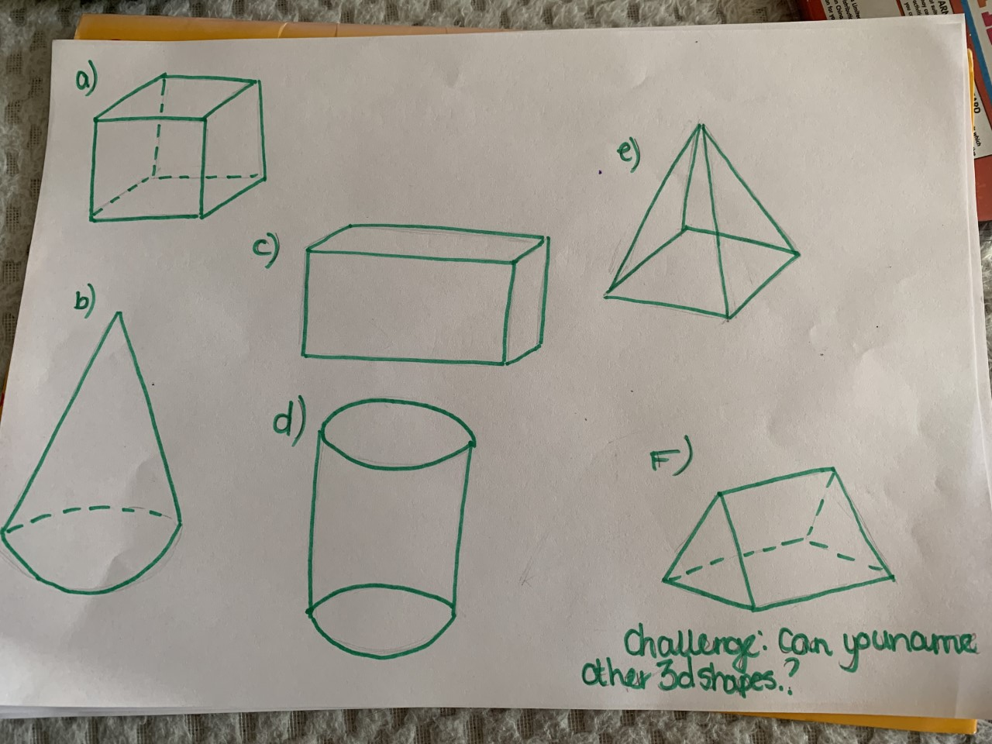
Shapes

Slide 12
3d Shape answers
Cube
Cuboid
Pyramid
Cone
Cylinder
Triangular Prism.

