Slide 1
Tuesday 19th of May
Good Morning Primary 2/3!
French: Bonjour la class! Ca Va?
Aujourd’hui cest Mardi 19th Mai 2020
L.I- To say simple greetings in French
Watch: Bonjour! Bonjour! https://www.youtube.com/watch?v=atNkI6QFZ50

Slide 2
Literacy
Stage 2 Phonics
LI: We are learning to recognise, read and make words containing the e-e phoneme.
Sing with Mr Mac- Boom shake the Alphabet https://www.youtube.com/watch?v=Emb2yvwAHtc
2. Watch Mr Thorne “e-e”
https://www.youtube.com/watch?v=kFuETDoqVnA
3. Read you’re e-e phoneme story and highlight the words that have the e-e sound in them. Make sure that you can read these words.
4. Use your “u-e” Wordmaker to make the following words:
these here eve complete Steve
Are there any other e-e words you can make?

Slide 3
L.I – I can spell words containing the e-e phoneme.
Task – Can you complete this phoneme flower in your jotter? Write a different ‘e-e’ word in each petal and illustrate.
*Challenge
Choose an ‘e-e’ word and write a super sentences in your jotter.
e-e

Slide 4
Literacy
Stage 3 Phonics: U (oo) phoneme
LI: We are learning to recognise, read and make words containing the u phoneme.
Sing with Mr Mac- Boom shake the Alphabet https://www.youtube.com/watch?v=Emb2yvwAHtc
Read you’re “u” phoneme story and highlight the words that have the u sound in them. Make sure that you can read these words.
Watch: Mr Thorne with the “u” phoneme https://www.youtube.com/watch?v=jC0XpKQoJOQ
4. Use your “u” wordmaker to make the following words:
put push pull awful
bull cushion full bush

Slide 5
L.I – I can spell words containing the u (oo) phoneme.
Task – Can you complete this phoneme flower in your jotter? Write a different ‘u’ word in each petal and illustrate.
*Challenge
Choose a ‘u’ word and write a super sentences in your jotter.
u

Slide 6
Reading
Choose a new book for your child to read this week from Oxford Owl
Here is the website link and login information
https://www.oxfordowl.co.uk/?sellanguage=en&mode=hub username: stantsps password:homelearning

Slide 7
Story time https://www.youtube.com/watch?v=euZ18F-uIPQ

Slide 8
Numeracy – Warm Up
LI: To use mental strategies to solve maths problems and be able to explain my strategy
Splat

Slide 9
13
www.stevewyborney.com
Steve Wyborney

Slide 10
18
www.stevewyborney.com
Steve Wyborney

Slide 11
14
www.stevewyborney.com
Steve Wyborney

Slide 12
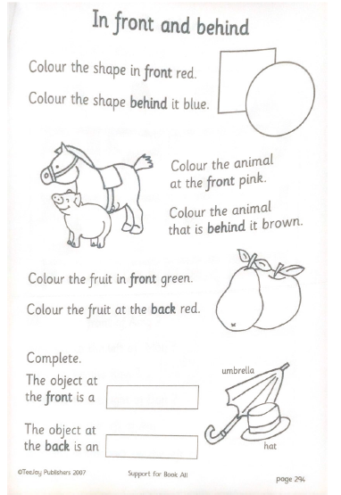
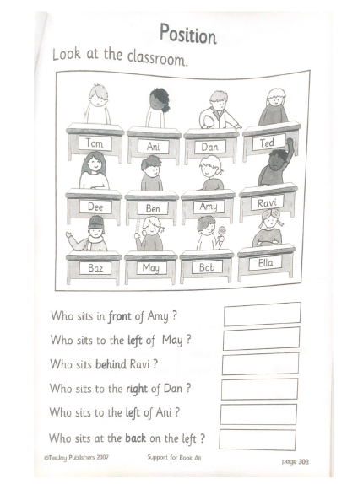
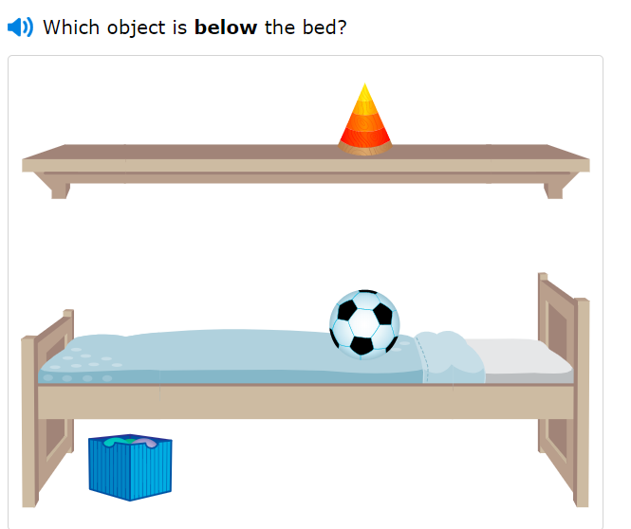
P2 Maths Activities
L.I – I can describe the position of an item using the correct language
Watch: https://www.bbc.co.uk/bitesize/clips/zvxhyrd
Complete these 2 pages in your workbook
Play: IXL Maths https://uk.ixl.com/math/year-2/above-and-below

Slide 13
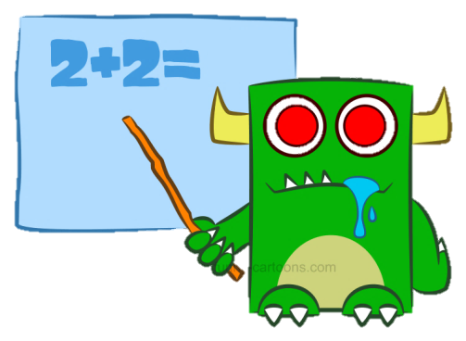
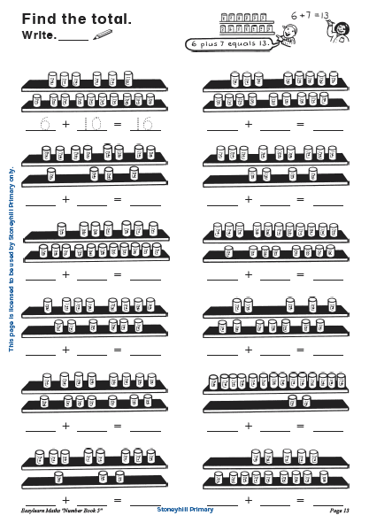
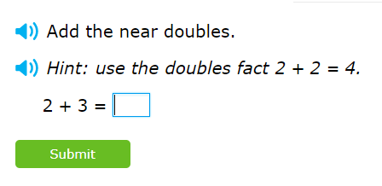
P3 Numeracy Activities
LI: To use counting on and addition strategies to find the total
Addition and Subtraction workbook
Please do the first page of your
booklet.
2. IXL Maths: Doubles and Near Doubles Practise
https://uk.ixl.com/math/year-2/add-using-doubles-plus-one

Slide 14
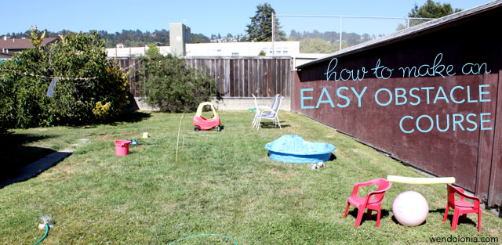
Play Topic: Obstacle Course
*Your challenge today is to make an at home obstacle course*
You can set up your obstacle course either indoors or outdoors in your garden.
Your obstacle course should be made using only what you already have at home.
There are some obstacle course videos that might help you come up with your own ideas on the next slide.

Slide 15
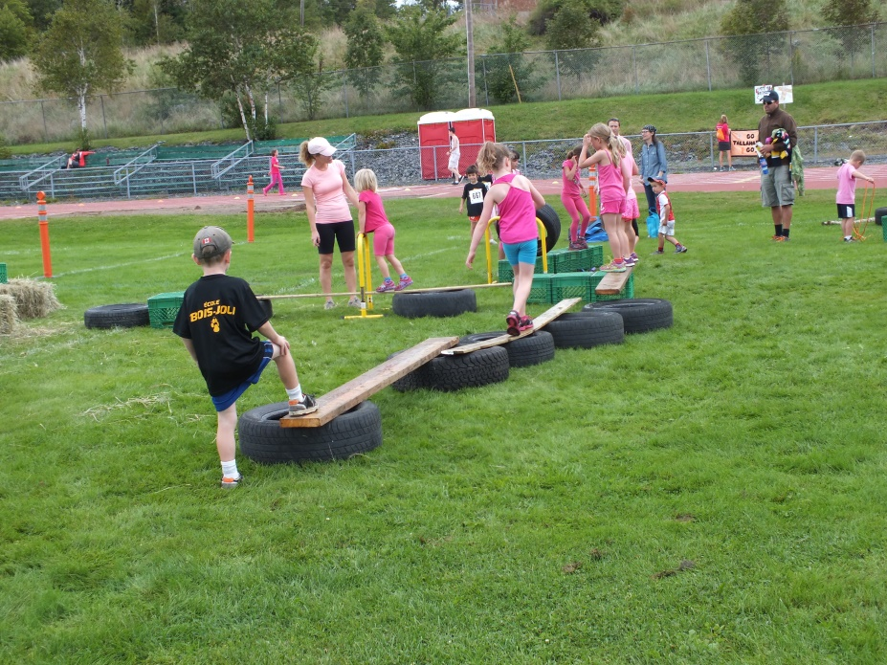
Indoor Obstacle Courses: https://www.youtube.com/watch?v=FKF6iPL3kTc https://www.youtube.com/watch?v=0vLvoEXLApA https://www.youtube.com/watch?v=8o4CQkSGZoQ Garden Obstacle Courses: https://www.youtube.com/watch?v=_NdJtdfYoMc https://www.youtube.com/watch?v=wkPUqZ5fEHo https://www.youtube.com/watch?v=pVfuTsu31ms

Slide 16
I hope you have enjoyed your lessons today. It would be lovely to hear how you got on. Enjoy the rest of your day Primary 2/3!

