Slide 1

Tuesday 19th of May
Good Morning Primary 1!
Bonjour la class! Ca Va?
L.I – I can say some simple greetings in French
https://www.bbc.co.uk/sport/av/supermovers/47131128

Slide 2


French
Consolidation Week
Please access the Linguascope website where you will be able to find French games, video clips and worksheets to do with your child.
Please choose a topic from the following list.
All of these topics have been covered in class.
French greetings
Numbers to 10
Colours
https://www.linguascope.com/
student username- stanthonys
student password – stant123

Slide 3
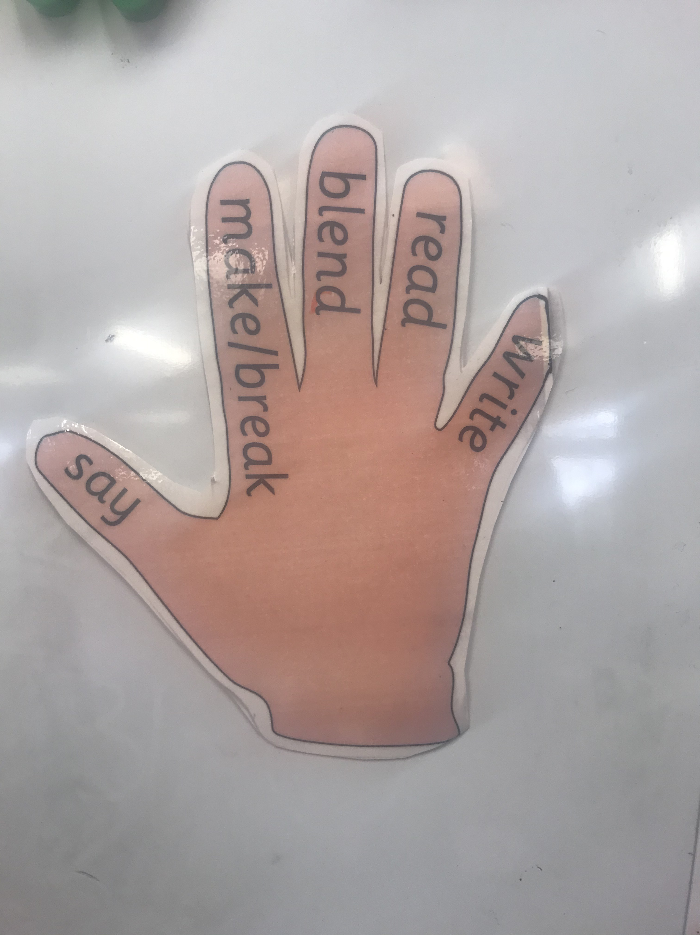
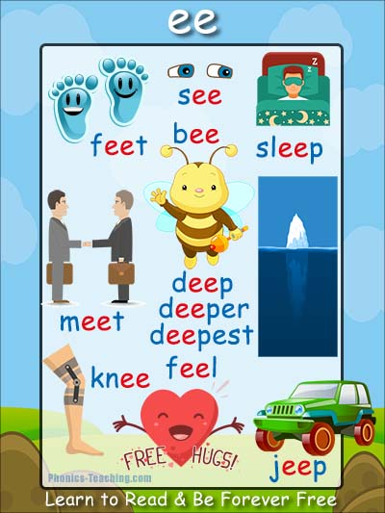
Literacy
L.I - I can recognise, read and make words containing the ‘ee’ phoneme.
Revise letter names –
https://www.bbc.co.uk/sport/av/supermovers/42909650
Watch –
size/topics/zvq9bdm/articles/zn9q92p
https://www.youtube.com/watch?v=qfM7Hz7US0U

Slide 4
Task 1:
Complete phoneme word maker in home learning pack
Try to make the following words:
Task 2:
Read phoneme story and highlight phoneme words
(items found in home learning pack)

Slide 5



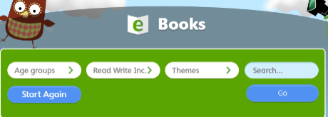
Oxford Owl Ebooks
Login to the following website : https://www.oxfordowl.co.uk/
Click on the following ‘My class login’ at the top of the page
Username: stanothnysp12
Password: Homelearning*1
Click on ‘My Bookshelf’
Click on ‘Series’ button and select Oxford Reading Tree
Scroll down the list of books and choose one suitable for your child. We advise you read one book per week as we sill set ‘read to write tasks’ for your child to complete.

Slide 6

Authors Live on BBC
Julia Donaldson
https://www.scottishbooktrust.com/authors-live-on-demand/julia-donaldson

Slide 7

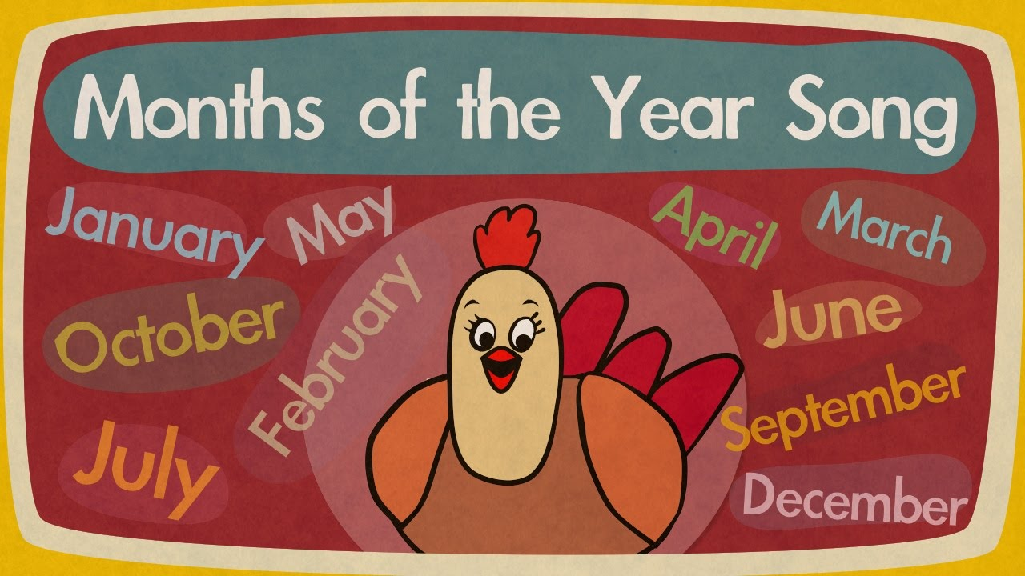
Maths Rhyme Time
I can participate actively in songs, rhymes and stories.
https://youtu.be/Fe9bnYRzFvk
Click on the above picture to take you to the link.

Slide 8
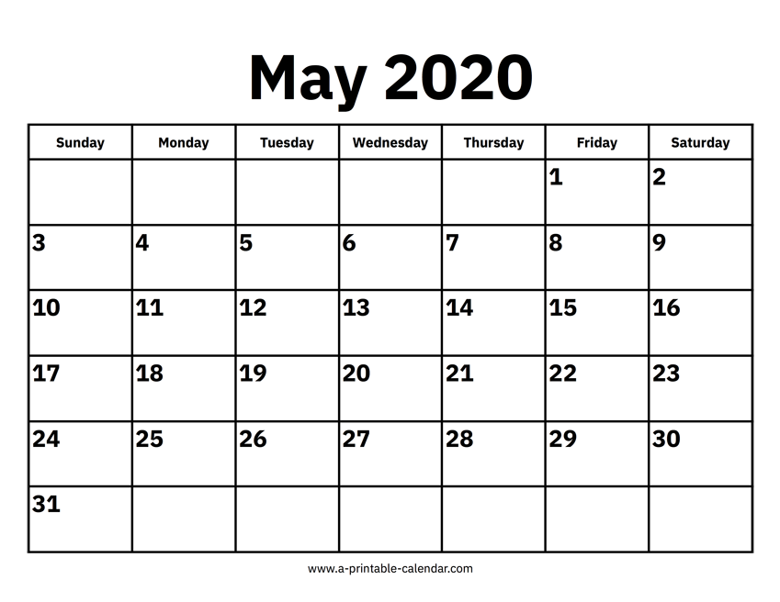
Months of the Year
L.I. I can use a calendar to find out information.
Can you find today’s date on the calendar? What day was it yesterday? What days is tomorrow?
.
S.C. - I can explain why we use a calendar.
I can name some months of the year in order

Slide 9
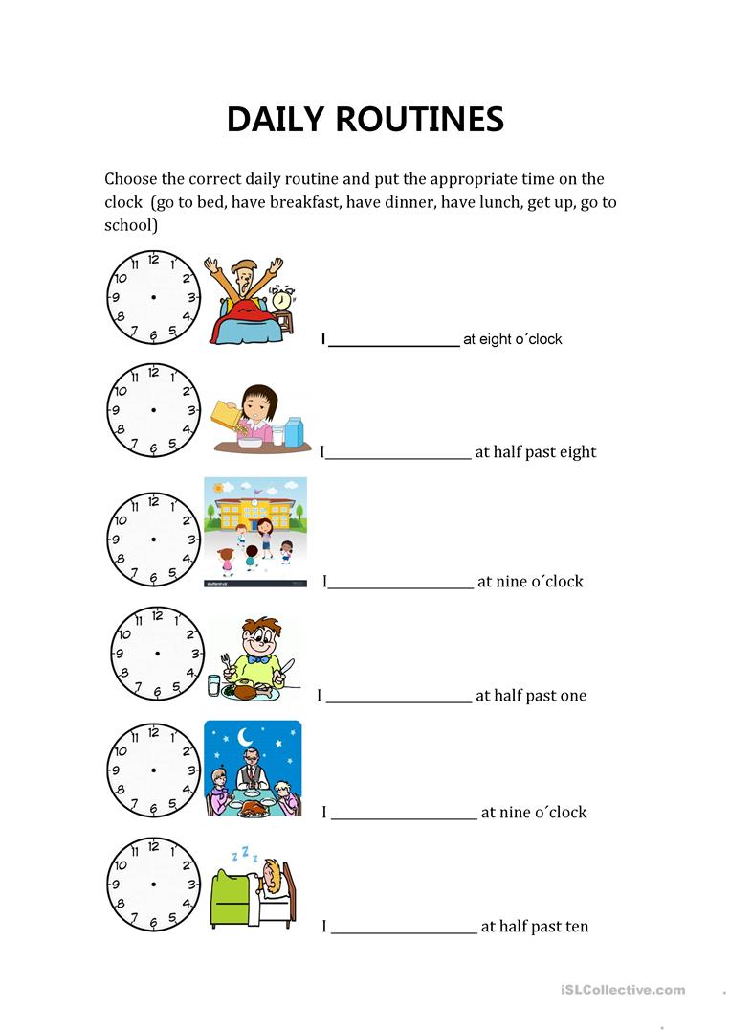
Maths Activities
Task: Can you fill in this daily routine worksheet?
I have linked a word document to the blog if you wish to print it off.

Slide 10


Mathematics
Number Talk
Warm up - https://www.bbc.co.uk/teach/supermovers/ks1-maths-counting-with-john-farnworth/zbct8xs
*Remember – number talks are all about how you solve a task, mentally.
‘Splat’
By Steve Wyborney

Slide 11
How many blue shapes do you see?
7
Splat!
How many shapes are under the splat? How do you know?
How else could you know?
Let’s look under the splat to see how many shapes are there.
What can we learn from this picture?
www.stevewyborney.com
Steve Wyborney

Slide 12
6
www.stevewyborney.com
Steve Wyborney

Slide 13
6
www.stevewyborney.com
Steve Wyborney

Slide 14
7
www.stevewyborney.com
Steve Wyborney

Slide 15
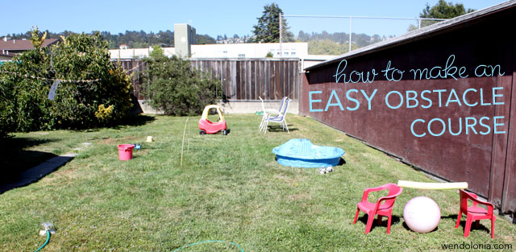
Play Topic: Obstacle Course
*Your challenge today is to make an at home obstacle course*
You can set up your obstacle course either indoors or outdoors in your garden.
Your obstacle course should be made using only what you already have at home.
There are some obstacle course videos that might help you come up with your own ideas on the next slide.

Slide 16
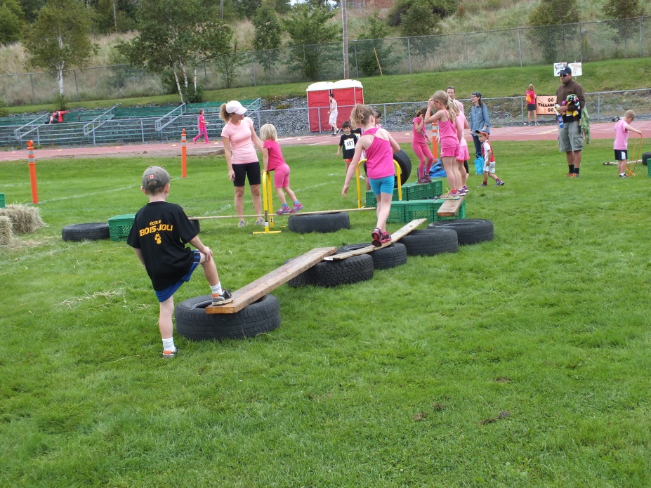
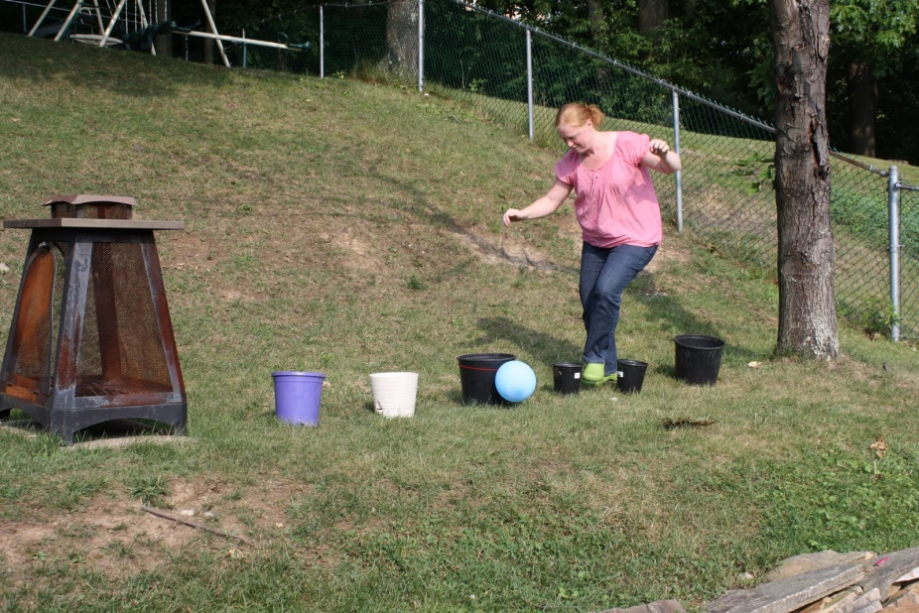
Indoor Obstacle Courses: https://www.youtube.com/watch?v=FKF6iPL3kTc https://www.youtube.com/watch?v=0vLvoEXLApA https://www.youtube.com/watch?v=8o4CQkSGZoQ
Garden Obstacle Courses: https://www.youtube.com/watch?v=_NdJtdfYoMc https://www.youtube.com/watch?v=wkPUqZ5fEHo https://www.youtube.com/watch?v=pVfuTsu31ms

Slide 17
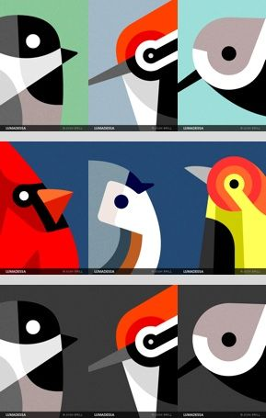
Art and Design
How to draw a bird - https://www.youtube.com/watch?v=zUJWEZ4X8F8
Challenge - Design your own bird
What to do
Can you think of your favourite birds and what you love about them. If your not sure, you could spend some time before this activity looking at different UK birds.
Create a new species of bird with the features from these favourite birds, for example, with a robin’s red breast, a kingfisher’s long beak and a mallard’s big webbed toes! Finally give your bird a name.

