Slide 1
Friday 15th May
Good Morning Primary 4!
French: Bonjour la class! Ca Va?
Quelle est la date aujourd’hui?
Aujourd’hui cest Vendredi 15th Mai 2020
Listen to the days of the week song!
https://www.youtube.com/watch?v=Lpwf5N0rfVE

Slide 2
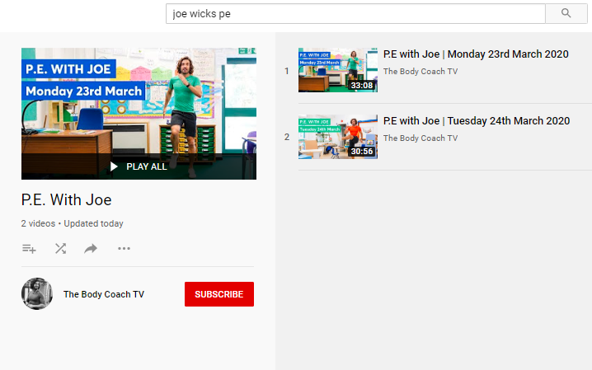
Health and Wellbeing
LI: We are learning to move our body well, exploring how to manage and control it, finding out how to use and share space.
P.E with Joe- Friday 15th May Video
(he is nearly as fun as Mr Martin, not quite, but nearly)
https://www.youtube.com/playlist?list=PLyCLoPd4VxBvQafyve889qVcPxYEjdSTl

Slide 3
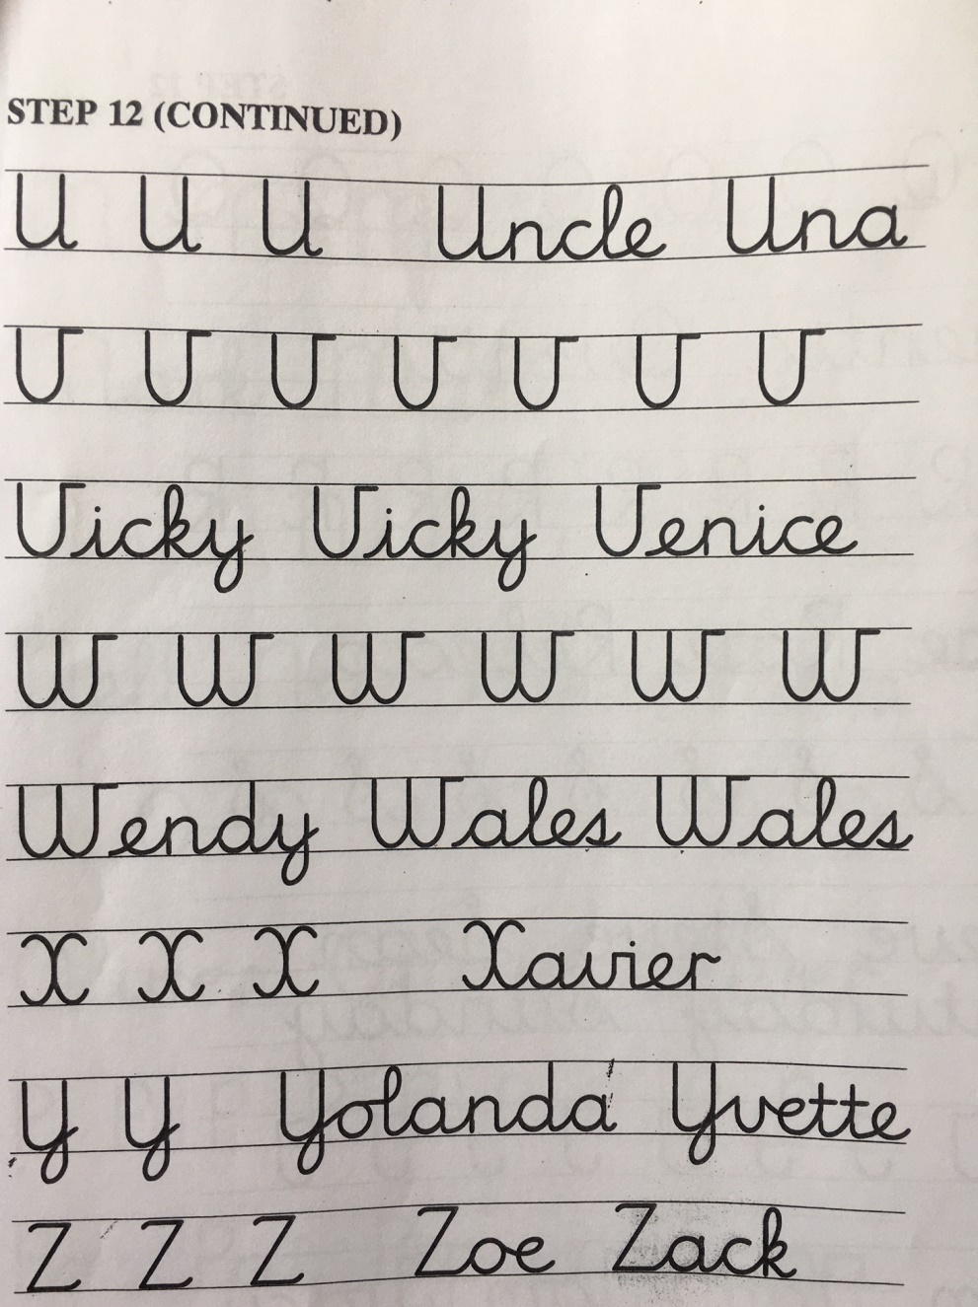
Handwriting
L.I. I can use joined up handwriting
S.C.
In your jotter, practise the following handwriting page. You will find the paper version inside your pack!
How neat can you be?!

Slide 4
LI: I can recognise and spell words that use the ‘oe’ phoneme
Spelling slide 1 (Tom Fletcher & Roald Dahl groups)
This week, you have worked on words that use the ‘oe’ phoneme and you have all done really well!
This morning, I’d like you to play some online games to explore this sound further.
Click on the link below to see a big list of ‘oe’ words. You’ll find all of the representations that we have worked on this week (o-e, oa, ow and oe).
https://www.spellzone.com/unit07/page18.cfm
To access and explore the games, click on the little green footballs. You will find these underneath each list of words!

Slide 5
Spelling (David Walliams Group)
L.I. I am learning to spell ‘ea’ words
TASK: click on the link below to play the ‘ea’ online word search and continue exploring words that use the ‘ea’ phoneme!
https://www.spellzone.com/word_lists/games-208.htm

Slide 6
BIG MATHS… BEAT THAT CHALLENGE!
LI: We are learning our times tables
On the next slide, you will find a link to an online timer and you will see a big version of a Big Maths Beat That challenge!
2. Your challenge is to answer as many questions as you can, as quickly as you can! Write down the answers in your jotter.
3. You should work out the answers in your head! (no cheating) If you are stuck on one, move onto the next one!
4. Once you have answered all the questions that you can, stop the timer and write your time down next to your answers.
5. Finally, use a calculator (https://www.online-calculator.com/) to check that your answers are correct. If any are wrong, correct them! If you got stuck on some, work them out!)
DID YOU BEAT YOUR TIME FROM LAST WEEK?

Slide 7
Time yourself!
https://www.online-stopwatch.com/

Slide 8
HAVE A GREAT WEEKEND, PRIMARY 4! WELL DONE FOR WORKING SO HARD. MR P

