Slide 1
Friday 14th may 2020
Home learning

Slide 2
Daily French writing
Copy this into your green jotter.
Aujord’hui c’est vendredi quinze mai.
Today is Friday 15th May
Il fait nuageuse.
The weather is cloudy.
Je suis content(e)
I am good
Je suis d’accord
I am okay
Je suis mal
I am not well

Slide 3
Morning starter
Find the Maths Quiz in teams in assignments.
Choose to do either Green, Amber or Red.

Slide 4
Literacy task board
DAVID WALLIAMS
Spelling Task – Dictation
Handwriting
ROALD DAHL
Spelling Task – Dictation
Handwriting
TOM FLETCHER
Spelling Task – Dictation
Handwriting

Slide 5
Writing task
Use the success criteria to mark your piece of writing from yesterday.
Success Criteria – Everyone
Have at least 3 characters – with 1 main character
Have at least 4 panels
Use speech bubbles are dialogue (the balloon)
Use lines for dialogue to keep writing centered.
Go over pencil with black pen.

Slide 6
Groups for teacher, peer and self marking
On a Friday, we usually have our Writing Conference in which we mark our writing from the previous day. We split into three groups for this Teacher, Peer and Self.
Teacher marking – Group 3 – I will mark this groups writing. Please upload your work to assignments in teams so I can see it – you can even just add a picture of your jotter to the assignment.
Peer marking – Group 1 – You can with ask your writing partner in teams to mark it or get someone at home to mark your writing.
Self marking – Group 2 – You are marking your own piece of writing.

Slide 7
Writing partner groups
Group 1
Jessica and Megan
Bruce, Thomas and Jack R
Holly F and Maisie
Declan and Arran
Group 2
Holly C and Kelly
Fergus and Logan
Jack J and Callum
Peter and Franceska
Group 3
Katie and Gracie
Gary and Jack H
Cole and Fraser
Alfie and James

Slide 8
Maths task board
TRIANGLES
Maths Quiz
Big Maths – please find sheet in your pack.
CIRCLES
Maths Quiz
Big Maths – please find sheet in your pack.
SQUARES
Maths Quiz
Big Maths – please find sheet in your pack.

Slide 9
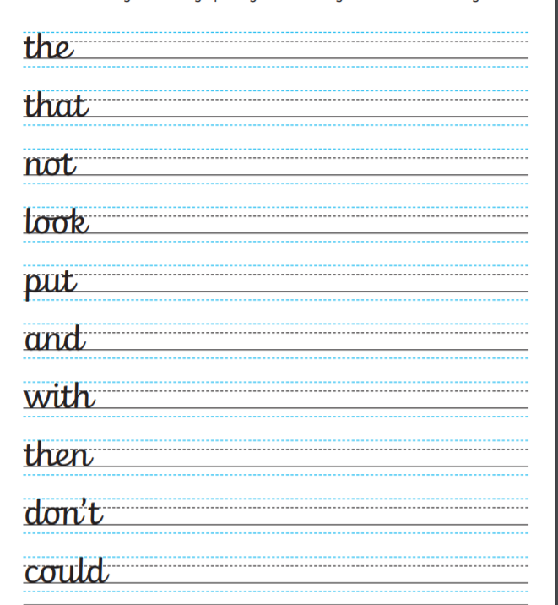
Handwriting
We have finished the alphabet!
So now we are onto practicing some common
words using our cursive handwriting!

Slide 10
Dictation
Remember you can pause the audio if you need more time to write.
‘consolidation’ Dictation -
‘set 5’ Dictation –
‘set 12’ Dictation -

Slide 11
Target setting
As we come to the end of a learning week, please think about your target for next week.
What do you want to learn next week?
What do you want to improve next week?
How do you think you will improve next week?

Slide 12
Sumdog competition
Starting today there is a sumdog competition across West Lothian.
Remember, to even qualify, 10 pupils from our class need to play.
Let’s see how well we can do!

