Slide 1
Friday 15th of May
Good Morning Primary 2/3!
French: Bonjour la class! Ca Va?
Quelle est la date aujourd’hui?
Aujourd’hui cest V______ 15th Mai 2020
Numbers from 10-20 with Alexa
https://www.youtube.com/watch?v=PysB3B-eZnA

Slide 2
Literacy
LI: To use my phoneme and common word knowledge to spell accurately.
Spelling Day 5 : Sentence Dictation
Choose a dictation sentence from the list in the pack
Read aloud the sentence to your child first, for them to listen to it
in full.
Then re-read sentence again slowly, word by word(sounding out where necessary), allowing the child to write down each word independently.
Please encourage your child to:
- Have a go.
Think about what sounds can they hear in the word and chunk it into sounds they know.
Remember their core writing targets- full stops, capital letters, finger spaces.

Slide 3
Reading- Stage 2 Common Words
every, find, want, girl
Every night I go to bed and I find I just cant sleep. Its not that I don’t want to so mum says “try counting sheep”. She did it when she was just a girl, and it helped her every night.

Slide 4
Reading- Stage 3 Common Words
through, sing, morning, colour, kind
Every morning I wake up and sing my favourite song. It’s the kind of song that helps me to get through the day. It goes like this: (to the tune of sing a rainbow)
Red and Yellow and Pink and Green
Purple and Orange and Blue
I can sing the colours, sing the colours
Can you sing them too?

Slide 5
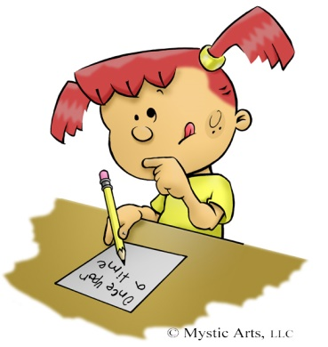
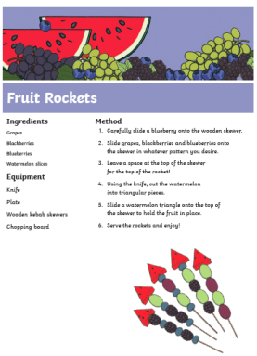
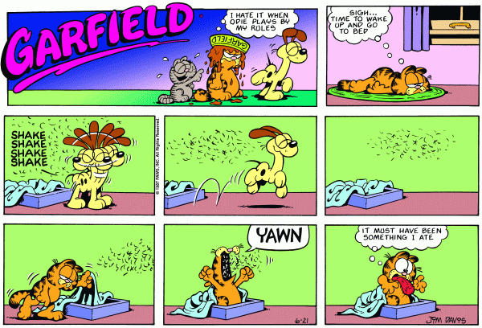
Literacy-Free Writing Friday
LI: To create a text of my choice
Set 15 minutes on a timer. Maybe your adult could do free writing at the same time as you?
Decide what type of writing you would like to do.
Collect all the writing tools you need to complete the task in time.
When the timer is up, share what you have done with each other.
Don’t forget you can send a picture of your work to our twitter! I would love you to share what you have written with me on our school twitter page!

Slide 6
Numeracy – Warm Up
LI: To use mental strategies to solve maths problems and be able to explain my strategy
Splat
The slides get harder as they progress so just do the ones you can manage.

Slide 7
How many blue shapes do you see?
Splat!
How many shapes are under the splat? How do you know?
How else could you know?
Let’s look under the splat to see how many shapes are there.
What can we learn from this picture?
4
www.stevewyborney.com
Steve Wyborney

Slide 8
9
www.stevewyborney.com
Steve Wyborney

Slide 9
16
www.stevewyborney.com
Steve Wyborney

Slide 10
The total number of shapes is…
Splat!
How many shapes are under each splat? How do you know?
How else could you know?
Let’s look under the splats to see how many shapes are there.
What can we learn from this picture?
15
www.stevewyborney.com
Steve Wyborney

Slide 11
This week, your topic tasks are all about preparing for a Friday Family Movie Night!
Task 5
It’s finally time for your Family Movie Night!
Prepare the movie area – make it nice and cosy!
Ask your customers to see their tickets before showing them to their seats.
Snuggle up together and enjoy a lovely family night of fun! ☺

Slide 12
Well Done Primary 2/3 families! You have completed another week of online learning! Enjoy your weekend everyone. I will be ready to welcome you back on Tuesday morning. Mrs Doghudje

