Slide 1
Friday 15th of May
Good Morning Primary 1!
Bonjour la class! Ca Va?

Slide 2
Lets start the day off with a happy memory!

Slide 3
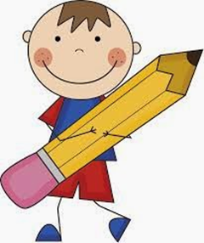
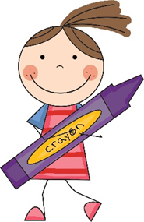
Literacy
We are learning to write sentence containing our common words.
Sing and complete actions to jolly phonics alphabet songs
https://www.youtube.com/watch?v=nVvxyolRj04
Activity - Dictation
Choose a dictated sentence from list in the pack.
Read slowly to your child and encourage them to write it independently.
Tip – Help them sound out the letters in each word.
Remember core writing targets!

Slide 4
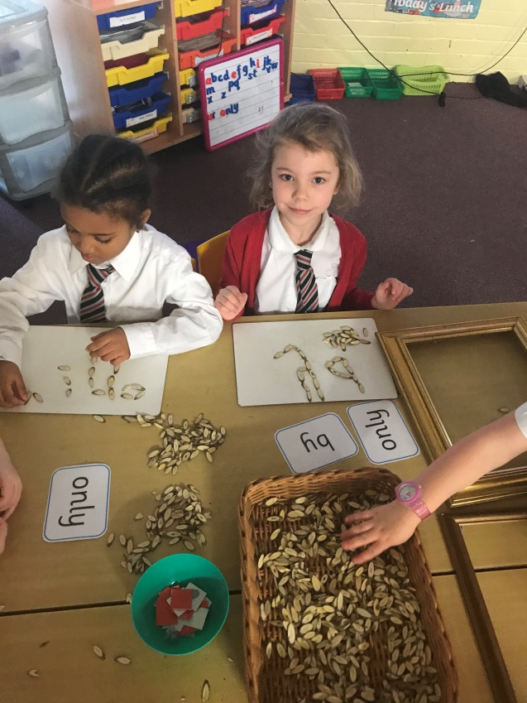
Active Spelling Challenge
Lets get creative
Here we are using wood chips to make our words.
What can you find around the house or in the garden to make “ng” words with?.
Can you invent your own way to learn your spelling words?
If you can think of something new then share it with us on Twitter to feature in next weeks spelling challenge.
song sing long strong

Slide 5
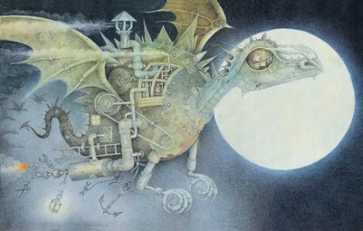
Read along with the Dragon Machine by Helen Ward
https://www.booktrust.org.uk/books-and-reading/have-some-fun/storybooks-and-games/the-dragon-machine/

Slide 6
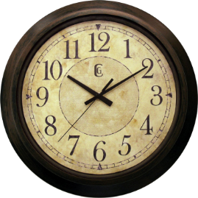
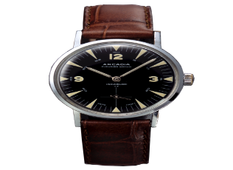
Time!
We are learning to read the time
on an analogue clock.
Watch
https://www.youtube.com/watch?v=3Posbu-VKxU
This clip covers o’clock and half past.
I would focus on o’clock to begin with then move on to half past later.
If you feel your child is coping with o’clock you could do some half past examples orally.
https://www.topmarks.co.uk/time/teaching-clock
You could use the teaching clock to give your child some examples of o’clock times.
New word
O’clock
Task
Complete page 239 of your workbook.
Play
https://mathsframe.co.uk/en/resources/resource/117/telling_the_time_in_words#

Slide 7
This week, your topic tasks are all about preparing for a Friday Family Movie Night!
Task 5
It’s finally time for your Family Movie Night!
Prepare the movie area – make it nice and cosy!
Ask your customers to see their tickets before showing them to their seats.
Snuggle up together and enjoy a lovely family night of fun! ☺

Slide 8
Have a lovely weekend!
.

