Slide 1

Thursday 14-5-20
Good Morning Everyone!

Slide 2
Today’s Timetable
Morning Exercise
French
Morning Starter
Maths Lesson
Grammar
Writing Task
Health and Wellbeing
French Main Lesson
Topic
Prayer

Slide 3


Daily Exercise
Try to do some form of exercise to start the day. This could be a walk or run with a family member or a workout in the house. Check with your parents that it is ok for you to do this.
Why not try this circuit workout this morning :-
https://www.youtube.com/watch?v=_97QFX3w1E4

Slide 4

A little bit of French to start the day
Quelle est la date aujourd’hui? Comment a va?
e.g. C’est mercredi treize mai Je suis content(e)
Je ne suis pas content(e)
Quel temps fait-il? Qu’est ce-que tu veux pour le
e.g. Il y a du soleil dejeuner? eg.
Il pleut / Il fait beau/ Il fait froid/ Je voudrais un sandwich au thon
Il fait mauvais/ Il y a des nuages/ Je voudrais un sandwich au fromage
Il y a du soleil/ Il fait du vent Je voudrais un sandwich au jambon
Je voudrais un sandwich aux oeufs

Slide 5

Morning Starter
Today, everyone’s morning starter is 15-20 minutes on
Hit the Button
Please choose a times table that you are not so good at. Please also work on division facts
If you normally do IDL Maths, please do this also for 15-20mins.

Slide 6


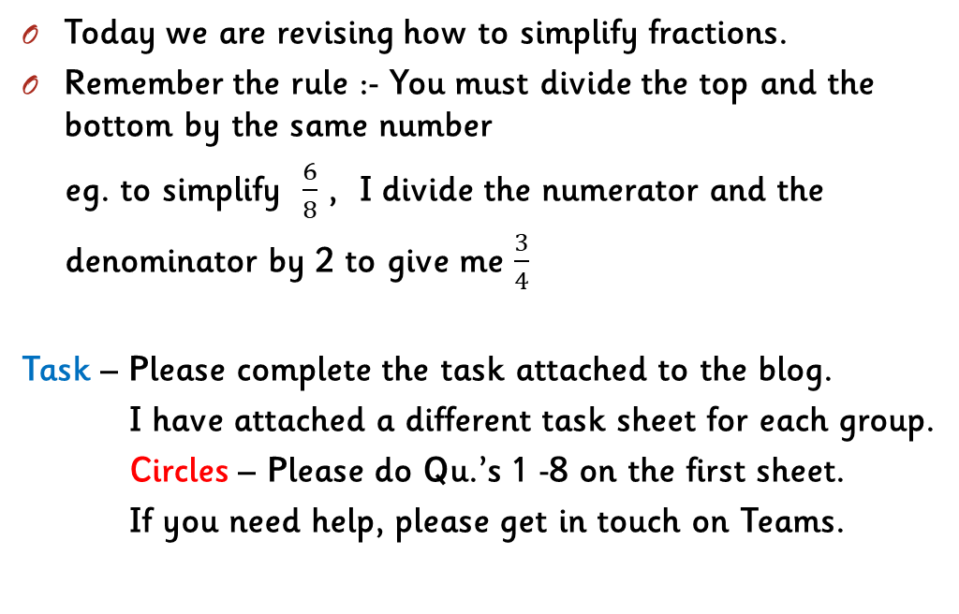
Maths Lesson
Today we are revising how to simplify fractions.
Remember the rule :- You must divide the top and the bottom by the same number
eg. to simplify $\frac{6}{8}$ , I divide the numerator and the
denominator by 2 to give me $\frac{3}{4}$
Task – Please complete the task attached to the blog.
I have attached a different task sheet for each group.
Circles – Please do Qu.’s 1 -8 on the first sheet.
If you need help, please get in touch on Teams.

Slide 7
Grammar
This is the last day to finish your challenge on Sumdog Grammar. I’ll log in this afternoon to see how you all got on.
Your task is set up according to your reading group.
Red Group – Group 1, Blue Group – Group 2
Green Group – Group 3
Remember to please let me know how you found it
as I will be setting a new Grammar challenge
next week.
SUMDOG

Slide 8


Writing
Task:- Your task is to finish your story about your secret, magical powers. Following on from last time, you should now have a title, a picture and an introductory paragraph and the main part of your story[the plot]
Your task today is to work on the endingof your story. Remember to use lots of describing words and make it exciting for the reader. This is the last time I will set this story as a task however you can always finish it in your own time
If you missed the last lesson or would like to watch Cressida Cowell again, please click on the link:-
https://www.scottishbooktrust.com/authors-live-on-demand/cressida-cowell
I have attached some word lists to help you as well as a narrative checklist.

Slide 9

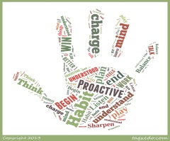

Health and Wellbeing
Today we are going to learn about habit 4
‘Think win win’
This video gives some examples of how you can adopt this habit into your everyday life:-
https://www.youtube.com/watch?v=QfDG3_fArbo
Task:- Your task is to use this habit at some point this week.

Slide 10


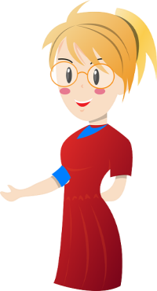
French
Today we’re going to revise the vocabulary and phrases which we use to tell people about ourselves. You may wish to use some of the games on Linguascope to refresh your memory.
https://www.linguascope.com/
Your task is to draw a picture of yourself. Underneath you need to write a short paragraph about yourself in french:- your name, age, where you live, favourite colour, favourite food, pets. Don’t panic – you have done all the learning!
Transition task:- St Kent’s has sent out a new transition task for you to do. I have posted it on the blog and Teams. To complete Option A - use your paragraph from the task above. Completed booklets need to be uploaded to the French Transition folder in the ‘Files’ section on Teams. Again, don’t panic, you have plenty of time to complete this.
I have put a help sheet on the blog to help you with the correct spelling etc. You can post your paragraph on Teams for me to check, if that would help.

Slide 11
Paris
Today we are learning all about Paris
Watch the powerpoint on Paris to learn
about this incredible city.
Watch lesson 10 on High-Five French
https://radiolingua.com/learnathome/
Task:-Create a postcard of Paris
You need to include 1 or more drawings of famous
landmarks. [Please use coloured pencils or pens]
Do not do this on the computer.
Next to the drawing you must include the french
word for the landmark used on the high five french
lesson eg. le monument etc.
The word ‘ Paris’ must appear somewhere on your
postcard. Bonne chance!

Slide 12

A prayer to end our day
Take a few moments to say a short prayer for all the key workers who are keeping all our vital services going.

Slide 13

Well done!
Well done for working hard today!

