Slide 1
Thursday 14th MAY 2020
Home learning

Slide 2
Daily French writing
Copy this into your green jotter.
Aujord’hui c’est jeudi quatorze mai.
Today is Thursday 14th May.
Il fait beau.
The weather is nice..
Je suis content(e)
I am good
Je suis d’accord
I am okay
Je suis mal
I am not well

Slide 3
Morning starter
A farmer put 18 scarecrows into 3 fields.
Each field had the same number of scarecrows.
How many were in each field?
179 apples are shared amongst 6 horses.
How many does each horse get and how many are left over?
51. 8 ÷ 7 =

Slide 4
Pe tasks
Thursday is normally a PE day for us so here are some ways you can choose to get active today:
9am – Dan Hancock PE lesson - https://www.facebook.com/danhancockfitness
9am – Joe Wicks PE lesson - https://www.youtube.com/channel/UCAxW1XT0iEJo0TYlRfn6rYQ
9am – Jump Start Jonny dance and workouts - https://www.youtube.com/channel/UC8PDFwCV0HHcl08-1SzdiBw
10:30am – Shaper/Caper dance and active movement - https://www.facebook.com/shapercaper
11:30am – Dance Lesson with Oti Mabuse (Strictly professional) https://www.youtube.com/user/mosetsanagape
Or try some yoga - https://www.youtube.com/user/CosmicKidsYoga

Slide 5
Literacy task board
DAVID WALLIAMS
Spelling Task – Phonics Boards – ‘consolidation’
Reading Task – Create your own dinosaur. Draw and name your dinosaur and list 3 facts about them.
Read, Write, Spell it.
Online learning:
Sumdog Spelling - task
IDL Literacy
Doorway Online
Writing Task – see next slide
ROALD DAHL
Spelling Task – Fun spelling task
Primary 4 – set 5
Primary 5 – set 12
Reading Task – Inference
Online learning:
Sumdog Spelling - task
Doorway Online
Teach your monster to read
Writing Task – see next slide
TOM FLETCHER
Spelling Task – Fun spelling task
Primary 4 – set 5
Primary 5 – set 12
Reading Task – Comprehension Questions.
Online Learning:
Sumdog Spelling - task
Teach your monster to read
Writing Task – see next slide

Slide 6
Writing task
Thursday is normally our writing day, so here is a writing task for you to do:
Genre: Report
L.I. – I can create a comic strip.
Watch this youtube clip about how to create a comic strip, listen carefully to his tips.
https://www.youtube.com/watch?v=XHtVJdaqdqU
Success Criteria – Everyone
Have at least 3 characters – with 1 main character
Have at least 4 panels
Use speech bubbles are dialogue (the balloon)
Use lines for dialogue to keep writing centered.
Go over pencil with black pen.

Slide 7
Maths task board
TRIANGLES
Colour and Order Fractions Worksheet.
Online learning:
Sumdog Maths – fractions task.
Mathscircles – Times Tables Rockstars
Make sure to check the blog for more maths websites.
CIRCLES
Missing Fractions on a number line.
Online learning:
Sumdog Maths – fractions task.
Mathscircles – Times Tables Rockstars
Make sure to check the blog for more maths websites.
SQUARES
Counting in fractions and quarters.
Online learning:
Sumdog Maths – fractions task.
Mathscircles – Times Tables
Make sure to check the blog for more maths websites.

Slide 8
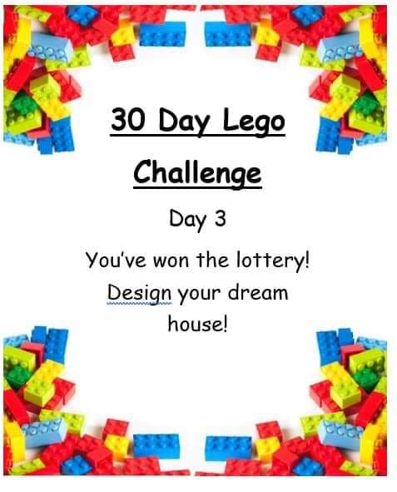
LEGO CHALLENGE
If you don’t have lego, you can use any other building resources you have or you can draw your design.
Feel free to extend the challenge and build anything else related to your dream house e.g. furniture. You could even draw your rooms and design the wall colour/paper you would want.

