Slide 1
Thursday 14th of May Good Morning Primary 3!
Bonjour la class! Ca Va?
Aujourd’hui c’est (J……..) 14th (M…….) 2020.
In class, we got really good at our French colours.
Watch this short video to refresh your memory:
https://www.youtube.com/watch?v=zduapTwsSwA

Slide 2
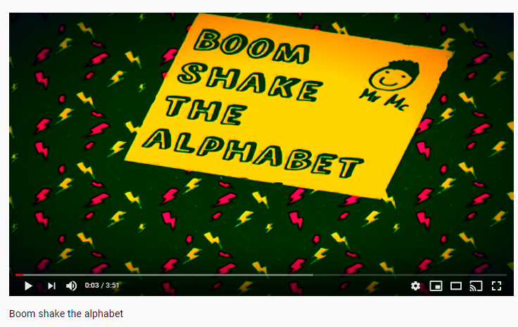
Literacy
We are learning to read and spell this weeks common words.
Join in with Mr Mc and sing Boom Shake the Alphabet.
https://www.youtube.com/watch?v=Emb2yvwAHtc
Activity – Can you remember what a vowel is? Write out your common words and underline each vowel with a coloured pencil.

Slide 3
Writing
Blurb
LI: We are learning to write a blurb.
Most books have a blurb on the back cover. The blurb gives readers an idea of what the book is going to be about. It should encourage readers to read the book.
For today’s writing task, I would like you to write a new blurb for your favourite book. Think of a blurb like a summary. You want to include important details about the book, but don’t want to spoil it for someone who hasn’t yet read it. Perhaps you could read the blurb of another book for inspiration.
Your blurb must include:
4 or 5 sentences
Capital letters, full stops and finger spaces
The main parts of the book/ characters.

Slide 4
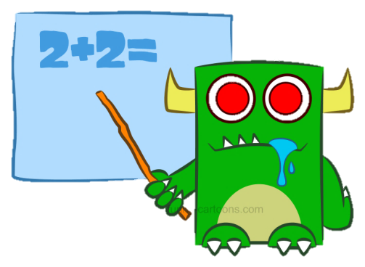
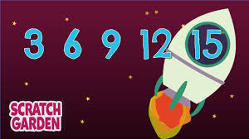
Numeracy – Warm Up
LI: We are learning to count in 3s.
Counting by Threes – Scratch Garden
https://www.youtube.com/watch?v=I_cn87hOCDM

Slide 5
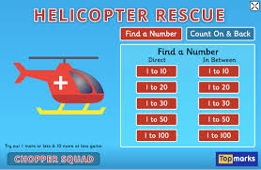
Numeracy Activities
LI: We are learning to count on.
Play – Helicopter Rescue on Topmarks
Select – Count On and Backwards, the you can choose whether to select ‘within the 10s’ or ‘across the 10s’.
https://www.topmarks.co.uk/learning-to-count/helicopter-rescue

Slide 6
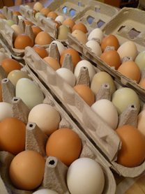
Health and Wellbeing
LI: To know and understand where my food comes from and how it gets to me.
Watch: Excellent Eggs
https://www.youtube.com/watch?v=_kIc5baCEoQ
Have a look at an egg and see if you can spot the stamps on it. Try and find out what farm your egg is from by typing in the number here:
http://lioneggfarms.co.uk/

Slide 7
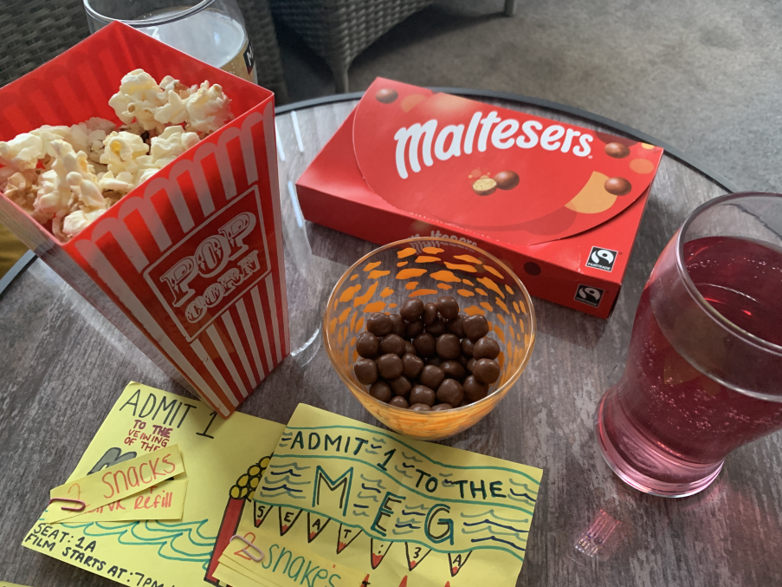
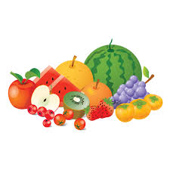
This week, your topic tasks are all about preparing for a Friday Family Movie Night!
Task 4
Task – Prepare some special snacks for your movie night.
Think about what snacks your family would enjoy.
Some snacks we had for our movie night

Slide 8
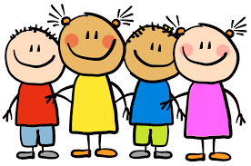
Well done for working super hard! Enjoy the rest of your day Primary 3!

