Slide 1
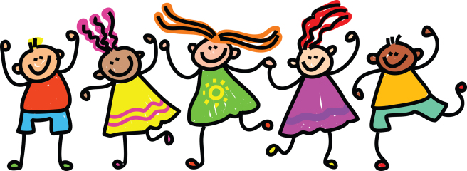
Thursday 14th of May
Good morning primary 2!
Bonjour la class! Ca va?
L.I – I can say some simple greetings in French
Today let’s just sing our favourite French songs
https://www.youtube.com/watch?v=UsEz58BblMY
https://www.youtube.com/watch?v=atNkI6QFZ50
https://www.youtube.com/watch?v=Lpwf5N0rfVE
Practise this again with your family.
Q.-Comment tu t’appelle?
(What is your name?)
Je m’appelle…….
(I am called ……..)
.

Slide 2
Reading- Common Words
These are some common words you had at the beginning of
P.2. Can you remember them?
very took fast there
their some them last
Choose a book, a comic , a newspaper etc
To see if you can find them in the text.
Using your reading book from Oxford Owl think about these questions and try and answer them. Don’t write them down just tell someone what you think.
Do you know the name of the Author?
Do you know the name of the illustrator?
What did you like about the book?
Is there anything you didn’t like about the book?
What was your favourite part?

Slide 3
https://www.youtube.com/watch?v=ROYNKC1Iy2M

Slide 4
Writing –What colour I am today?
L.I- To write about your feelings.
After listening to the story, think about which colour you are today.
ARE YOU?
red
blue
green
rosy
Today you are going to chose the colour which best suits how you feel and write about it.
Start your story with………
Today I am
Helpful reminders
Think about WHO WHAT WHERE WHEN WHY when composing your story.
Share YOUR IDEAS before you start.
Get help with tricky words but DON’T WORRY give the words a go!
Remember CAPITAL LETTERS, FULL STOPS AND FINGER SPACES

Slide 5
Numeracy – Warm Up
LI: To count forward and back multiples of 2 (within 20) and 10 (within 100)
Number Tennis: You say, I say
Start on 0
You say- 0
I say 2 0r 10
You say 4 or 20
I say 6 or 30
And so on until you reach 20 or 100

Slide 6
Numeracy – Warm Up
LI: To count forward and back multiples of 2 (within 20) and 10 (within 100)
Number Tennis: You say, I say
Start on 20 or 100.
You say- 20
I say 18
You say 16
I say 14
And so on until you reach 0
(If your child is not managing this, start by counting back in 1’s and shouting every second number they say e.g 20, 19, 18, 17, 16 and so on.)

Slide 7
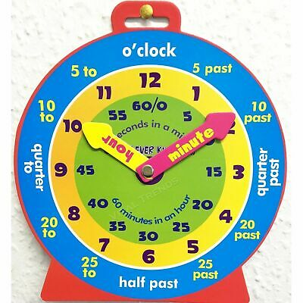
P2 Maths Activities
LI: To identify digital times of o’clock, half past, quarter past and quarter to .
Remember
o’clock=big hand points to 12
quarter past= big hand points to 3
half past= big hand points to 6
quarter to= big hand points to 9
Play
http://www.ictgames.com/mobilePage/hickoryDickory/index.html

Slide 8
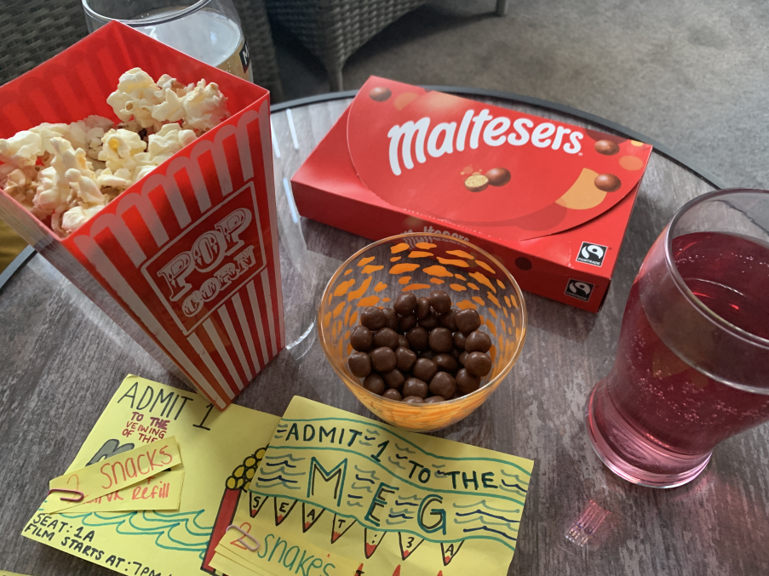
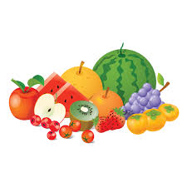
This week, your topic tasks are all about preparing for a Friday Family Movie Night!
Task 4
Task – Prepare some special snacks for your movie night.
Think about what snacks your family would enjoy.
Some snacks we had for our movie night

Slide 9
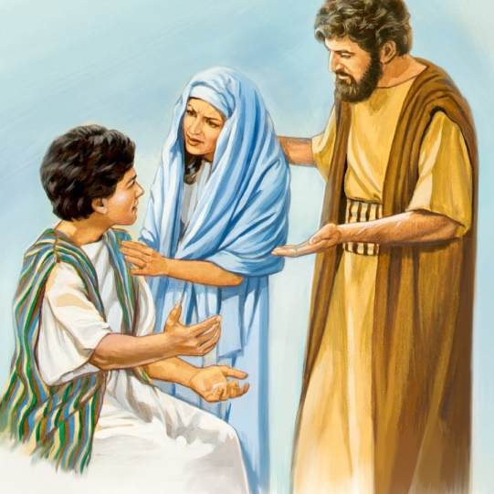
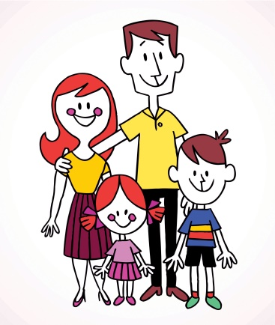
R.E L.I – I recognise the importance of prayer and honour Mary as mother of Jesus
Jesus Mary and Joseph travelled to Jerusalem to visit the temple. On the last day of the visit Mary and Joseph got ready to leave but Jesus stayed behind. He wanted to talk to the Priests and Elders about God. Mary thought that Jesus was with Joseph and Joseph thought that he was with Mary. When they realised he was missing how do you think they were feeling?
They both hurried back to the temple to find Jesus and they found him sitting with the elders.
Mary hugged Jesus then gave him a row. She asked him why he had done such a thing. Jesus replied that he was doing God’s work and not to worry.
Say the Hail Mary to honour our Mums.
L.I –
Always remember to let your parents know where you are?
Think of some ways you can show your Mum and Dad or big person that you love
them .
Remember to do it today.

Slide 10
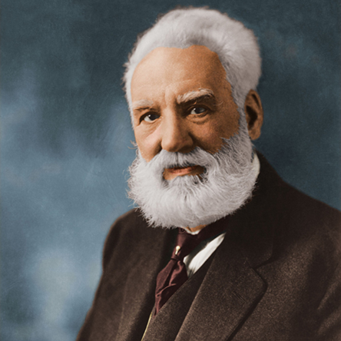
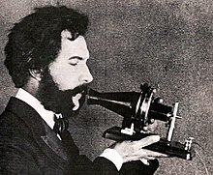
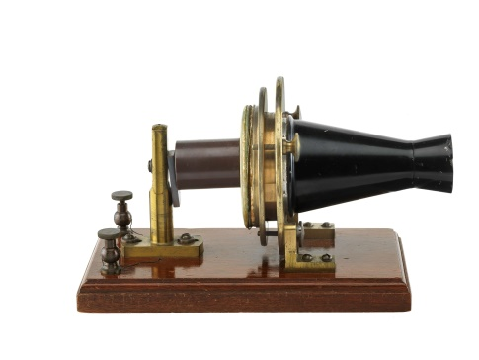
Alexander Graham Bell
Alexander Graham Bell was a Scottish inventor who invented the telephone.
The phone is important now than it ever was. Without this we wouldn’t be able to keep in contact with our loved ones while in lockdown.
Watch this to learn some facts about this famous inventor.
https://www.youtube.com/watch?v=TrLObtDvsa8
Or
https://www.youtube.com/watch?v=9n_5jG_9fAE
This one is a bit longer.

Slide 11
My favourite invention
Activity
Can you think of something you couldn’t live without?
Can you find out -with the help of an adult- who invented it?
Draw a picture of this invention then write a sentence/tell somebody why this is your favourite invention.
I love this invention because….

Slide 12
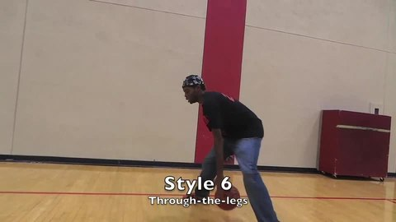
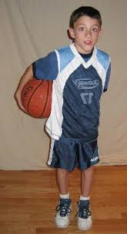
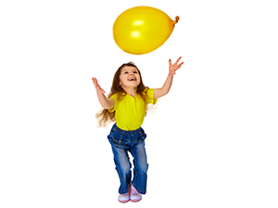
L.I – I can perform a sequences of actions. If the weather is good you can try this outside with a ball.
P.E. - Challenge
Using a balloon or a pair of rolled up socks, let’s see how many of these sequences can you in a minute.
1. Do a figure of 8 round your legs.
2. Pass it once round your waist.
3. Hit it into the air, pose and catch. Start again.

Slide 13
Remember to have some fresh air and exercise too.

