Slide 1
Thursday 14th of May
Good Morning Primary 2/3!
French: Bonjour la class! Ca Va?
Quelle est la date aujourd’hui?
Aujourd’hui cest J____ 14th M____2020
L.I- To know the number names to 20
Can you start at 10 and count up to 20 with me?

Slide 2
Reading Comprehension
Using your reading book from Oxford Owl think about these questions and try and answer them. Don’t write them down just tell someone what you think.
Do you know the name of the Author and where can you find out?
Do you know the name of the Illustrator and where can you find out?
What did you like about the book?
Is there anything you didn’t like about the book and why?
What was your favourite part and why?

Slide 3
Story time https://www.youtube.com/watch?v=ROYNKC1Iy2M

Slide 4
Writing –What colour I am today?
L.I- To write about your feelings.
After listening to the story, think about which colour you are today. ARE YOU?
red
blue
green
rosy
Today you are going to chose the colour which best suits how you feel and write about it.
Start your story with………Today I am
Helpful reminders
Think about WHO WHAT WHERE WHEN WHY when composing your story.
Share YOUR IDEAS before you start.
Get help with tricky words but DON’T WORRY give the words a go!
Remember CAPITAL LETTERS, FULL STOPS AND FINGER SPACES

Slide 5
Splat!
What can we learn from this picture?
How many red shapes do you see?
How else could you know?
Let’s look under the splat to see how many shapes are there.
4
How many shapes are under the splat? How do you know?
www.stevewyborney.com
Steve Wyborney

Slide 6
Splat!
How many red shapes do you see?
How many shapes are under the splat? How do you know?
15
Let’s look under the splat to see how many shapes are there.
How else could you know?
What can we learn from this picture?
www.stevewyborney.com
Steve Wyborney

Slide 7
The total number of shapes is…
Splat!
How many shapes are under each splat? How do you know?
How else could you know?
Let’s look under the splats to see how many shapes are there.
What can we learn from this picture?
11
www.stevewyborney.com
Steve Wyborney

Slide 8
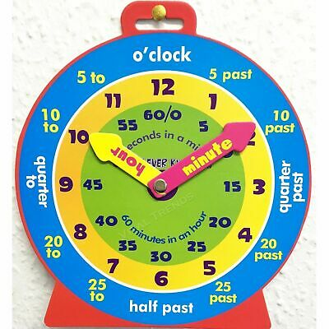
P2 Maths Activities
LI: To identify digital times of o’clock, half past, quarter past and quarter to.
Remember
o’clock= is 00 minutes past
quarter past= is 15 minutes past
half past= is 30 minutes past
quarter to= is 45 minutes past
Play
https://www.splashlearn.com/time-games
Scroll down to

Slide 9
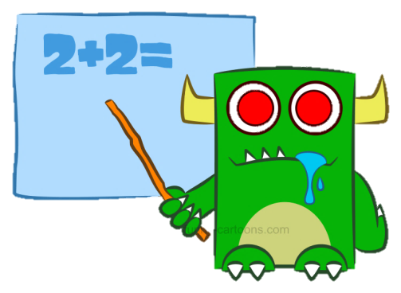
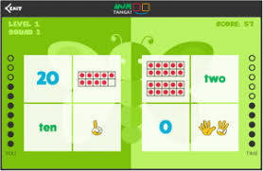
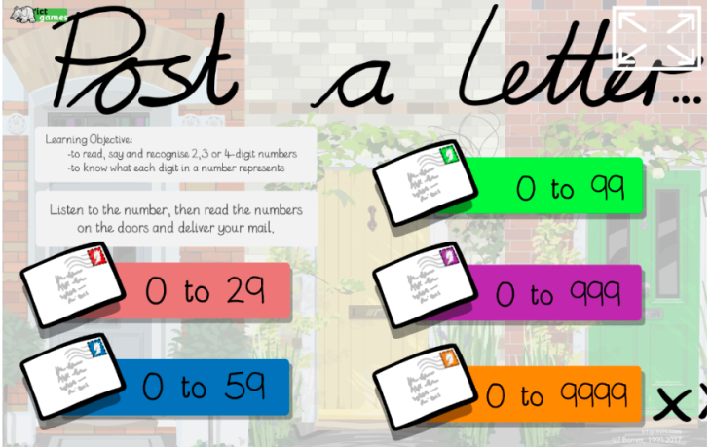
P3 Numeracy Activities
LI: We are learning to recognise read and understand numbers to 1000.
Click these links and play
Numtanga and Post a letter
https://www.gregtangmath.com/numtanga
https://www.ictgames.com/postAletter/index.html

Slide 10
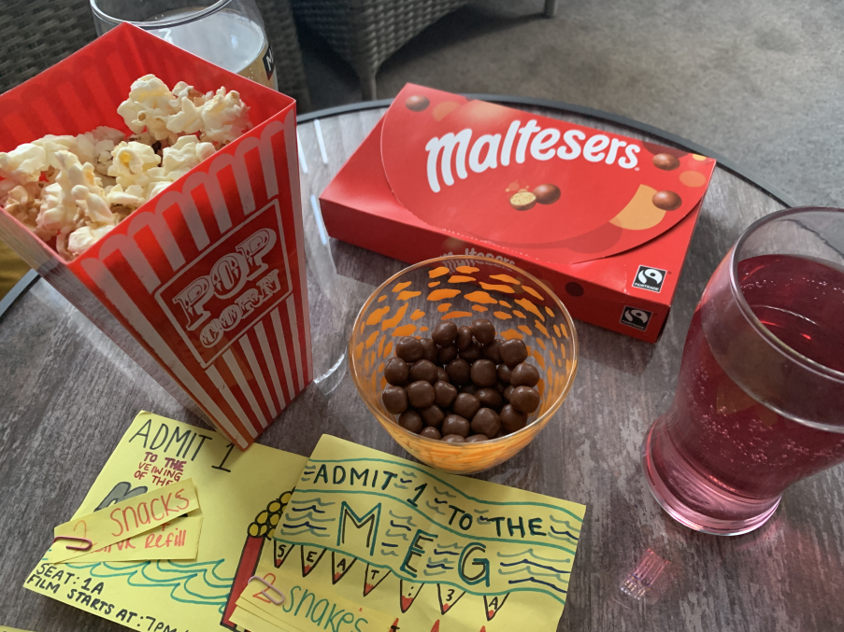
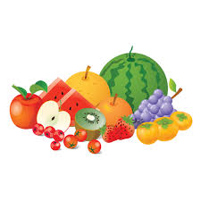
This week, your topic tasks are all about preparing for a Friday Family Movie Night!
Task 4
Task – Prepare some special snacks for your movie night.
Think about what snacks your family would enjoy.
Some snacks we had for our movie night

Slide 11
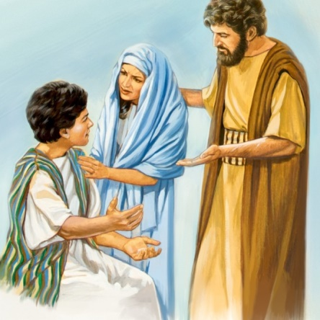
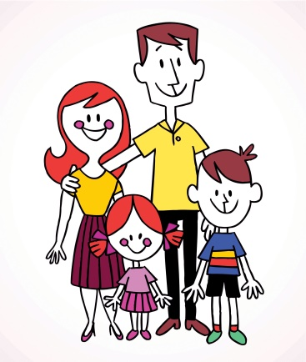
R.E L.I – I recognise the importance of prayer and honour Mary as mother of Jesus
Jesus, Mary and Joseph travelled to Jerusalem to visit the temple. On the last day of the visit Mary and Joseph got ready to leave but Jesus stayed behind.
He wanted to talk to the Priests and Elders about God. Mary thought that Jesus was with Joseph and Joseph thought that he was with Mary. When they realised he was missing how do you think they were feeling?
They both hurried back to the temple to find Jesus and they found him sitting with the elders.
Mary hugged Jesus then gave him a row. She asked him why he had done such a thing. Jesus replied that he was doing God’s work and not to worry.
Say the Hail Mary to honour our Mums.
Always remember to let your parents know where you are!
Think of some ways you can show your Mum and Dad or big person that you love them .
Remember to do it today.

Slide 12
Leave a comment on the blog about what you learned today. Enjoy the rest of your day Primary 2/3!

