Slide 1
Thursday 14th of May
Good Morning Primary 1!
Sing the days of the week and have a little dance
https://www.youtube.com/watch?v=VD6SCq-OlhI
Sing days of the week in French
https://www.youtube.com/watch?v=Lpwf5N0rfVE

Slide 2
Reading and Common Words
Task 1
We are revising our common words
Much only my
Of by For
Choose a book, a comic , a newspaper etc
To see if you can find them in the text.
Task 2
Using your reading book from Oxford Owl think about these questions and try and answer them.
Don’t write them down just tell someone what you think.
Do you know the name of the Author?
Do you know the name of the illustrator?
What did you like about the book?
Is there anything you didn’t like about the book?
What was your favourite part?

Slide 3
https://www.youtube.com/watch?v=ROYNKC1Iy2M

Slide 4
Writing –What colour I am today?
To write about your feelings.
After listening to the story, think about which colour you are today.
red
blue
green
rosy
Today you are going to chose the colour which best suits how you feel and write about it.
Start your story with………
Today I am
Helpful reminders
Think about WHO WHAT WHERE WHEN WHY when composing your story.
Share YOUR IDEAS before you start.
Get help with tricky words but DON’T WORRY give the words a go!
Remember CAPITAL LETTERS, FULL STOPS AND FINGER SPACES

Slide 5
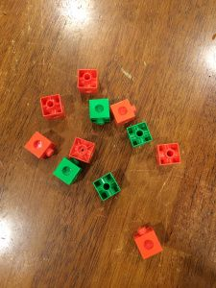
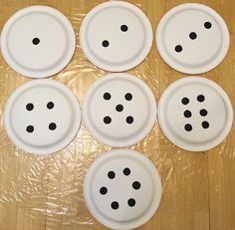
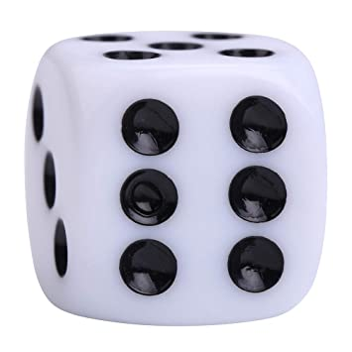
Subitising
Watch –
https://www.youtube.com/watch?v=ib5Gf3GIzAg
We are learning to say how many without counting.
Subitising is the ability to instantly recognise the number of objects in a small group without the need to count them.
Here are some objects you may have at home which you could subitise with.
Ask the questions - ”How many dots do you see?” “How do you see them?”
Cubes/beads/beans/pasta.
Drop them on the table. Let your child look. You could then cover them to make it trickier.
Draw dots on a plate/paper. Hold the plate up one at a time.
Dice
You could try using 2 if you would like a challenge!
Dominoes
I see 7
4 + 3= 7

Slide 6
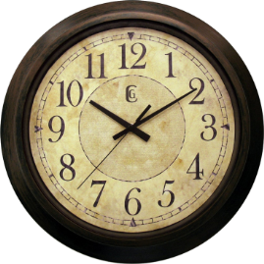
Time!
Watch
https://www.bbc.co.uk/bitesize/clips/zmpc2sg
Discuss
Ask children if they can count the little lines round a clock.
How many are there all together?
How many are there between 1 and 2, or 2 and 3?
Once they have had a chance to investigate, tell them that there are 60 lines round the clock because there are 60 minutes in one hour.
We are learning to read the time
on an analogue clock.
Task
Set a one minute timer – Can you stay silent for minute while you watch the clock. Does it feel like a long time?
What can you do in one minute?
How many times can you write your name in one minute?
How many jumps can you do in a minute? Is it more or less than you did in 5minutes yesterday?
Watch this clip https://www.bbc.co.uk/bitesize/clips/zv4mvk7

Slide 7
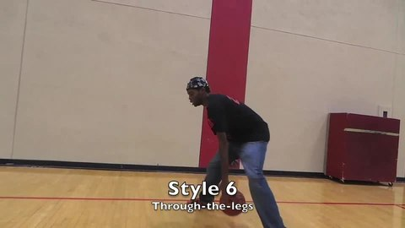
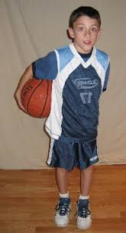
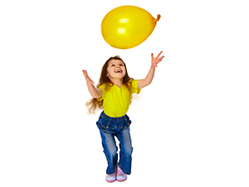
L.I – I can perform a sequences of actions. If the weather is good you can try this outside with a ball.
P.E. - Challenge
Using a balloon or a pair of rolled up socks, let’s see how many of these sequences you can do in a minute.
1. Do a figure of 8 round your legs.
2. Pass it once round your waist.
3. Hit it into the air, pose and catch. Start again.

Slide 8
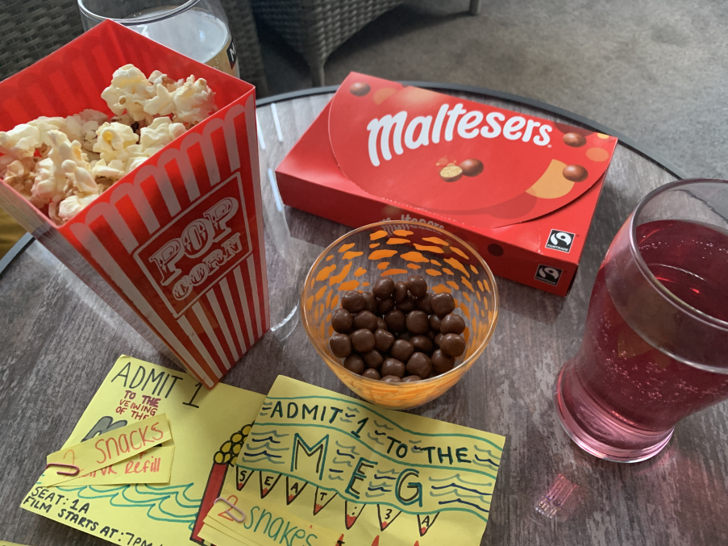
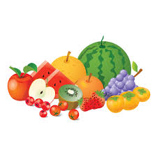
This week, your topic tasks are all about preparing for a Friday Family Movie Night!
Task 4
Task – Prepare some special snacks for your movie night.
Think about what snacks your family would enjoy.
Some snacks we had for our movie night

Slide 9
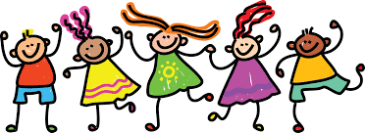
Leave a comment on the blog about what you learned today. Enjoy the rest of your day Primary 1!

