Slide 1
Welcome to the primary 1-3
Marvelous Invention Convention

Slide 2
Since we are not able to come into school to show case all of your hard work. I have put together a virtual Invention Convention to show off all of your AMAZING inventions!

Slide 3
Primary 1’s
Inventions!

Slide 4
This is a fantastic invention, you have put a lot of thought into it and worked very hard to build it.
I love the video you made demonstrating how it works and well done for incorporating some maths into your descrition.

Slide 5
What an amazing idea this is. I would love one of these in my house for when I get to the end of my toothpaste and cant get anymore out! This is also a very eco friendly invention as it would stop lots of waste! Well done!
I love the description you have given of your invention. Well done ☺

Slide 6
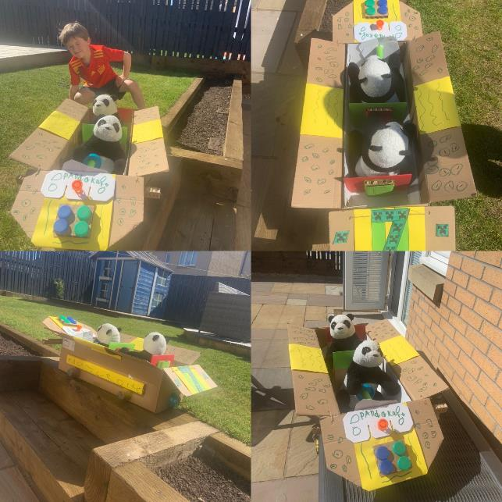
“We had lots fun making and playing with our panda kart invention for P1 fun topic.”
This is a super invention! I can tell you have put a lot of thought and planning into it. You have used your design skills to make it very eye catching!

Slide 7
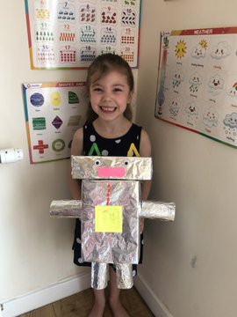
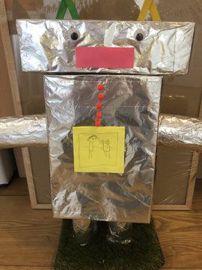
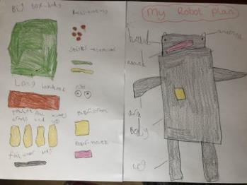
“It was lots of fun planning , choosing materials and finally building! Mummy is hoping this will magically clean my bedroom like I’ve said it will.”
Well done for putting so much hard work and thought into your invention. Your plan is amazing! I would love one of these to help me clean my house.

Slide 8
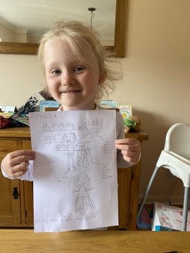
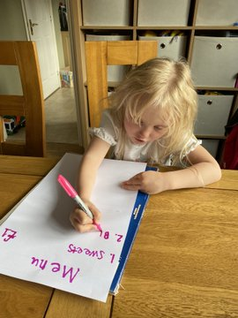
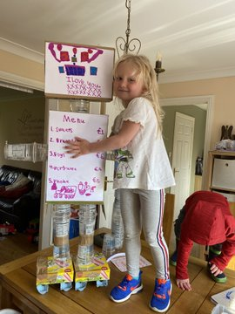
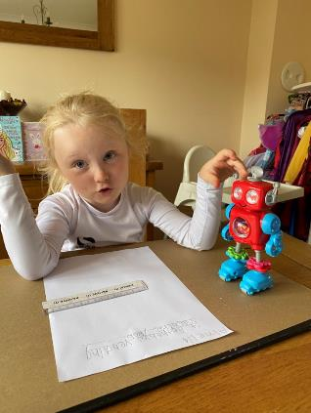
“This is the St Anthony’s vending machine robot! It’s sells a variety of things and will start its daily route at P1 then work its way to P7”
WOW! Look at the size of your Vending Machine Robot. This is exactly what we need at school. This must have taken a lot of hard work to make. I also notice that you have made up a detailed plan of your invention. Well done! Your writing is super as well ☺.

Slide 9
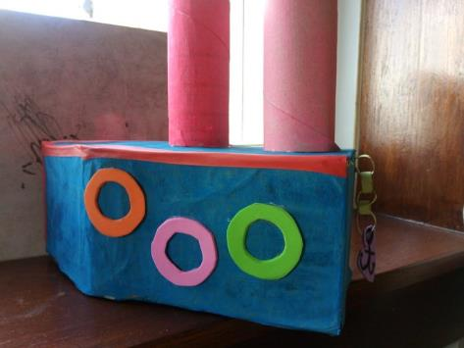
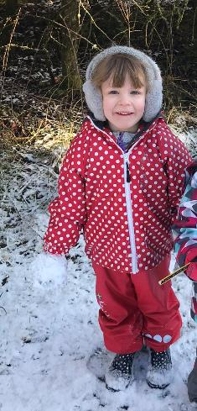
This ship is amazing! I love all of the colours you have used to make your model very eye catching. I can tell you have put a lot of time and effort into your model, Well done!

Slide 10
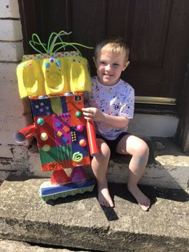
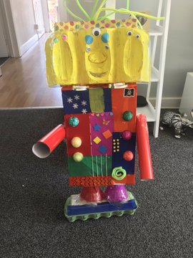
WOW! This is a super robot. I would love to know what you would like it to do for you?
I could be doing with a robot helping me out around the house. I bet you had lots of fun making this. You must feel so proud of your finished invention!

Slide 11
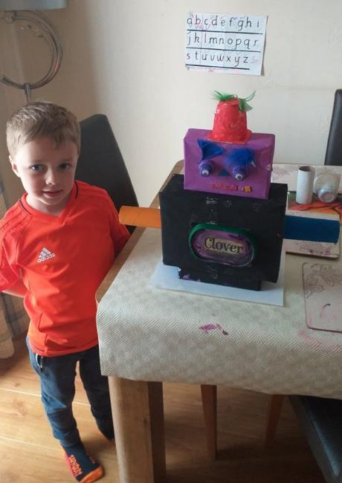
This is an amazing robot! Your mum has told me about your idea behind it and all of the planning you put into it and I am so impressed. Well done ☺

Slide 12
Primary 1/2’s
Inventions!

Slide 13
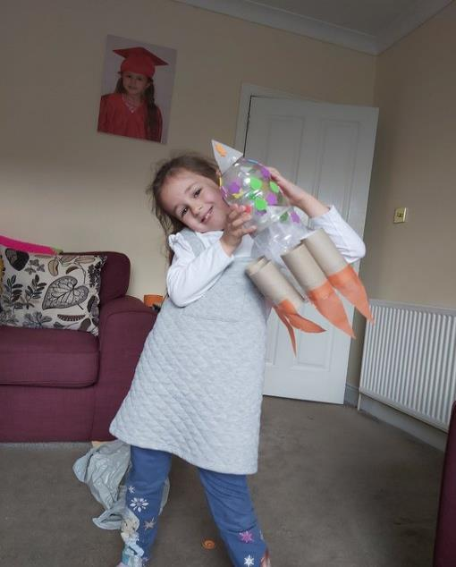
Spring Rocket Well done! I love that you have used a range of materials to create your invention. It is very clear to us what you have made ☺

Slide 14
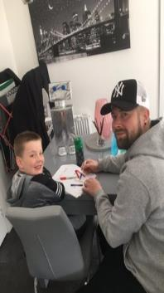
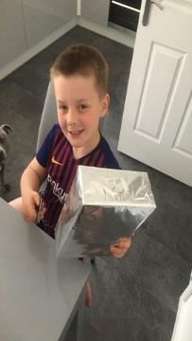
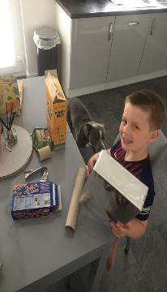
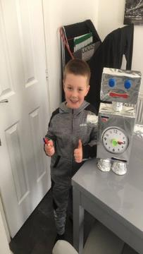
What a fantastic model! I can see that you carefully planned before you started constructing. Well done!
I designed and build a time robot with my dad!

Slide 15
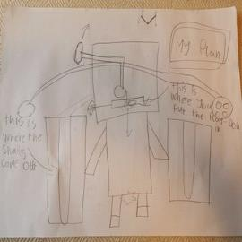
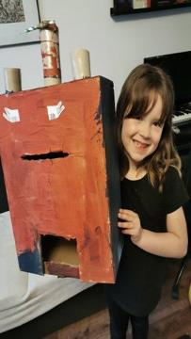
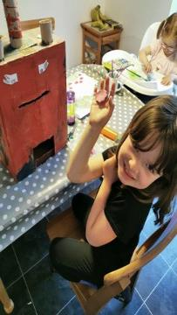
This weeks project was great fun! We made a robot that makes play doh shapes.
A clearly labelled plan with fantastic instructions. Well done!

Slide 16
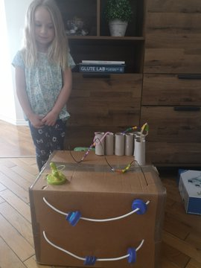
This looks very interesting and intricate. Well done!
Here is our construction, lots of fun! Great project!

Slide 17
Primary 2/3’s
Inventions

Slide 18
What a lot of thought and hard work went into this “Fossilised Pokemon Maker”
I love that you have made a video which clearly explains your thinking and how your invention works!
Well Done you!!

Slide 19
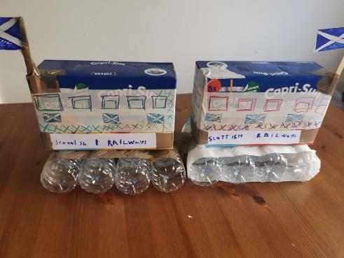
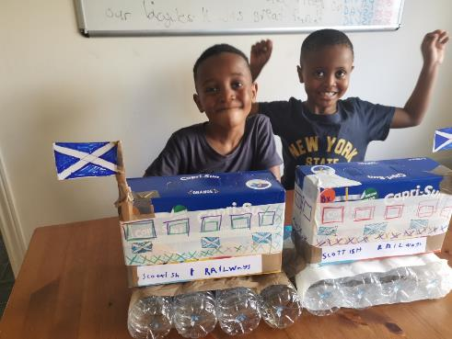
What a great job you have done boys! What a choo-tiful job you have made of your train models! You have clearly put a lot of thought into the design and construction of these.

Slide 20
Primary 3’s
Inventions

Slide 21
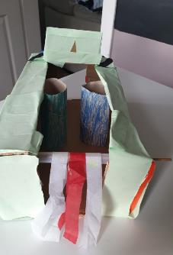
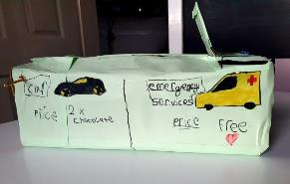
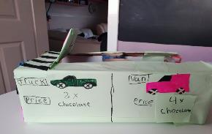
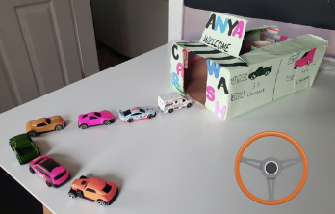
Primary 3
WOW! A hand made car wash. What a creative idea! You have put so much detail into your design. ☺
I wish I could get my car washed and pay for it with chocolates! Such a cool idea!

Slide 22
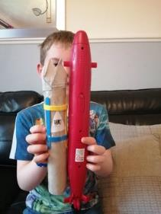
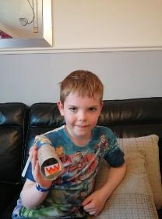
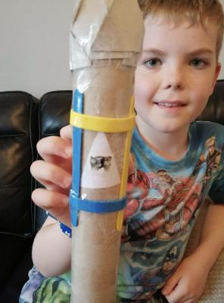
Primary 3
‘Dogs in a rocket with security cameras to keep everyone safe’
The effort you have put into your design is FANTASTIC!
You have used your imagination and created a thoughtful invention. It would be super cool if we had dogs in rockets looking out for us. ☺

Slide 23
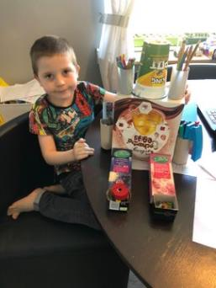
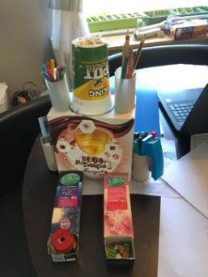
Primary 3
This is a great way to recycle old packaging.
You have put in lots of effort and your invention is super creative and useful!
Well Done! ☺
‘A Robot Desk Tidy’

Slide 24
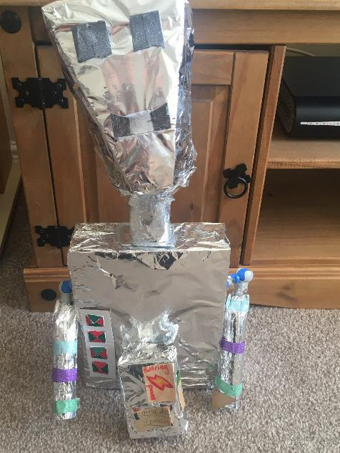
Primary 3
‘Ronnie the Robot’
WOW! You have put so much effort into your super cool invention!
You have used lots of different materials and included really interesting details like the battery.
Great work ☺

Slide 25
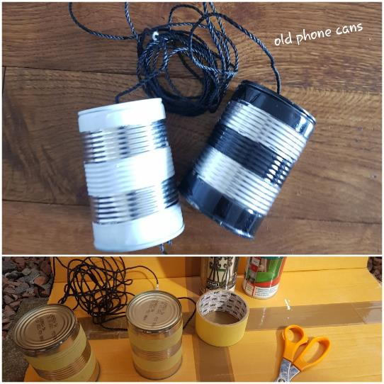
Primary 3
What a creative idea!
A great way to recycle old cans! This invention will be super fun to play with.
Great Job ☺

Slide 26
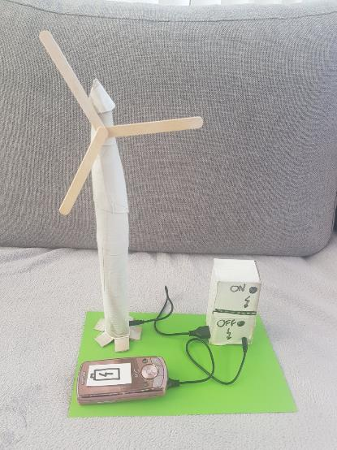
Primary 3
How cool is this invention, a windmill that can charge phones!
I love your creativity and imagination! You have put so much hard work into your design. A great eco friendly idea!
Well done ☺

Slide 27
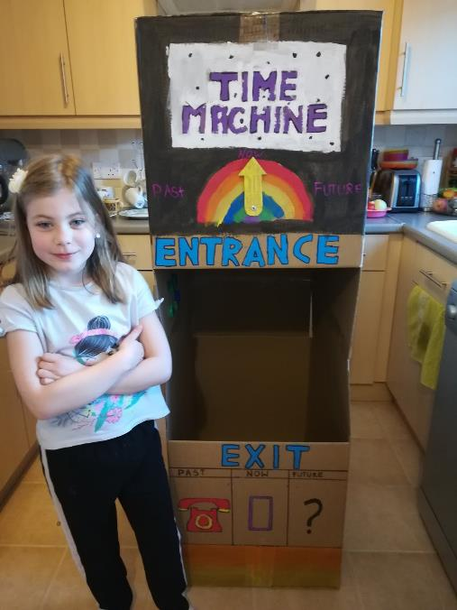
Primary 3
WOW! What a fantastic Time Machine!
Such a creative idea!
You have put so much effort into your design.
I wonder where your time machine will take you?

Slide 28
Keep on inventing and stay inspired!
You can be anything you want to be!
https://www.youtube.com/watch?v=XiuU1mlFeEc&t=6s

