Slide 1
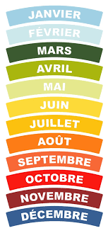
Monday 11th of May
Good Morning Primary 3!
French: Bonjour la class! Ca Va?
Can you say todays date in French?
Aujourd’hui c’est (L…………) 11th (M………) 2020
Let’s refresh our memory and sing the French
months of the year song:
https://www.youtube.com/watch?v=7_u2SigckNQ
Notes:
Hello c

Slide 2
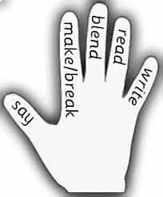
Literacy
LI: We are learning to recognise, read and make words containing the ‘y’ phoneme.
Sing ABC, abc and vowel song.
Read the phoneme story and highlight the phoneme words.
Click on the link below. It will take you to a page on BBC Bitesize. Watch the short video to find out some more ‘y’ phoneme words. Underneath the video is a short spelling activity for you to complete.
https://www.bbc.co.uk/bitesize/topics/zt62mnb/articles/z3mktv4
4. Complete the Phoneme word maker.

Slide 3
Reading
We are learning to read fluently.
https://www.oxfordowl.co.uk/?sellanguage=en&mode=hub
Username – stantsps3
Password – primary3
Click the ‘My Class Login’ button and type the above username and password.
Go to ‘My Bookshelf’ and enter your child’s age and perhaps a genre that they may find interesting.
Click on a book and begin reading.
*You could also read a book from your house if you would like*
Today, I would like you to read for 10-15minutes. Look out for new or tricky words.

Slide 4
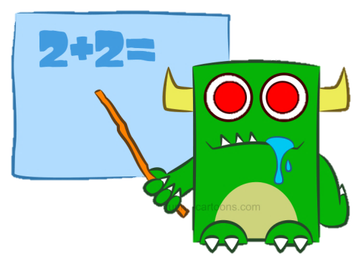
Numeracy – Warm Up
LI: We are learning to count in 2s, 5s and 10s.
Jack Hartmann – Workout and Count
https://www.youtube.com/watch?v=q_yUC1NCFkE

Slide 5
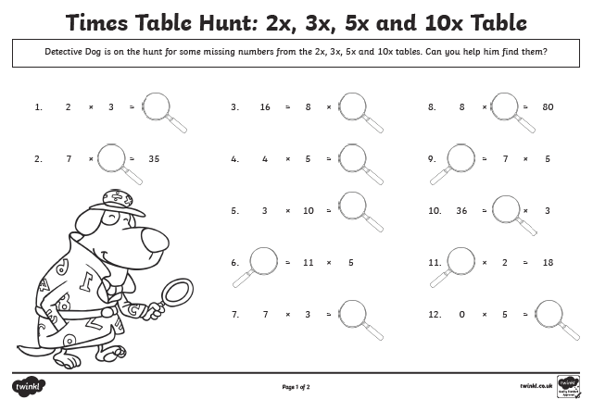
Numeracy Activities
LI: We are learning to count in 2s, 3s and 5s.
Attached to this blog post is a ‘Times Table Hunt’ worksheet for you to complete.
You can look at the worksheet online and write the answers in your jotter or you can print it off (it’s up to you). You don’t need to answer all the questions, just do what you can.
Once you have completed your worksheet, you could play the ‘Mental Maths Train’ game on Topmarks
https://www.topmarks.co.uk/maths-games/mental-maths-train

Slide 6
Health and Wellbeing
We are learning to carefully listen to sounds in my environment and I can understand that my feelings change depending on what is happening around me.
It can be difficult to identify the different songs of our garden birds when they all sing together.
Watch and listen to the link below to explore different bird songs.
https://www.youtube.com/watch?v=xudHav8digY
It can be very relaxing listening to birds singing. Listen out for these birds on your daily walk or when you are in your garden. How many can you hear?

Slide 7
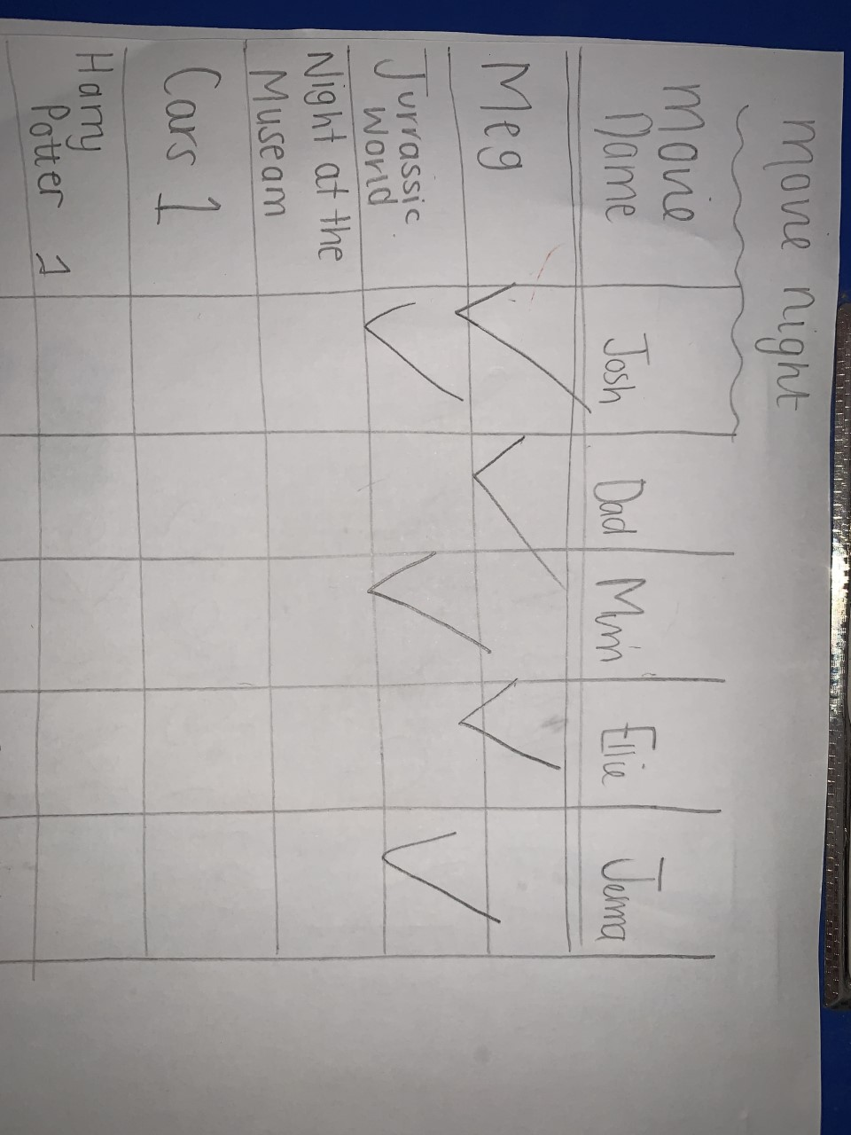
This week, your topic tasks are all about preparing for a Friday Family Movie Night!
Day 1
Task 1 – Choose 3 movies in your house that you think your family
would enjoy.
Task 2 – Create a table and complete a survey to find out the most popular movie. Make sure you ask all your family members for their opinions.
Task 3 – Look at the results of the survey and the movie with the most votes is the winner.
Your table might look like this

Slide 8
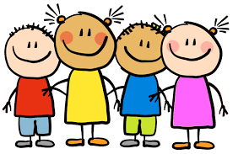
Well done, you have completed all of our Monday tasks! Enjoy the rest of your day Primary 3 ☺

