Slide 1
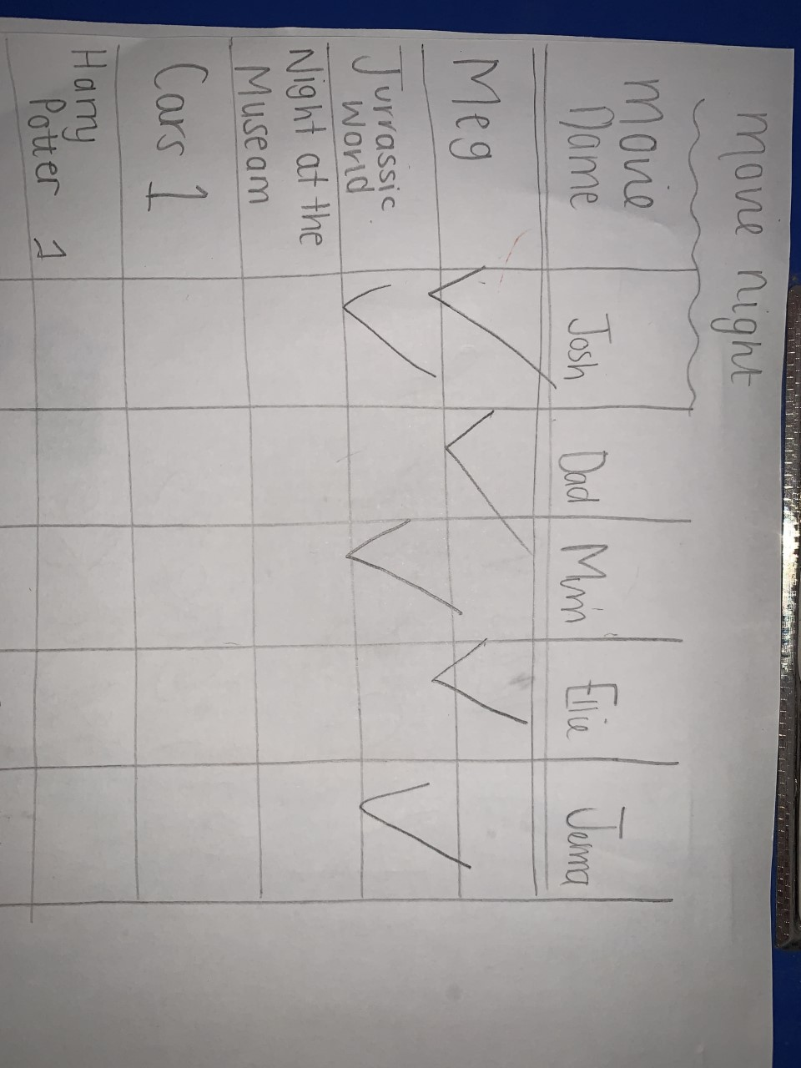
This week, your topic tasks are all about preparing for a Friday Family Movie Night!
Task 1
Task 1 – Choose 3 movies in your house that you think your family
would enjoy.
Task 2 – Create a table and complete a survey to find out the most popular movie. Make sure you ask all your family members for their opinions.
Task 3 – Look at the results of the survey and the movie with the most votes is the winner.
Your table might look like this

Slide 2
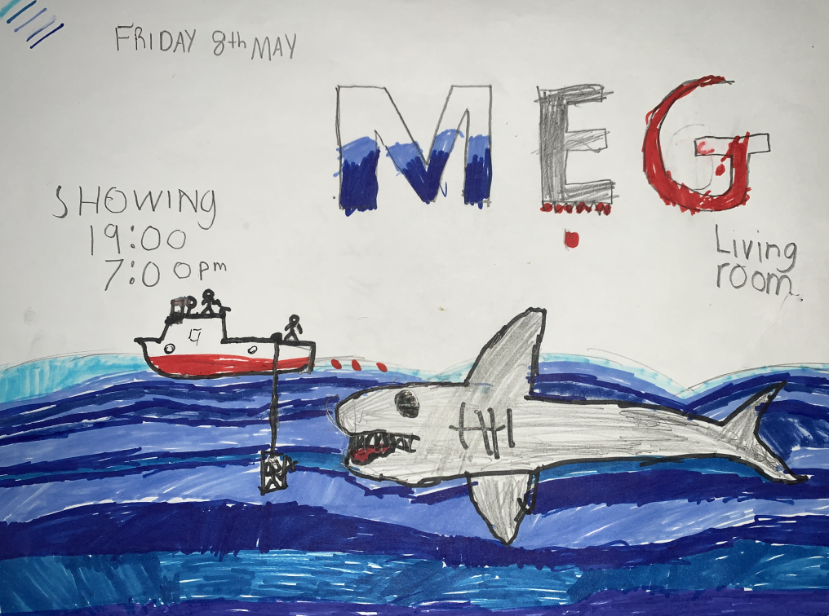
This week, your topic tasks are all about preparing for a Friday Family Movie Night!
Task 2
Task – Create a poster advertising your movie.
Your poster must include:
The name of the movie
The date of the movie night
The time of the movie night
The location of the movie
night
Your poster might look like this

Slide 3
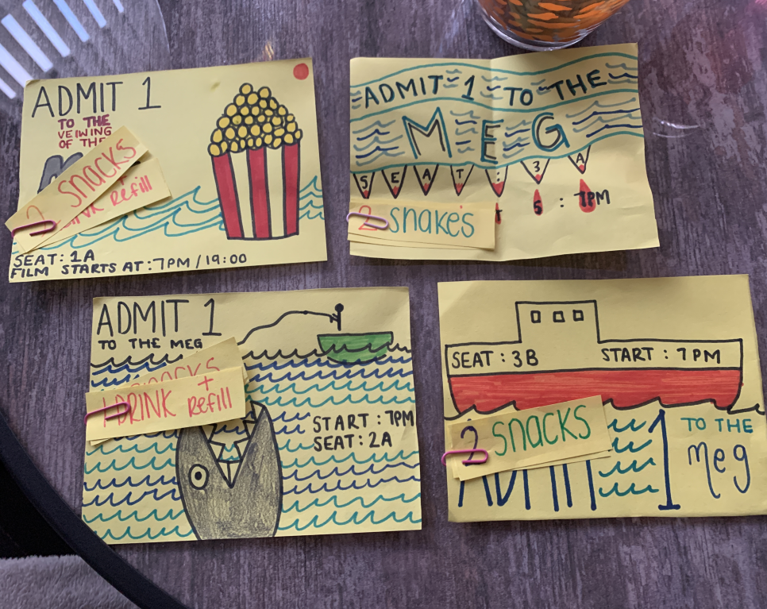
This week, your topic tasks are all about preparing for a Friday Family Movie Night!
Task 3
Task – Create tickets for the movie.
Make sure you have the correct date and time.
Try and be creative with
your tickets and make them look interesting.
Your tickets might look like this

Slide 4
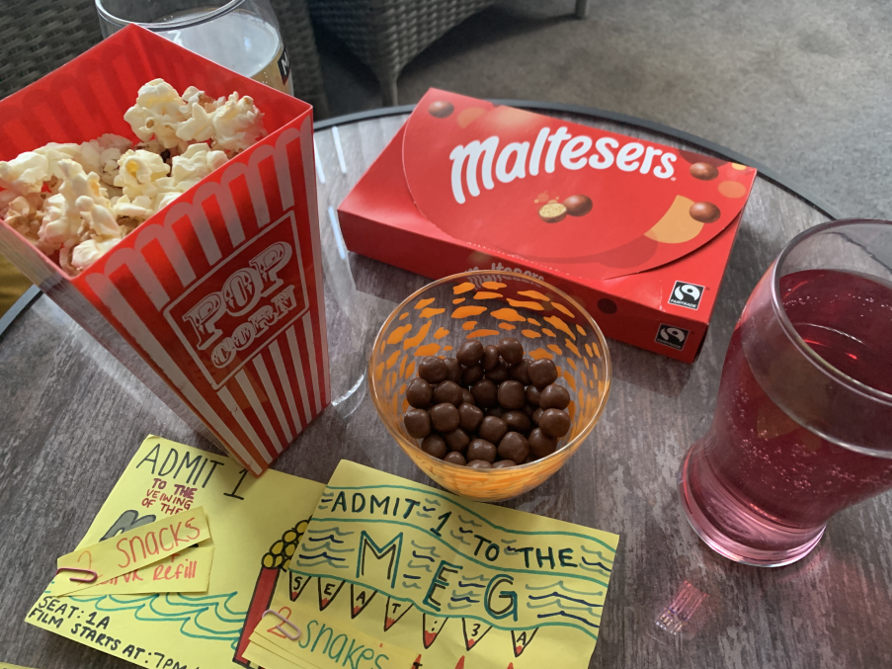
This week, your topic tasks are all about preparing for a Friday Family Movie Night!
Task 4
Task – Prepare some special snacks for your movie night.
Think about what snacks your family would enjoy.
Some snacks we had for our movie night

Slide 5
This week, your topic tasks are all about preparing for a Friday Family Movie Night!
Task 5
It’s finally time for your Family Movie Night!
Prepare the movie area – make it nice and cosy!
Ask your customers to see their tickets before showing them to their seats.
Snuggle up together and enjoy a lovely family night of fun! ☺

