Slide 1
Monday 11th May

Slide 2
Time table
French
Daily exercise
Spelling
Reading
Maths
Topic

Slide 3
French
Click on the link below to sing along to the months of the year song in French?
https://www.youtube.com/watch?v=7_u2SigckNQ
Can you write today’s date in French?
Quelleestla date aujourd’ hui?
C’est……………………..

Slide 4
Daily exercise
Try to do some form of exercise to start the day. This could be a walk or run with a family member or a workout in the house. Check with your parents that it is ok for you to do this.
Why not try a bit of disco enfrancais this morning :-
https://www.youtube.com/watch?v=KVhfIgghOPw

Slide 5
Spelling – I am learning to use various spelling strategies.
We are on Week 2 of Common word set 12.
Firstly,Change,Does,Goes,Changing,Shouted,Sixteen,slowly,Baby,Balloon,Caught,
Didn’t,Can’t,Evening,off.
You are doing partner spell for your words today. If you do not have someone to partner spell with, look, cover, write and check your words instead.

Slide 6
Reading starter
In 5 minutes, how many other words can you make out of the following 3:
Bright yellow tulips.

Slide 7
Reading
I can watch a story (Myth) about The Banshee and use the video to answer comprehension questions.
Remember when answering question to answer in full sentences.
https://www.bbc.co.uk/bitesize/topics/z4j8rj6/articles/z9446yc

Slide 8
Reading questions
1. what is the Banshee also know as in stories?
2. what does the Banshee’s cry do?
3.What is the Banshee?
4. What is the difference between a legend and a myth?
5. Can you name another legend or myth that you know?
Challenge – can you create your own question about the Banshee?

Slide 9
Maths – Number Talks
467 – 234
478 – 321
678 – 576
789 – 329
Complete the above sums. Think of the strategies you use to work them out. I have put some examples to the left.

Slide 10
Maths – I am learning to name angles
Question 1 – what type of angles are being show in the triangles? Remember last week we looked at acute, right angle, obtuse, reflex and straight line.
Question 2 – copy the diagrams and match with the correct statement.
Extra challenge – there is a challenge live on Sumdog on Angles.

Slide 11
Topic – I can research about a place in my local area.
I have been going on a walk for my daily exercise. I have came across a local landmark on my walks. Below is a picture of what The Peel of Leving’s-toun use to look like and what it looks like now.
Livingston began here in 1124 when de Leving a Flemish nobleman, built a square stone tower house or Peel. His servants and workers lived in cottages nearby, which people began to call Leving’stoun or Livingston.
Can you find out three facts about Levings-toun peel or about De Leving himself?

Slide 12
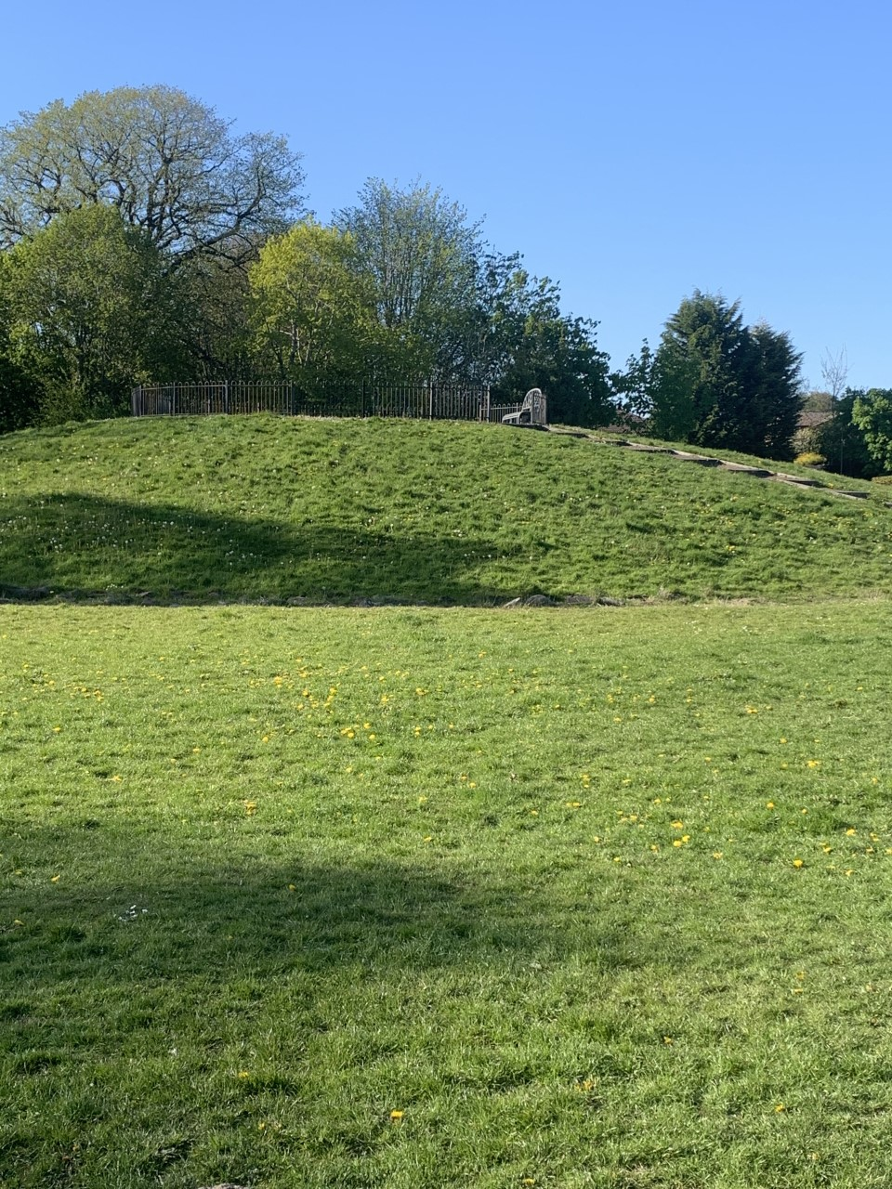
Leving’stoun Peel
On the left is what the peel use to look like. On the right you can see it is now a mound.

