Slide 1
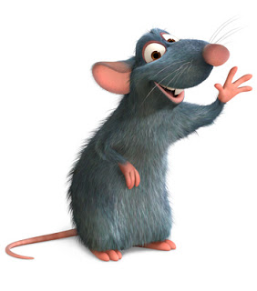
Monday 11-5-20
Good Morning Everyone!

Slide 2
Today’s Timetable
Morning Exercise
French
Morning Starter
Maths Lesson
Grammar
Literacy
R.E.
P.E.
Prayer

Slide 3
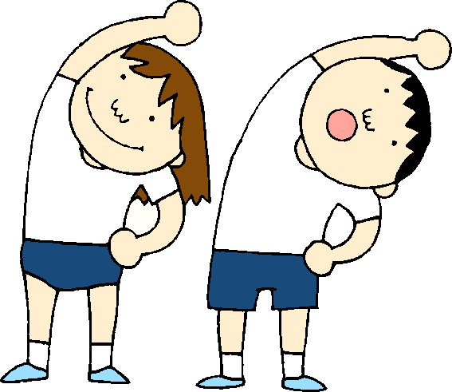
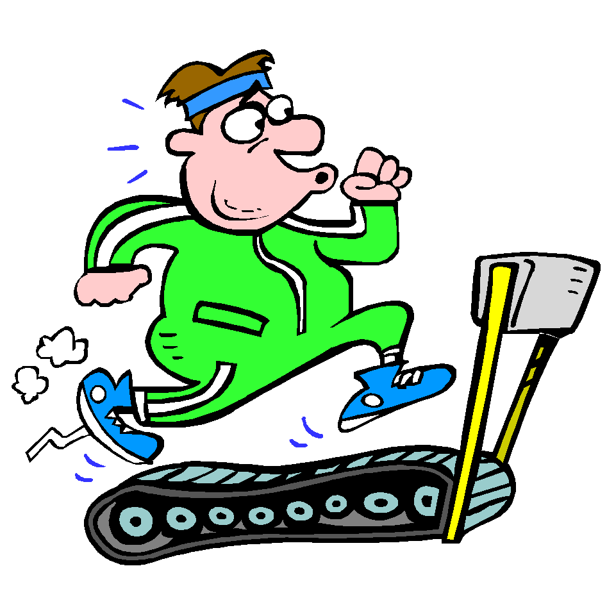
Daily Exercise
Try to do some form of exercise to start the day. This could be a walk or run with a family member or a workout in the house. Check with your parents that it is ok for you to do this.
Why not try disco en francais:-
https://www.youtube.com/watch?v=KVhfIgghOPw
Or join the Body Coach live at 9am

Slide 4
A little bit of French to start the day
Click on the link below to sing along to the weather song in French?
https://www.youtube.com/watch?v=eBvJVOuBPXI
Can you write today’s date in French?
Quelle est la date aujourd’hui?
C’est ……………………..
Can you also write today’s weather in French?
Quel temps fait-il?
Il pleut/ Il fait beau/ Il fait froid/ Il y a du vent/
Il fait mauvais/ Il y a des nuages/ Il y a du soleil

Slide 5
Morning Starter
Today, everyone’s morning starter is 15-20 minutes on
If you have log-in details for IDL Maths please continue to access this as normal.
SUMDOG

Slide 6
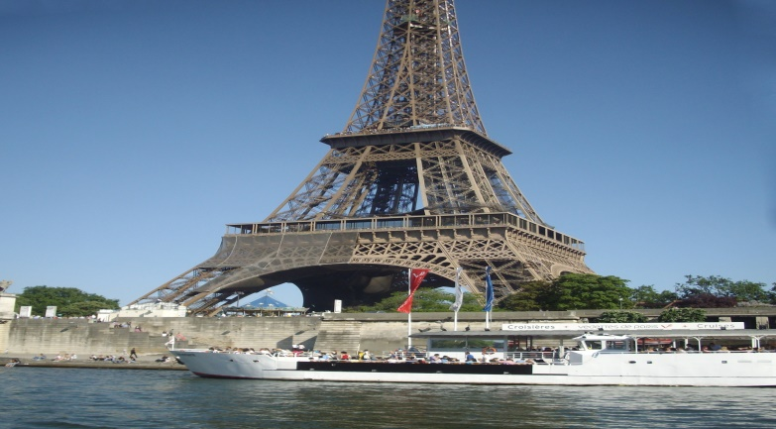
Maths Lesson
Today we are doing some Paris themed Maths questions
Please find your Maths task attached to the blog.
I have attached a task for each Maths group.

Slide 7
Grammar
Log in to Sumdog for your grammar task.
You will need to make sure you click on the task set for your group.
Group 1 – Red Group, Group 2 – Blue Group
Group 3 – Green Group
This task is set for this week so you do not need to finish it today. Please let me know if it is too hard or too easy by posting a message on Teams. Unfortunately, I am not able to see examples of the questions they will ask you.

Slide 8
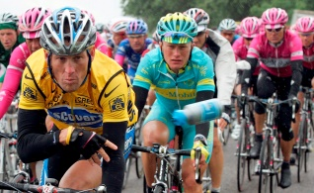
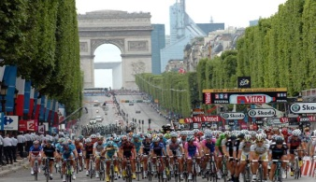
Literacy
Today, we’re going to do a reading comprehension on The Tour de France.
The Tour de France is a world famous cycling race which takes place every year throughout France. The final stage of the race always takes place in Paris.
Please find the reading comprehension attached to the blog. The answers are attached, so answer the questions first before scrolling down to the answers. There are 3 versions of the reading comprehension.
Red group – version 1, Blue Group – version 2, Green group – version 3
If you have log-in details for IDL please continue to do 20 – 30mins Mon-Fri.
If you would like to watch a clip on The Tour de France click on the link:-https://www.youtube.com/watch?v=ZacOS8NBK6U

Slide 9
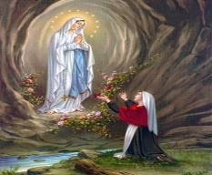
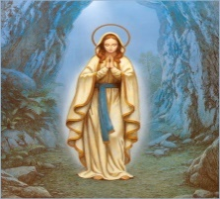
R.E.
Today we are going to learn about Our Lady of Lourdes.
Every year over 6 million people pilgrims visit the town of Lourdes in South-West France, to honour Our Lady and visit the shrine where she appeared to Bernadette.
Click on the link to find out more:-
https://www.facebook.com/sanctafamiliamedia/videos/lourdes-a-place-of-pilgrimage-and-prayer/2191909581138144/
Your task is to make up your own prayer to Our Lady. When we pray to Our Lady we are asking her to intercede on our behalf [ she asks God for help].
Your prayer can be about anything you like eg. you might be asking for peace in the world or an end to the corona virus or help for a family member. .

Slide 10
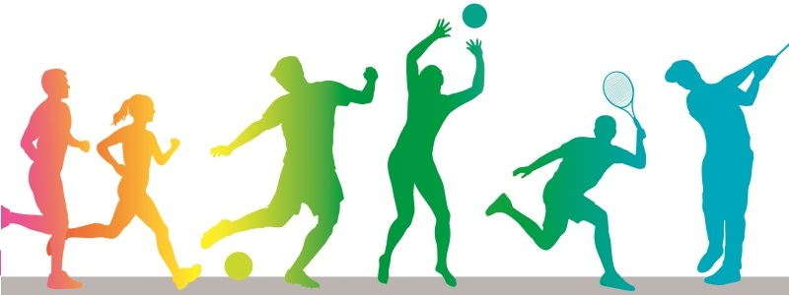
P.E.
Click on the following link for today’s P.E. session
https://www.youtube.com/watch?v=MNFdY4cZtWY
Alternatively, join family members for a walk, run or cycle.

Slide 11
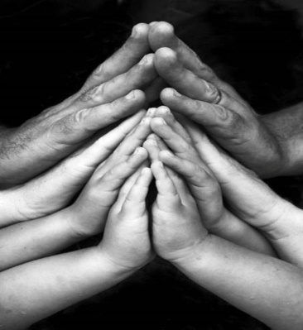
A prayer to end our day
Take a few moments to say a short prayer. You might like to dedicate your prayer to someone in your family who is unwell or who just needs your prayers.

Slide 12
Well done!
Well done for working hard today!

