Slide 1
Monday 11th of May
French: Bonjour la class! Ca Va?
Aujourd’hui cest L____ 11th M____ 2020
L.I- To know the number names to 20
Watch: https://www.youtube.com/watch?v=H2-REbL2OU0
There are a couple of games to test what you know at the end of the video.

Slide 2
Literacy
Stage 2 Phonics
LI: We are learning to recognise, read and make words containing the u-e phoneme.
Get youself up and moving with Workout to the letter sounds.
https://www.youtube.com/watch?v=VFa0b_IIRac
2. Watch Geraldine the Giraffe “u-e”
https://www.youtube.com/watch?v=BdfBg1SMFzM
3. Read you’re u-e phoneme story and highlight the words that have the a-e sound in them. Make sure that you can read these words.
4. Use your “u-e” Wordmaker to make the following words:
June ruler rude flute rule
Are there any other u-e words you can make?

Slide 3
Stage 2 Roll and Read
L.I -I can read words containing the ‘u-e’ phoneme.
Task: Roll the dice, read a word from the line of the number you rolled. First to get 4 in a row wins.

Slide 4
Literacy
Stage 3 Phonics: Y phoneme
LI: We are learning to recognise, read and make words containing the y phoneme.
Get youself up and moving with Workout to the letter sounds.
https://www.youtube.com/watch?v=VFa0b_IIRac
2. Read you’re “y” phoneme story and highlight the words that have the a-e sound in them. Make sure that you can read these words.
4. Use your “y” wordmaker to make the following words:
gym crystal pyramid
rhythm cygnet mystery

Slide 5
Literacy: Reading
Please choose a new book to read this week from the Oxford Owl website below.
There will be reading activities put up tomorrow and Wednesday for you to complete using the book you choose .
Please access the Oxford Owl website using the login.
Username: stantsps Password: homelearning
https://www.oxfordowl.co.uk/?sellanguage=en&mode=hub
The colour band of each book on the website is on the front and back covers (although a few have not got the colour on them, they will be the same colour banding as the other book titles next to them on the page) .

Slide 6
Story time
Click the picture to listen

Slide 7
Numeracy – Warm Up
LI: To use mental strategies to solve maths problems and be able to explain my strategy

Slide 8
2 + 3 + 2 = 7
2 + 3 + 2 = 7
4 + 4 – 1 = 7
9 – 2 = 7
5 + 2 = 7
3 + 3 + 1 = 7

Slide 9
Now I’ll show you a large copy of your pattern. What ways can you come up with you find the total number of dots? Here it is!
www.stevewyborney.com

Slide 10
www.stevewyborney.com

Slide 11
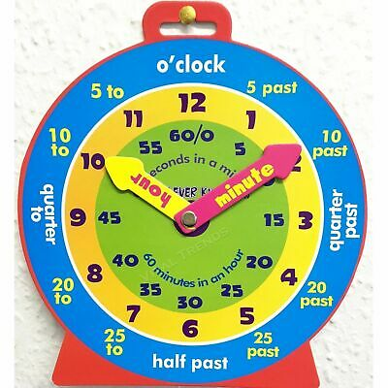
P2 Maths Activities
LI: To sequence the months of the year in the correct order .
You should now have completed your Time workbook.
For the next couple of days we are going to look at the
Months of the year
Watch: https://www.youtube.com/watch?v=5enDRrWyXaw
2. Play- Roy the Zebra- months of the year sequencing https://www.roythezebra.com/reading-games/high-frequency-words-months.html

Slide 12
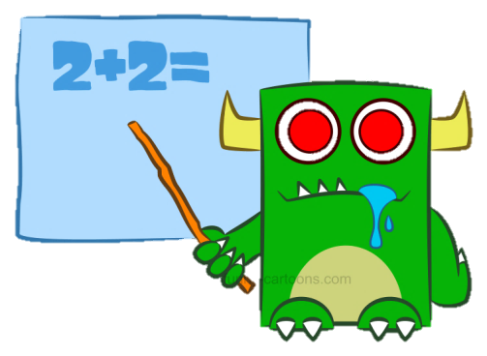
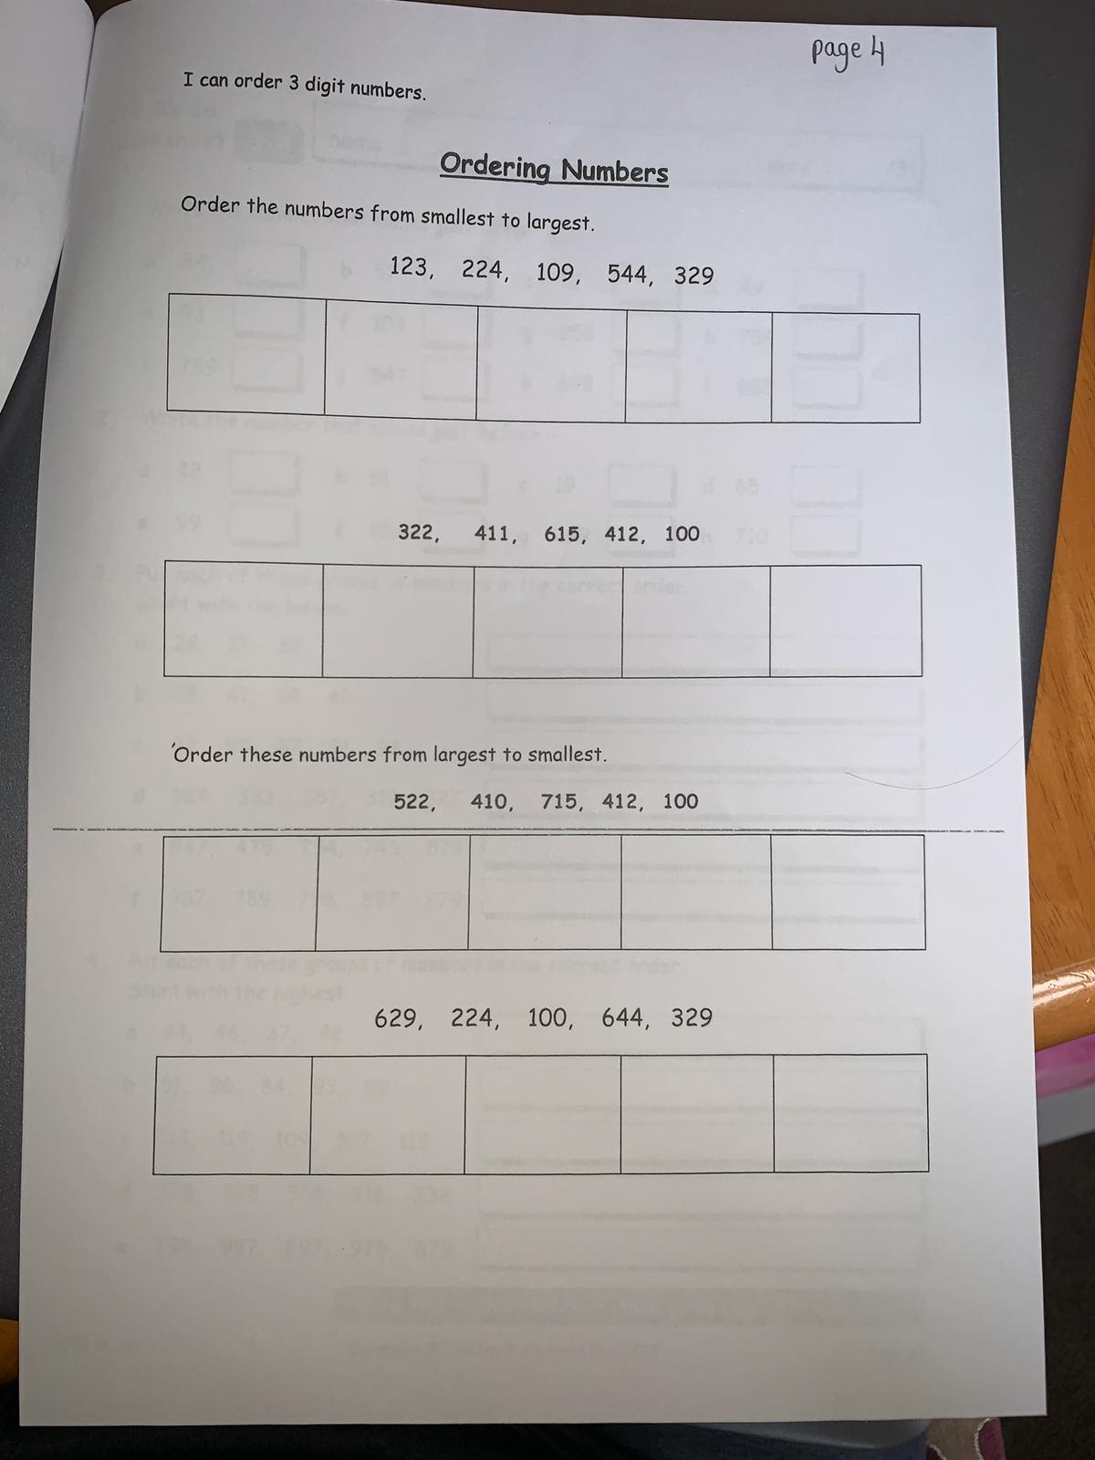
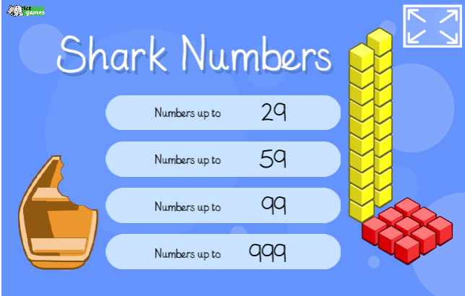
P3 Numeracy Activities
LI: To understand the value of each digit in a number
Place Value Workbook
Please do this page
2. ICT Games: Shark Numbers -0-1000
http://www.ictgames.com/sharkNumbers/mobile/index.html

Slide 13
Health and Wellbeing
LI: To know and understand where my food comes from and how it gets to me.
Watch: Yummy Honey
https://www.youtube.com/watch?v=UBZH8zKpJso
Bees are not only essential in the production of honey, but they are essential pollinators. Bees make sure that plants are pollinated which allows them to grow.
On the next slide there is an Apple Tipping Experiment which you can take part in to help Scotland’s Rural College to study pollinators.

Slide 14
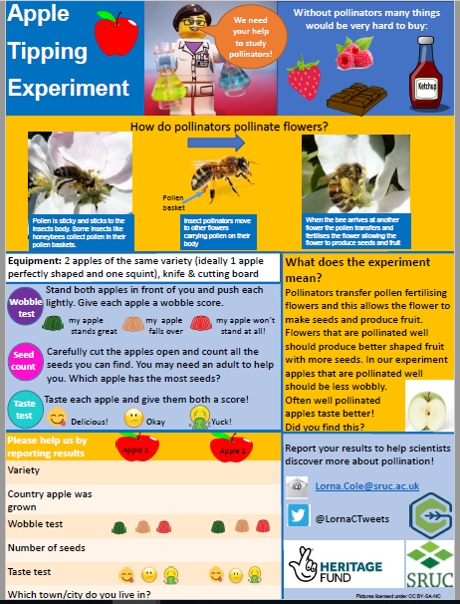
The Experiment opposite is attached to today’s blog post.
Tweet your results to @LornaCTweets
and help support SRUC to study pollinators.

Slide 15
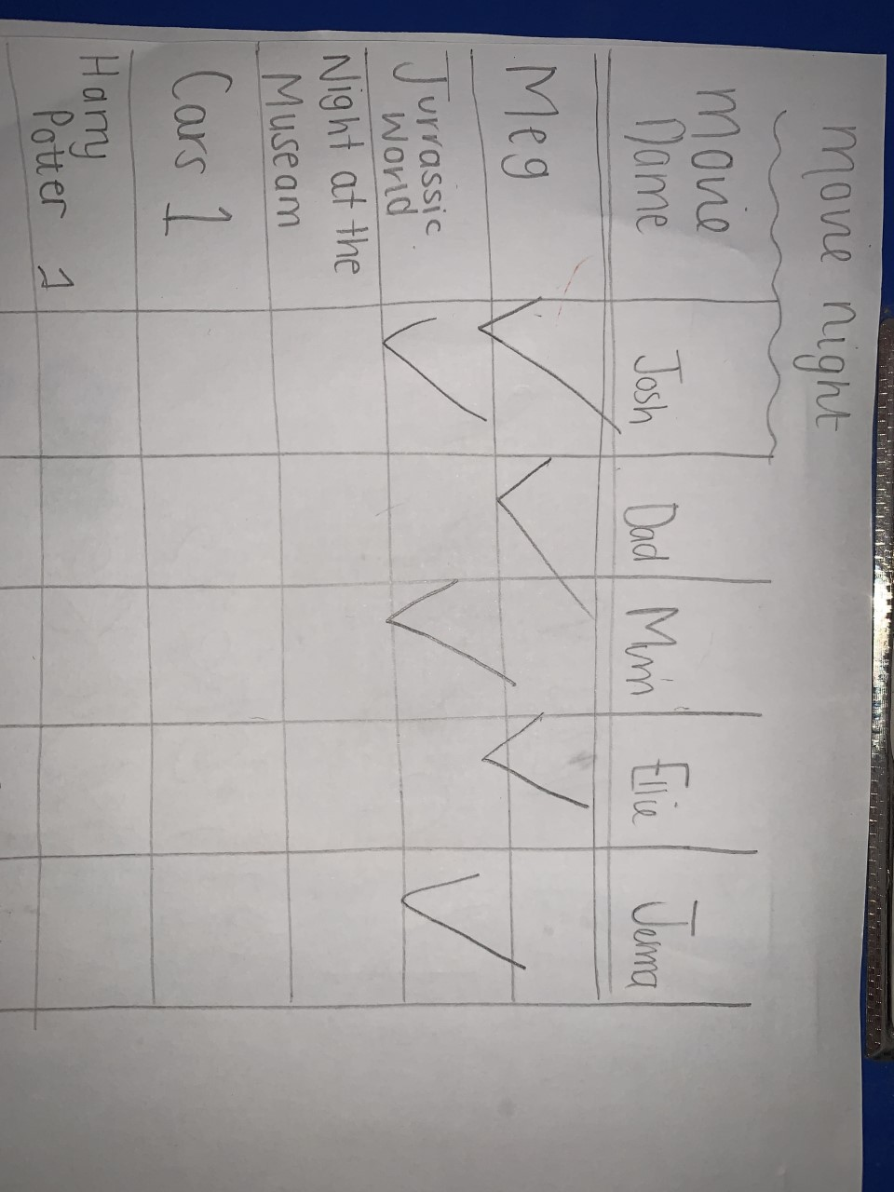
This week, your topic tasks are all about preparing for a Friday Family Movie Night!
Task 1
Task 1 – Choose 3 movies in your house that you think your family
would enjoy.
Task 2 – Create a table and complete a survey to find out the most popular movie. Make sure you ask all your family members for their opinions.
Task 3 – Look at the results of the survey and the movie with the most votes is the winner.
Your table might look like this

Slide 16
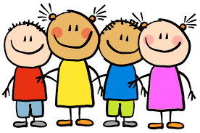
Enjoy the rest of your day Primary 2/3!

