Slide 1


Slide 2
What is a Leader ?
Leaders make good choices
Leaders plan
Leaders get along with others
Leaders use their talents and strengths to solve problems

Slide 3

Who can be a leader ?
Everyone can be a leader…
…even you!

Slide 4
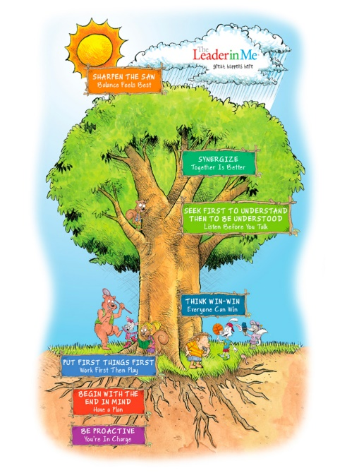
What tools does a good leader need to have ?
A good leader needs to develop good habits
There are 7 Habits you can learn that will help you to become a good leader

Slide 5
The Leader in Me will teach you how to:
1 Think about your choices before you make them
2. Plan ahead
3. Get along with others
4. Use your strengths and talents to solve problems

Slide 6

The 7 Habits

Slide 7
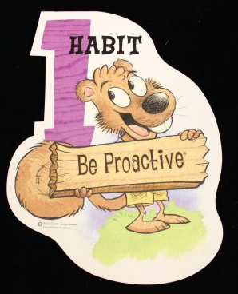
Habit 1
Be Proactive

Slide 8
Habit 1
Be Proactive
I am a responsible person. I take initiative.
I choose my actions, attitudes and moods.
I do not blame others for my wrong actions.
I do the right thing without being asked,
even when no-one is looking.

Slide 9
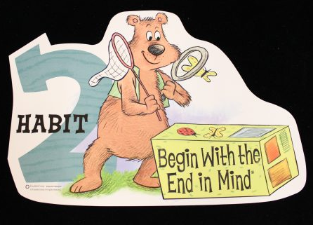
Habit 2
Begin with the end in mind

Slide 10
Habit 2
Begin with the end in mind
I plan ahead and set goals.
I do things that have meaning and make a difference.
I am an important part of my classroom and contribute to my schools vision and value.
I look for ways to be a good citizen.

Slide 11
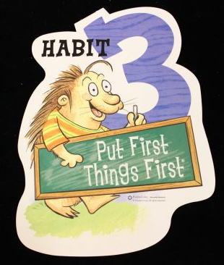
Habit 3
Put First things First

Slide 12
Habit 3
Put First things First
I spend my time on things that are most important.
This means I say no to things I know I should not do.
I set priorities, make a schedule and follow my plan.
I am disciplined and organised.

Slide 13
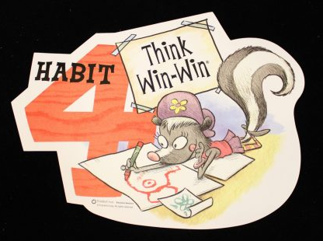
Habit 4
Think Win -Win

Slide 14
Habit 4
Think Win -Win
I balance courage for getting what I want with consideration for what others want.
When conflicts arise, I look for a win-win situation.

Slide 15
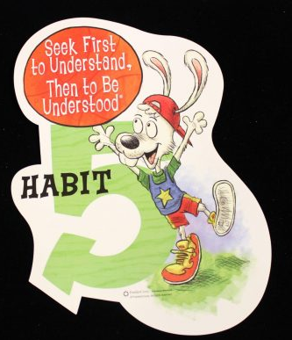
Habit 5
Seek first to Understand,
Then to be Understood

Slide 16
Habit 5
Seek first to Understand,
Then to be Understood
I listen to other people’s ideas and feelings. I try to see things from their viewpoint (paradigm).
I listen to others without interrupting.
I listen with my ears, my eyes and my heart.
I am confident at voicing my ideas.

Slide 17

Habit 6
Synergize

Slide 18
Habit 6
Synergize
I value other people’s strengths and learn from them.
I get along well with others, even people who are different than me.
I work well in groups.
I seek out other people’s ideas because I know that teaming with others, we can create better solutions than what any of us could do alone.
I look for third alternatives.

Slide 19
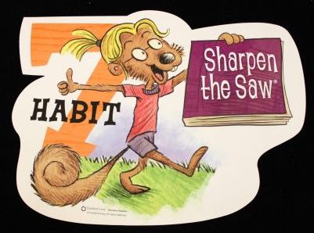
Habit 7
Sharpen the Saw

Slide 20
Habit 7
Sharpen the Saw
I eat right, exercise and get enough sleep (body).
I learn in lots of different ways and lots of places, not just at school (brain).
I spend time with family and friends (heart).
I take time to find meaningful ways to help people (soul).
I balance all 4 parts of myself.

Slide 21
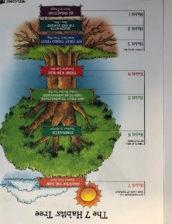
The 7 Habits Tree

Slide 22
Learning the Habits
Over the coming days, you will be learning about the 7 habits.
You will take part in a range of activities that will encourage you to develop an awareness of these leadership skills.
This will begin your journey of developing the Leader in You!

