Slide 1
Friday 8th May

Slide 2
Timetable
Daily exercise
French starter
Spelling
reading
Maths Quiz
Health and Wellbeing

Slide 3
Daily Exercise
I am learning to move our body well, exploring how to manage and control it, finding out how to use and share space.
I have been going out a daily walk to look at the new plants growing. If you can get outside for some fresh air that would be great. Remember to only do this if it is okay with parents. If not I have attached below the link to Joe Wicks workouts. I have been trying these myself at home!
https://www.youtube.com/watch?v=Na1rzigYlSU

Slide 4
French
Bonjour la class! Ca Va?
Quelle est la date aujourd’hui?
Can you write the following colours in French?
Pink, red, blue, green, yellow, black, brown, purple, orange and white?

Slide 5
Spelling
Make as many silly sentences you can using your common words.

Slide 6
Reading I am learning to create a visual picture of a character
Think of the book you are reading at home. Can you draw and label a character from your book. Think how they are described in the book by the author and other characters.
Think of describing words to do this. For example if you think the person is described as small could you change it to another word, such as little or petite?

Slide 7
Maths Quiz
Choose one column to complete.

Slide 8
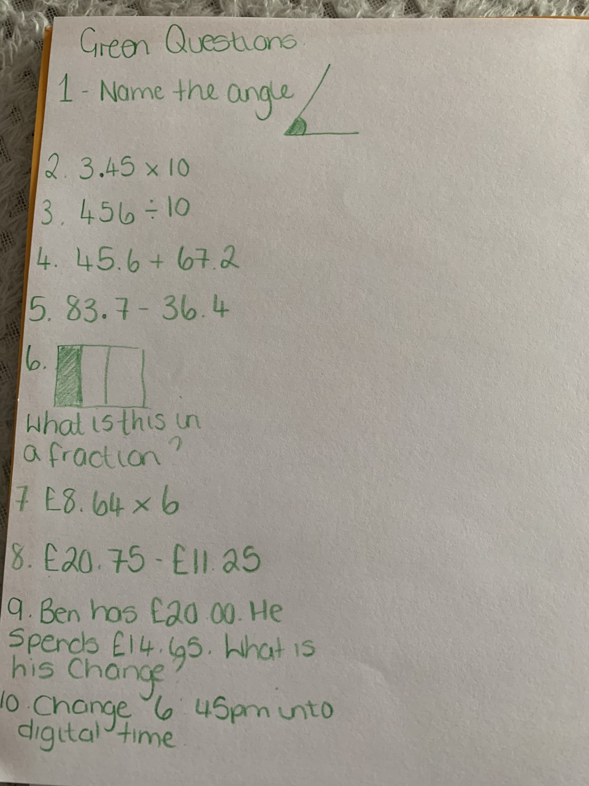
Green

Slide 9
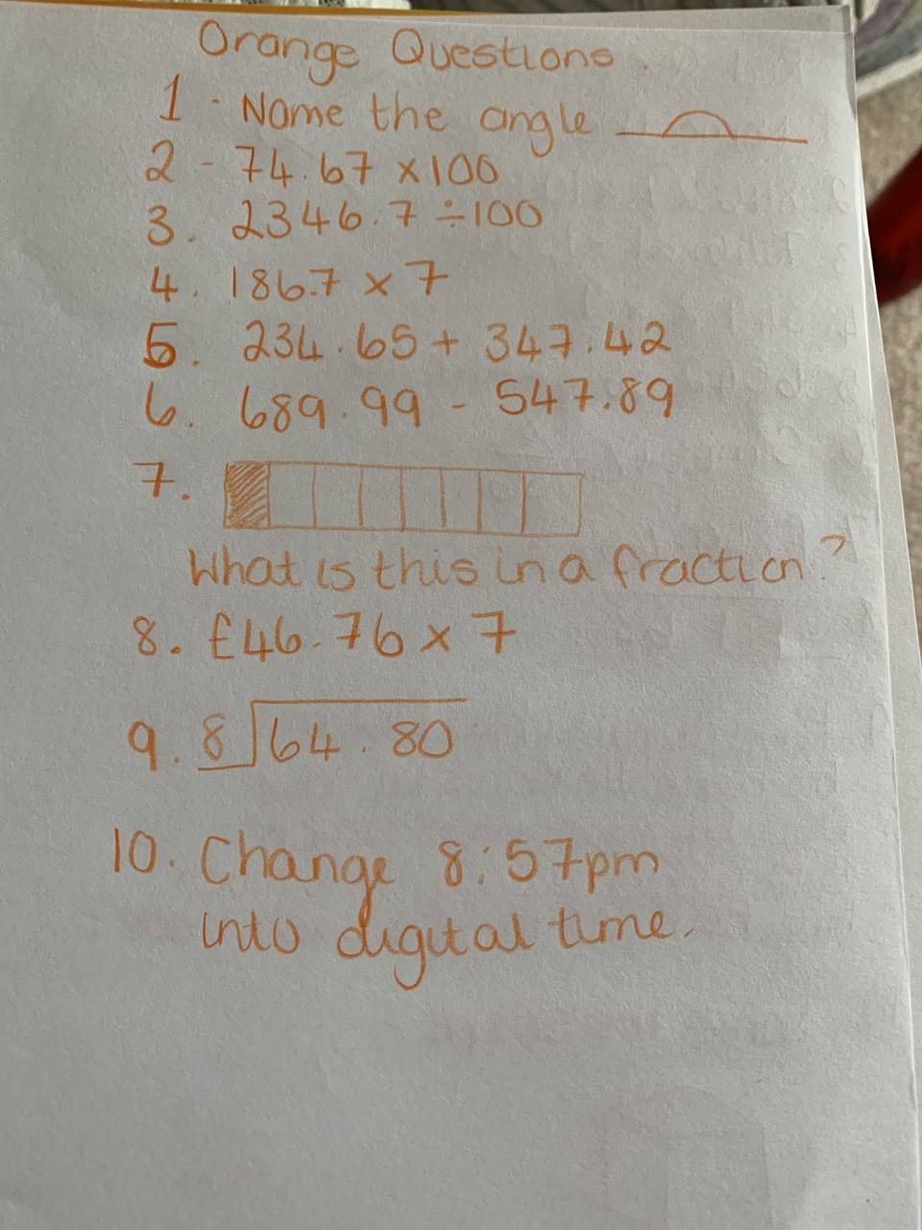
Orange

Slide 10
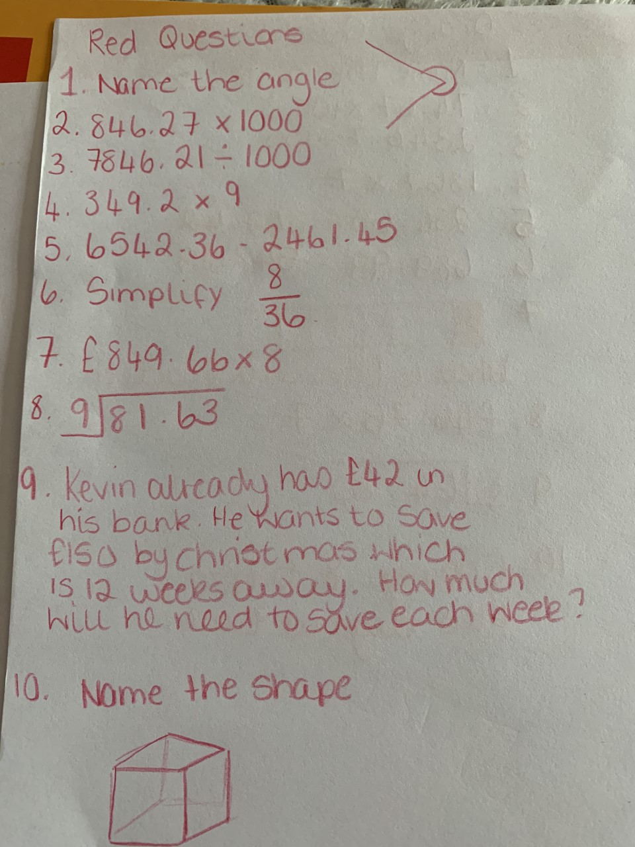
Red

Slide 11
Health and Wellbeing
We have looked at the SHANARRI indicators within class. Today we are going to focus on Healthy.
Talk to an adult how about how an unhealthy diet and lifestyle can negatively affect your heart. Identify three “super foods” for your heart and research why these foods can keep you healthy and prolong your life.

