Slide 1
Friday 8th may 2020
Home learning

Slide 2
Daily French writing
Copy this into your green jotter.
Aujord’hui c’est vendredi huit mai.
Today is Friday 8th May
Il fait nuageuse.
The weather is cloudy.
Je suis content(e)
I am good
Je suis d’accord
I am okay
Je suis mal
I am not well

Slide 3
Morning starter
Find the Maths Quiz in teams in assignments.
Choose to do either Green, Amber or Red.

Slide 4
Literacy task board
DAVID WALLIAMS
Spelling Task – Dictation
Handwriting
ROALD DAHL
Spelling Task – Dictation
Handwriting
TOM FLETCHER
Spelling Task – Dictation
Handwriting

Slide 5
Writing task
Use the Success Criteria to either Self, Peer and Teacher mark your writing. (Groups in next slide).
Genre: Report
L.I. – I can create a newspaper report after conducting an interview.
Success Criteria – Primary 4 and David Walliams Group
Understand why I am writing and who will read my report (audience and purpose).
Include a title to interest/inform the reader about the subject.
Write an opening paragraph that tells the reader what my report is about.
Use topic vocabularly.
Group facts together.
Give each section of my report a sub-heading and write the facts about that subject in paragraphs using my own words.
Aim to write 3 or more paragraphs in my report.
End the report by bringing the main information together.
Include pictures/photos/diagrams to tell the reader more information.
Success Criteria – Primary 5
Understand the purpose and audience.
Include a title to interest/inform the reader about the subject.
Include an introductory paragraph which gives information about the subject of the report.
Use the present tense verbs e.g. is, are, has, have.
Group facts together under headings and subheadings.
Use precise language, write a short paragraph under each subheading and include topic vocabulary. Use dictionary and thesaurus to extend vocabulary.
End the report by bringing the main information together.
Ensure the text is impersonal, no use of ‘I’ or ‘We’.
Can include pictures/photos/diagrams to give further information.
Acknowledge any sources of information I have used.

Slide 6
Groups for teacher, peer and self marking
On a Friday, we usually have our Writing Conference in which we mark our writing from the previous day. We split into three groups for this Teacher, Peer and Self.
Teacher marking – Group 1 – I will mark this groups writing. Please upload your work to assignments in teams so I can see it – you can even just add a picture of your jotter to the assignment.
Peer marking – Group 2 – You can with ask your writing partner in teams to mark it or get someone at home to mark your writing.
Self marking – Group 3 – You are marking your own piece of writing.

Slide 7
Writing partner groups
Group 1
Jessica and Megan
Bruce, Thomas and Jack R
Holly F and Maisie
Declan and Arran
Group 2
Holly C and Kelly
Fergus and Logan
Jack J and Callum
Peter and Franceska
Group 3
Katie and Gracie
Gary and Jack H
Cole and Fraser
Alfie and James

Slide 8
Maths task board
TRIANGLES
Maths Quiz
Big Maths – please find sheet in your pack.
CIRCLES
Maths Quiz
Big Maths – please find sheet in your pack.
SQUARES
Maths Quiz
Big Maths – please find sheet in your pack.

Slide 9
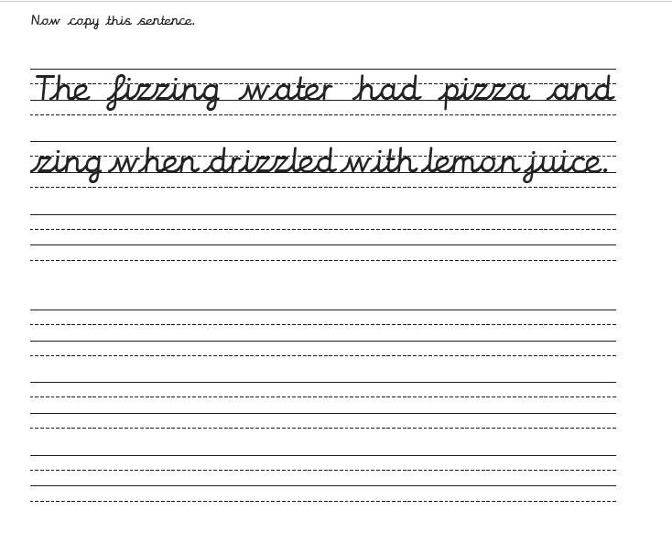
Handwriting

Slide 10
Dictation
Remember you can pause the audio if you need more time to write.
‘oi’ Dictation -
‘unit 4 - oe’ Dictation –
‘unit 11 - sh’ Dictation -

Slide 11
Target setting
As we come to the end of a learning week, please think about your target for next week.
What do you want to learn next week?
What do you want to improve next week?
How do you think you will improve next week?

Slide 12
Polls on teams
I am still looking for reponses to the three polls I put on teams. Can you make sure you answer them by the end of the day as I will go with the option that has the majority. The polls are about:
Self – evaluation
Assignments
Live lessons.

