Slide 1
Friday 8th of May
Good Morning Primary 3!
Bonjour la class! Ca Va?
Aujourd’hui c’est (Friday) 8th (May) 2020
Now watch the counting to 20 in French song. Maybe ask some family members to join in, remember to show them your cool moves!
https://www.youtube.com/watch?v=UsEz58BblMY

Slide 2
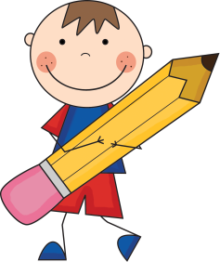
Literacy
LI: We are learning to use punctuation and spell common words correctly.
Below I have written some sentences but I think I might have made a few mistakes!
Can you copy the sentences into your jotter using the correct punctuation and spelling?
My littl sister ellie doesn’t like too much noise?
i bot my mum a woch for christmas.
I tryed to make bred but I didn’t have any flower.
there are eight days in week

Slide 3
Today is VE Day – ‘Victory in Europe’
VE stands for victory in Europe and marks the end of the Second World War on the 8th of May 1945.
Today marks the 75th anniversary and we remember all those people who had lost their lives during this time.
Watch: https://www.youtube.com/watch?v=4tYAK-PsqDk
Due to the coronavirus, celebrations will be different this year. We can mark this special anniversary by doing something in our homes.
Task – Can you make a soldier to display in your window?

Slide 4
My Family Tree
Can you fill out the family tree below with the names of members of your family?
Were any of your family alive during World War 2?
Gran
Grandad
Gran
Grandad
Mums Name
Dads Name
Your Name

Slide 5
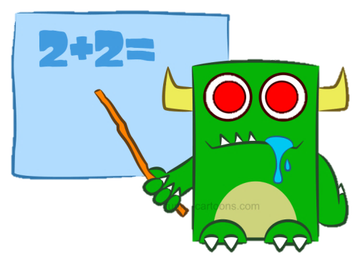
Numeracy
LI: We are learning to understand numbers and place value.
Activities
Can you read each number written below?
Can you work out what numbers are odd and what numbers are even?
Can you copy and circle (or point to) the tens column in each number?
CHALLE NGE - If you would like a challenge, try out these numbers
345
151
106
780
97
1613
1082
3401
1209

Slide 6
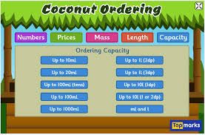
Numeracy
Today, you can choose the maths game you would like to complete.
Topmarks – Coconut Ordering https://www.topmarks.co.uk/ordering-and-sequencing/coconut-ordering
Topmarks – Hit the Button
https://www.topmarks.co.uk/maths-games/hit-the-button
Sumdog – Complete the times table challenge or complete 10 minutes of activities.

Slide 7
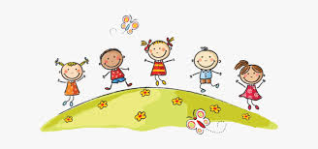
Well done Primary 3, you have completed your online learning for the week! Have fun weekend and stay safe ☺

