Slide 1
Friday ^{8th} of May
Good Morning Primary 2!
Bonjour la class! Ca Va?

Slide 2
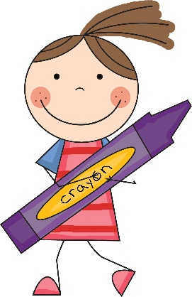
Literacy
L.I – We are learning to use our knowledge of common words and phonemes to spell, write and read words.
Watch - https://www.youtube.com/watch?v=3gFsszNp5RM
Activity - Dictation
Choose a dictated sentence from list in the pack.
Read slowly to your child and encourage them to write it independently in their jotter.
Tip – Help them sound out the letters in each word.
Remember core writing targets!

Slide 3
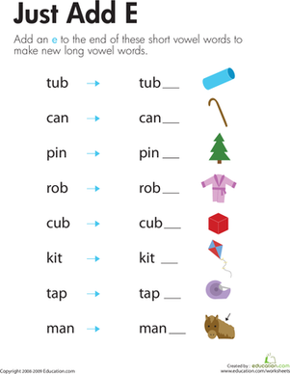
Reading
Read aloud with me! Click the speaker icon below

Slide 4
Relax and sing along
https://www.youtube.com/watch?v=C6ljGXMMB-g&list=RDC6ljGXMMB-g&start_radio=1

Slide 5
Mathematics Number Talk
The following screens will take you through todays number talk which is called the:
“Apple Vase”
This is part of the Esti-Mysteries by Steve Wyborney

Slide 6
How many apples are in the vase?
As the clues appear, use the information to narrow the possibilities to a smaller set. After each clue, use estimation again to determine which of the remaining answers is the most reasonable.
Write down your first estimate. After each clue, you’ll see if your estimate is still a possibility. After each clue, if it is no longer possible write down a new estimate – and be prepared to explain why you chose it.
Steve Wyborney
www.stevewyborney.com

Slide 7
Clue #1
Clue #1
The answer is less than 30.
Clue #2
Clue #2
Count by 2’s from 2 to 30. The answer is one of those numbers.
Clue #3
Clue #3
Cross off all the numbers
with only 1 digit.
Clue #4
Clue #4
The answer includes the digit 8.
1 | 2 | 3 | 4 | 5 | 6 | 7 | 8 | 9 | 10
11 | 12 | 13 | 14 | 15 | 16 | 17 | 18 | 19 | 20
21 | 22 | 23 | 24 | 25 | 26 | 27 | 28 | 29 | 30
1 | 2 | 3 | 4 | 5 | 6 | 7 | 8 | 9 | 10
11 | 12 | 13 | 14 | 15 | 16 | 17 | 18 | 19 | 20
21 | 22 | 23 | 24 | 25 | 26 | 27 | 28 | 29 | 30
1 | 2 | 3 | 4 | 5 | 6 | 7 | 8 | 9 | 10
11 | 12 | 13 | 14 | 15 | 16 | 17 | 18 | 19 | 20
21 | 22 | 23 | 24 | 25 | 26 | 27 | 28 | 29 | 30
1 | 2 | 3 | 4 | 5 | 6 | 7 | 8 | 9 | 10
11 | 12 | 13 | 14 | 15 | 16 | 17 | 18 | 19 | 20
21 | 22 | 23 | 24 | 25 | 26 | 27 | 28 | 29 | 30
Clue #5
Clue #5
There are now 2 numbers remaining. Which one do you think is the answer?
Steve Wyborney
www.stevewyborney.com

Slide 8
After seeing the clues, you have narrowed the possibilities to a small set of numbers. Before you see the answer, select your final estimate. Write it down, and explain to someone why you chose that number.
1 | 2 | 3 | 4 | 5 | 6 | 7 | 8 | 9 | 10
11 | 12 | 13 | 14 | 15 | 16 | 17 | 18 | 19 | 20
21 | 22 | 23 | 24 | 25 | 26 | 27 | 28 | 29 | 30
Steve Wyborney
www.stevewyborney.com

Slide 9
The Reveal
Click to see the answer.
28 apples
1 | 2 | 3 | 4 | 5 | 6 | 7 | 8 | 9 | 10
11 | 12 | 13 | 14 | 15 | 16 | 17 | 18 | 19 | 20
21 | 22 | 23 | 24 | 25 | 26 | 27 | 28 | 29 | 30
Steve Wyborney
www.stevewyborney.com

Slide 10
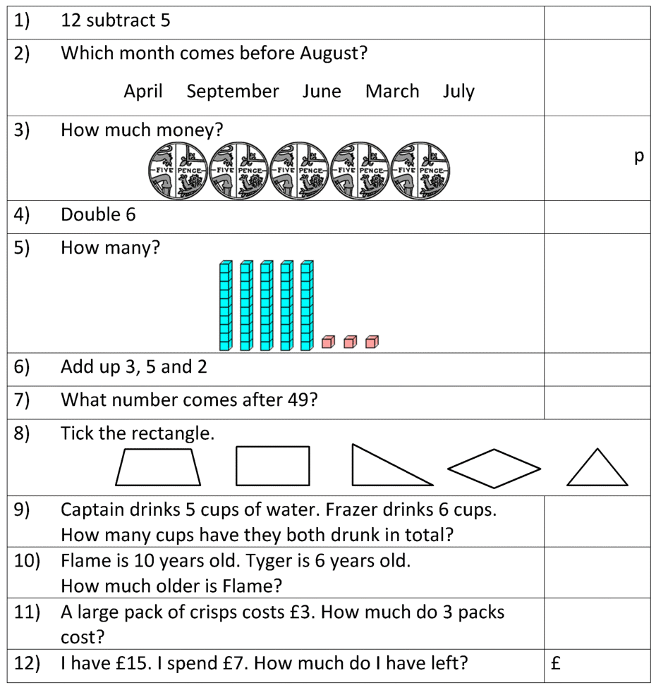
Can you complete these number questions in you jotter? *I have also provided this as a file if you wish to print it off

Slide 11
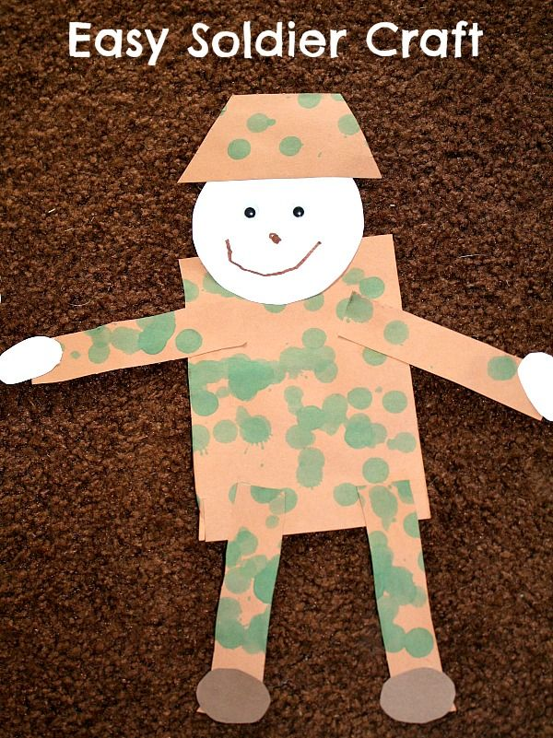
Today is VE Day – ‘Victory in Europe’
* Task - Can you make a soldier to display in your window?
VE day stands for victory in Europe and marks the end of the Second World War in Europe on the 8th May 1945.
Today marks the 75th anniversary and we remember all those people who lost their lives during this time.
Watch:
https://www.youtube.com/watch?v=4tYAK-PsqDk
Due to the coronavirus, celebrations will be different this year. We can to mark this special anniversary by doing something in our own homes.

Slide 12
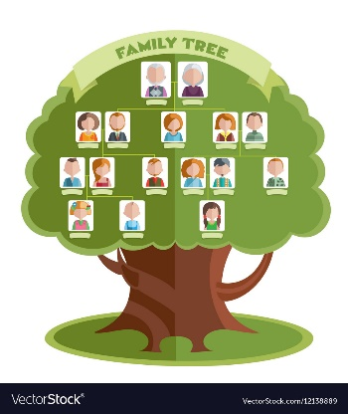
My Family Tree
Can you fill out the family tree below with the names of members of your family? Were any of your family alive during World War 2?
gran
grandad
gran
grandad
Mums Name
Dads name
Your name

Slide 13
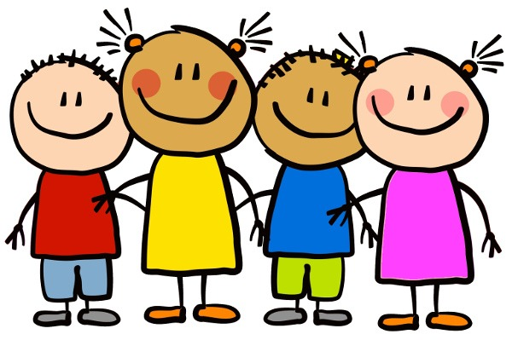
Have a lovely weekend and we will be back with more activities and lessons on Monday.

