Slide 1
Friday 8th of May
Good Morning Primary 2/3!
French: Bonjour la class! Ca Va?
Quelle est la date aujourd’hui?
Aujourd’hui cest V______ 8th Mai 2020
Listen to this French body parts song
https://www.youtube.com/watch?v=bChrAwLzoSo

Slide 2
Literacy
LI: To use my phoneme and common word knowledge to spell accurately.
Watch: Magic e rap https://www.youtube.com/watch?v=3gFsszNp5RM
Day 5 activity: Sentence Dictation
Choose a dictation sentence from the list in the pack
Read aloud the sentence to your child first, for them to listen to it
in full.
Then re-read sentence again slowly, word by word(sounding out where necessary), allowing the child to write down each word independently.
Please encourage your child to:
- Have a go.
Think about what sounds can they hear in the word and chunk it into sounds they know.
Remember their core writing targets- full stops, capital letters, finger spaces.

Slide 3
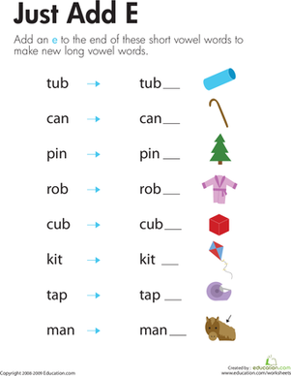
Reading
Read aloud with me! Click the speaker icon below

Slide 4
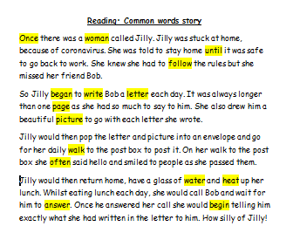
Stage 3: Reading
Your common words
Read aloud with me!
Click on the speaker icon below….

Slide 5
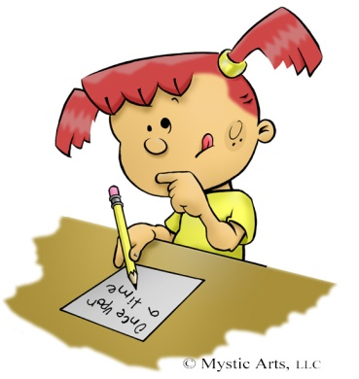
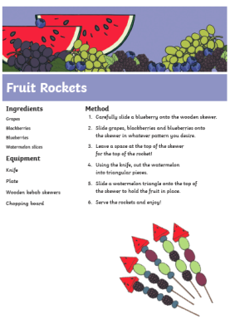
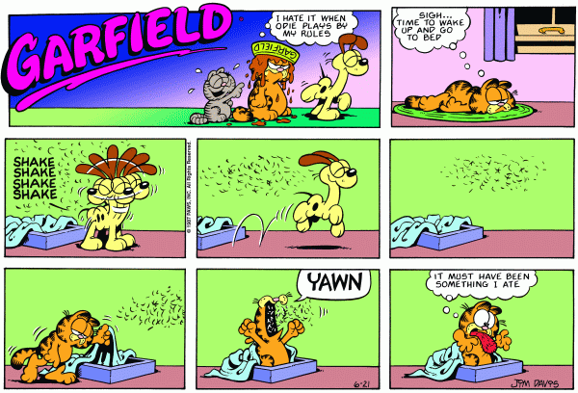
Literacy-Free Writing Friday
LI: To create a text of my choice
Set 15 minutes on a timer. Maybe your adult could do free writing at the same time as you?
Decide what type of writing you would like to do.
Collect all the writing tools you need to complete the task in time.
When the timer is up, share what you have done with each other.
Don’t forget you can send a picture of your work to our twitter! I would love you to share what you have written with me on our school twitter page!

Slide 6
Mathematics Number Talk
The following screens will take you through todays number talk which is called the:
“Apple Vase”
This is part of the Esti-Mysteries by Steve Wyborney

Slide 7
How many apples are in the vase?
As the clues appear, use the information to narrow the possibilities to a smaller set. After each clue, use estimation again to determine which of the remaining answers is the most reasonable.
Write down your first estimate. After each clue, you’ll see if your estimate is still a possibility. After each clue, if it is no longer possible write down a new estimate – and be prepared to explain why you chose it.
Steve Wyborney
www.stevewyborney.com

Slide 8
Clue #1
Clue #1
The answer is less than 30.
Clue #2
Clue #2
Count by 2’s from 2 to 30. The answer is one of those numbers.
Clue #3
Clue #3
Cross off all the numbers
with only 1 digit.
Clue #4
Clue #4
The answer includes the digit 8.
1 | 2 | 3 | 4 | 5 | 6 | 7 | 8 | 9 | 10
11 | 12 | 13 | 14 | 15 | 16 | 17 | 18 | 19 | 20
21 | 22 | 23 | 24 | 25 | 26 | 27 | 28 | 29 | 30
1 | 2 | 3 | 4 | 5 | 6 | 7 | 8 | 9 | 10
11 | 12 | 13 | 14 | 15 | 16 | 17 | 18 | 19 | 20
21 | 22 | 23 | 24 | 25 | 26 | 27 | 28 | 29 | 30
1 | 2 | 3 | 4 | 5 | 6 | 7 | 8 | 9 | 10
11 | 12 | 13 | 14 | 15 | 16 | 17 | 18 | 19 | 20
21 | 22 | 23 | 24 | 25 | 26 | 27 | 28 | 29 | 30
1 | 2 | 3 | 4 | 5 | 6 | 7 | 8 | 9 | 10
11 | 12 | 13 | 14 | 15 | 16 | 17 | 18 | 19 | 20
21 | 22 | 23 | 24 | 25 | 26 | 27 | 28 | 29 | 30
Clue #5
Clue #5
There are now 2 numbers remaining. Which one do you think is the answer?
Steve Wyborney
www.stevewyborney.com

Slide 9
After seeing the clues, you have narrowed the possibilities to a small set of numbers. Before you see the answer, select your final estimate. Write it down, and explain to someone why you chose that number.
1 | 2 | 3 | 4 | 5 | 6 | 7 | 8 | 9 | 10
11 | 12 | 13 | 14 | 15 | 16 | 17 | 18 | 19 | 20
21 | 22 | 23 | 24 | 25 | 26 | 27 | 28 | 29 | 30
Steve Wyborney
www.stevewyborney.com

Slide 10
The Reveal
Click to see the answer.
28 apples
1 | 2 | 3 | 4 | 5 | 6 | 7 | 8 | 9 | 10
11 | 12 | 13 | 14 | 15 | 16 | 17 | 18 | 19 | 20
21 | 22 | 23 | 24 | 25 | 26 | 27 | 28 | 29 | 30
Steve Wyborney
www.stevewyborney.com

Slide 11
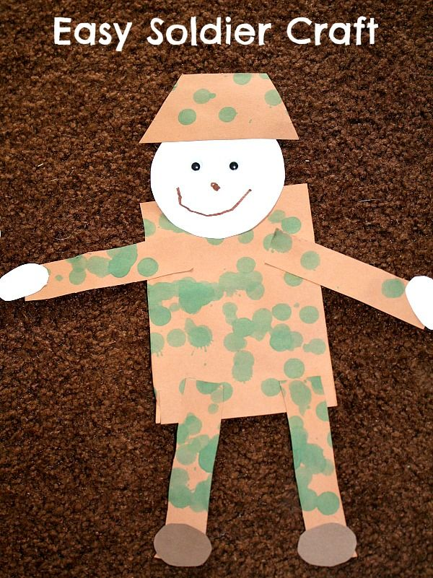
Today is VE Day – ‘Victory in Europe’
Task - Can you make a soldier to display in your window?
VE day stands for victory in Europe and marks the end of the Second World War in Europe on the 8th May 1945.
Today marks the 75th anniversary and we remember all those people who lost their lives during this time.
Watch:
https://www.youtube.com/watch?v=4tYAK-PsqDk
Due to the coronavirus, celebrations will be different this year. We can to mark this special anniversary by doing something in our own homes.

Slide 12
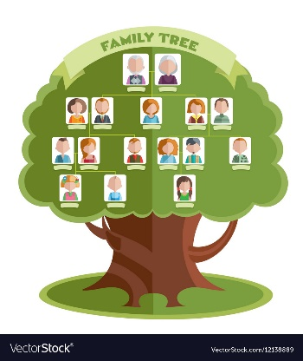
My Family Tree
Can you fill out the family tree below with the names of members of your family? Were any of your family alive during World War 2?
gran
grandad
gran
grandad
Mums Name
Dads name
Your name

Slide 13
Well Done Primary 2/3 families! You have completed another week of online learning! Enjoy your weekend everyone. I will be ready to welcome you back on Monday morning. Mrs Doghudje

