Slide 1

Thursday 07th April
Good Morning Primary 4!
French: Bonjour la class! Ca Va?
Quelle est la date aujourd’hui?
Aujourd’hui cest Jeudi 07th Mai 2020
Now watch the months of the year song in French :
https://www.youtube.com/watch?v=7_u2SigckNQ

Slide 2

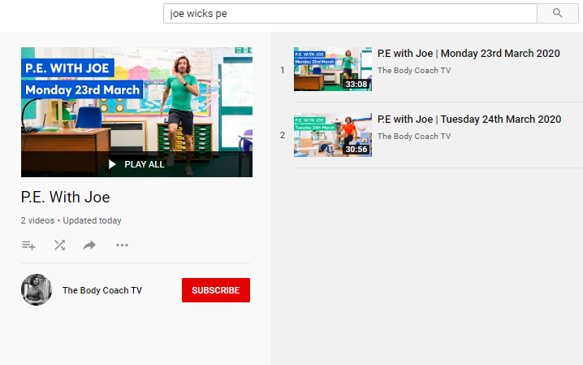
Health and Wellbeing
LI: We are learning to move our body well, exploring how to manage and control it, finding out how to use and share space.
P.E with Joe- Thursday 07th May Video
(he is nearly as fun as Mr Martin, not quite, but nearly)
https://www.youtube.com/playlist?list=PLyCLoPd4VxBvQafyve889qVcPxYEjdSTl

Slide 3

Reading
L.I I am using different reading strategies to help me understand my book
David Walliams: Hedgehog hotel (Use your garden – if you are able to – instead of school grounds). If you don’t have an outside space, you could design a hotel on paper.
Roald Dahl: Chapter 10 – Visualiser
Tom Fletcher: Chapter 1 – Visualiser

Slide 4

Writing (slide 1)
L.I I can write a non-fiction report
There are two types of writing – fiction and non-fiction.
Fiction is a made up story. A fictional story often has made up characters, places and events. Fiction writing can include fairy tales and fantasy adventures!
Non-fiction is about real-life people / places / things / events. Non-fiction writing can include instruction manuals, newspapers and fact files!
Watch this video (and try the activities) to learn more about FICTION and NON-FICTION:
https://www.bbc.co.uk/bitesize/topics/z2yycdm/articles/zty8xfr

Slide 5
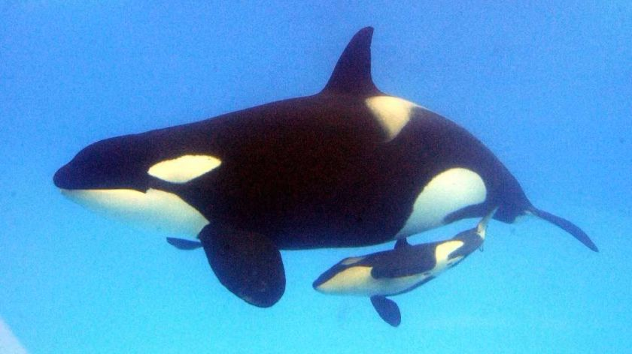
Writing (slide 2)
L.I I can write a non-fiction report
Task: Today’s task is to write a non-fiction report about a topic of your choice! Challenge – can you type your report on the laptop? Don’t worry if you can’t manage this – write it in your jotter if that’s easier!
HINT: Think about something that really interests you, and use the internet to find out some facts about it. Then, write these facts down in a report.
See the next slide for an example. I have started to write a report on something that I find interesting…
ORCA WHALES!

Slide 6
Writing (slide 3)
L.I I can write a non-fiction report
07/05/20 Orca Whales
When I was 12, I went on holiday to Canada with my family. We went on a whale watching trip and I saw wild orca whales! These are also known as killer whales. It was so exciting. I have loved orca whales ever since my trip, which is why I have decided to write my report on these amazing creatures.
How big are orca’s
Orcas are the largest member of the Dolphin family. Males are larger than females and they often grow to between 5.8 and 6.7 metres in length. The largest male on record was 9.8 metres long – that’s longer than a bus!
To read the rest of my report, download it from Teams or the Blog! Go to ‘Files’ / ‘Class Materials’.

Slide 7
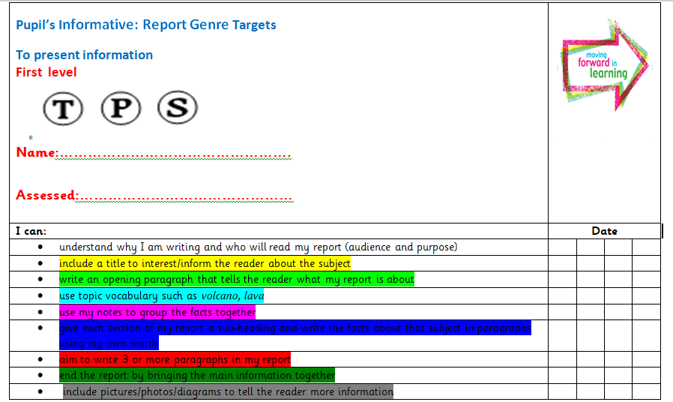

Writing (slide 4)
L.I I can write a persuasive exposition to argue my point
When I wrote my report on Orca’s, I used the Success Criteria to help me structure my work!
Please download the Success Criteria and my example from Teams or the blog and read them BEFORE you start your piece of writing.
I have highlighted the SC to match my own work – please look at them before you start your own piece of writing!

Slide 8
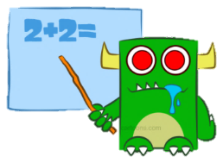
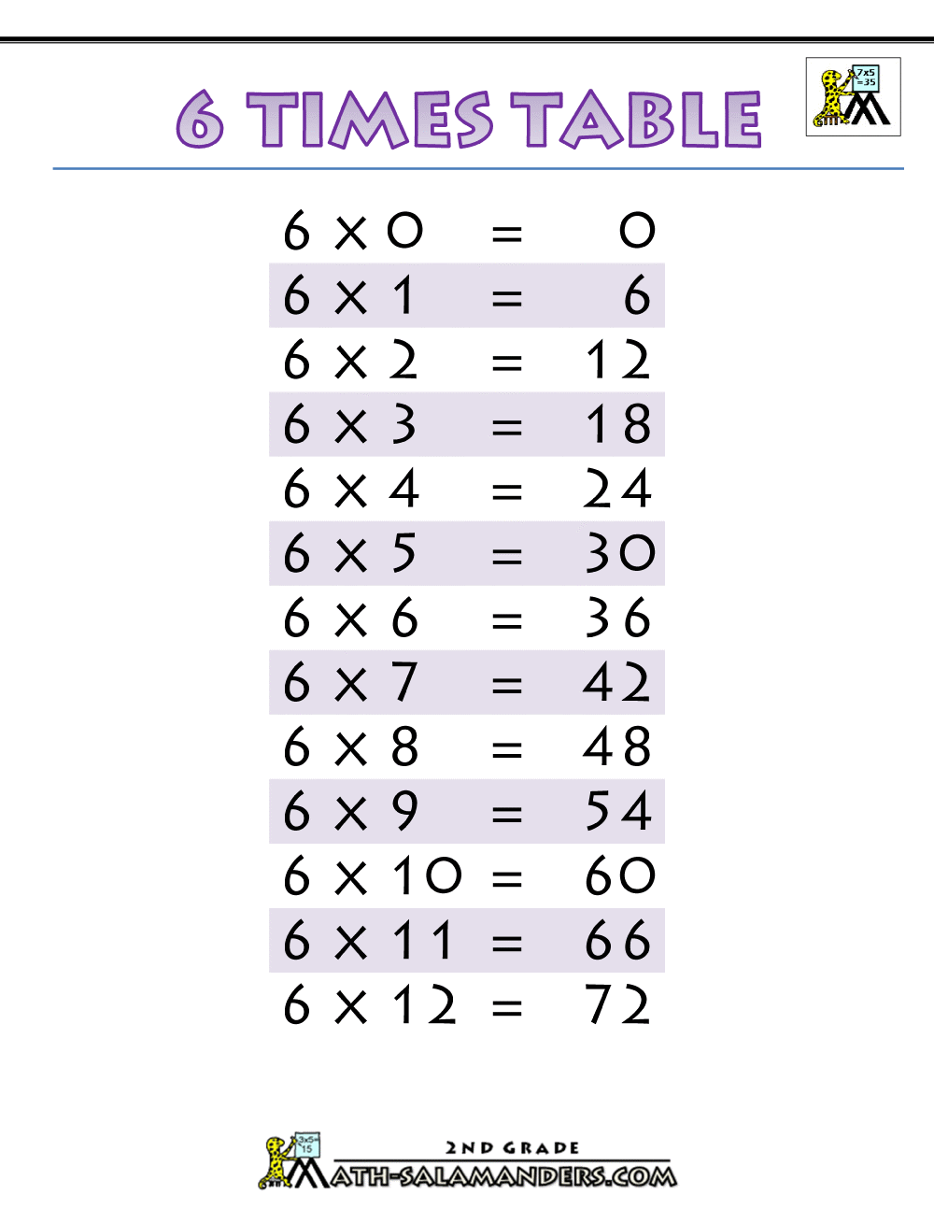

Maths (Slide 1)
L.I. I am learning the 6 x table
Yesterday, you started to practise the 6 x table!
TASK: Today, I want you to try and answer some 6 x table questions.
See the next slide for your questions. Please write the answers in your jotter.

Slide 9
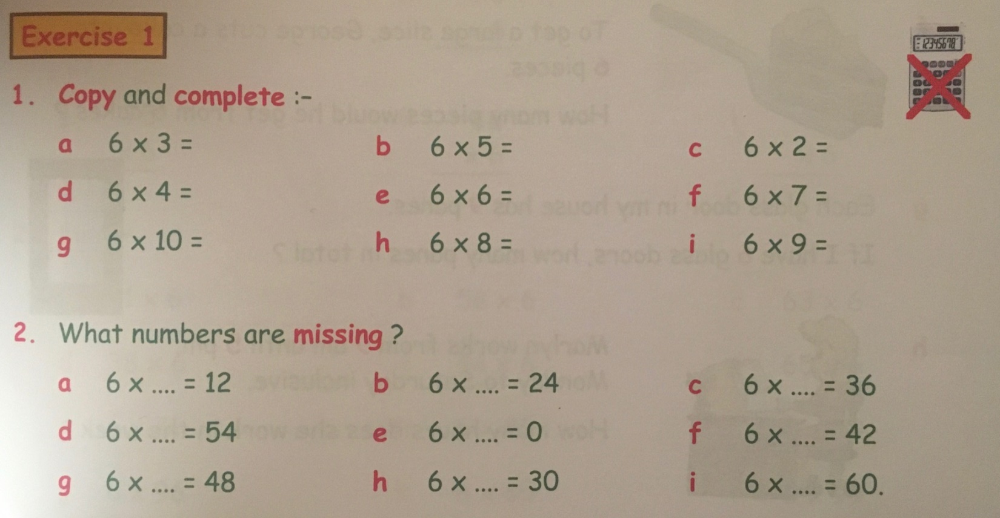
Maths (Slide 2)
L.I. I am learning the 6 x table
TASK: Answer these questions in your jotter. You can use your 6 x table on the previous slide to help but try not to use a calculator!

Slide 10

Feel free to leave comments / questions on Teams throughout the day and I will try my best to get back to you.
Enjoy your day, Primary 4!

