Slide 1
Thursday 7th of May
Good Morning Primary 1!
Sing the days of the week and have a little dance
https://www.youtube.com/watch?v=VD6SCq-OlhI
Sing days of the week in French
https://www.youtube.com/watch?v=Lpwf5N0rfVE

Slide 2
French
L.I - We are learning to say our age in French
warm up – say numbers to 10 in French
Can you work out the ages of the children in the video?
Watch
https://www.youtube.com/watch?v=4WksvcV6vU0
Quel age a tu?
J’ai ______ans.

Slide 3
Today’s story – is all about another inventor. https://www.youtube.com/watch?v=GxHwWqcoomo

Slide 4
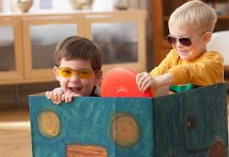
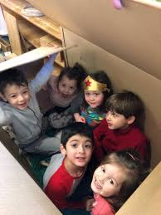
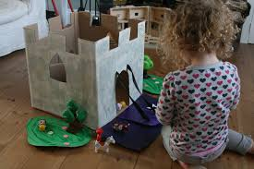
Writing – My Incredible New Toy
L.I- To write an imaginary story about your new toy
What did your box become?
Today you are going to write an imaginative story about an adventure you had with your new toy .
Helpful reminders
Think about WHO WHAT WHERE WHEN WHY when composing your story.
Share YOUR IDEAS before you start.
Get help with tricky words but DON’T WORRY give the words a go!
Remember CAPITAL LETTERS, FULL STOPS AND FINGER SPACES

Slide 5
Estimating
(Read through the next few slides with your child then watch the video at the end)
Estimation is a Skill for Life
As you walk around and live your life, imagine if you could easily estimate:
How much your shopping will cost.
Which item is the best value for money.
The size, areas and angles of things.
How many cars on a street/people in a room.
We are not talking exact answers here, but answers that are good enough for your life.

Slide 6
Estimating
Estimation is ...
... finding a number that is close enough to the right answer.
You are not trying to get the exact right answer. What you want is something that is good enough (usually in a hurry!)

Slide 7
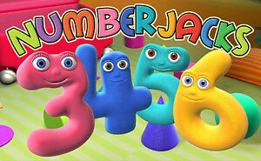
Estimating
https://www.youtube.com/watch?v=ygO4la2Ljug

Slide 8
Mathematics Number Talk
On the next couple of slides you are to estimate (make a good guess) how many balls are in the glass.
As it is a number talk, tell your adult why you think it is the number that you are guessing each time.
Tip- For the slides to work you must be view the PowerPoint as a slide show.

Slide 9
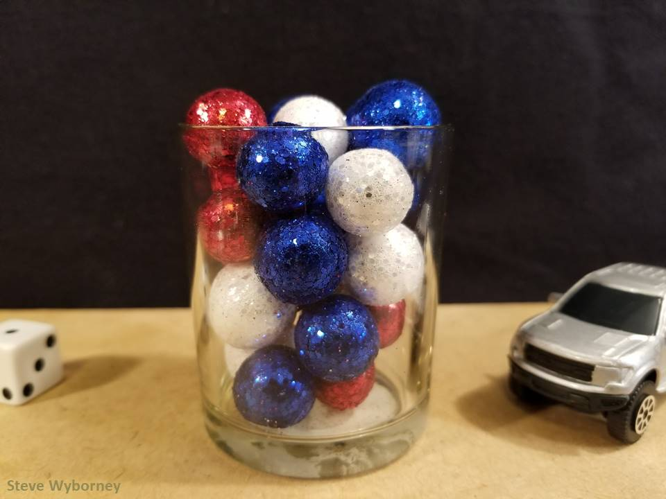
How many objects are in the container?
The Reveal
24 objects
www.stevewyborney.com

Slide 10
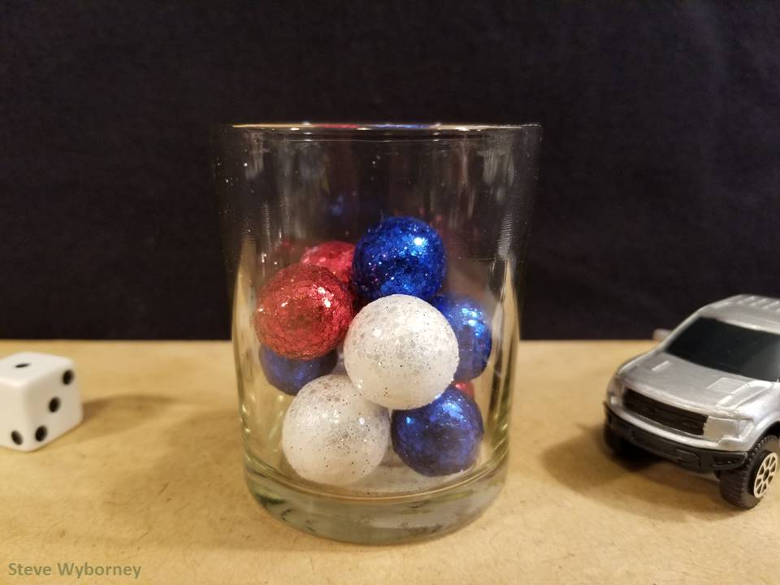
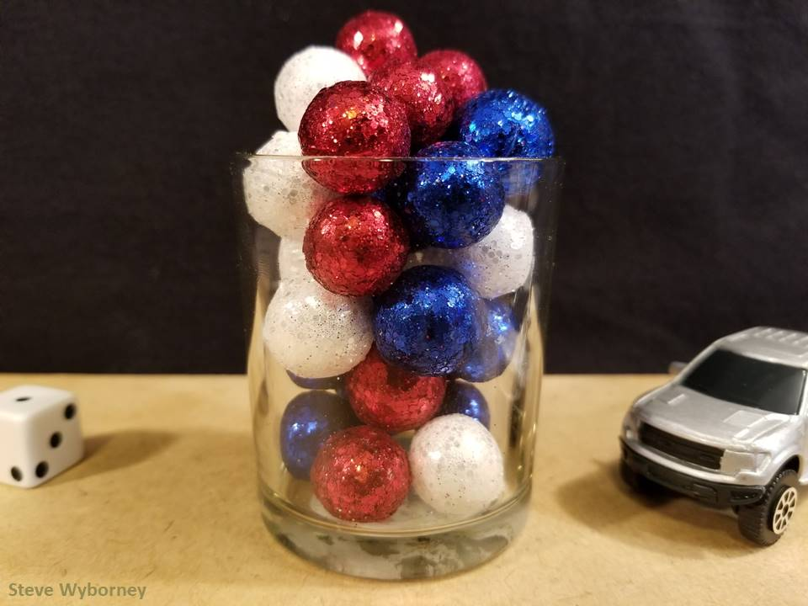
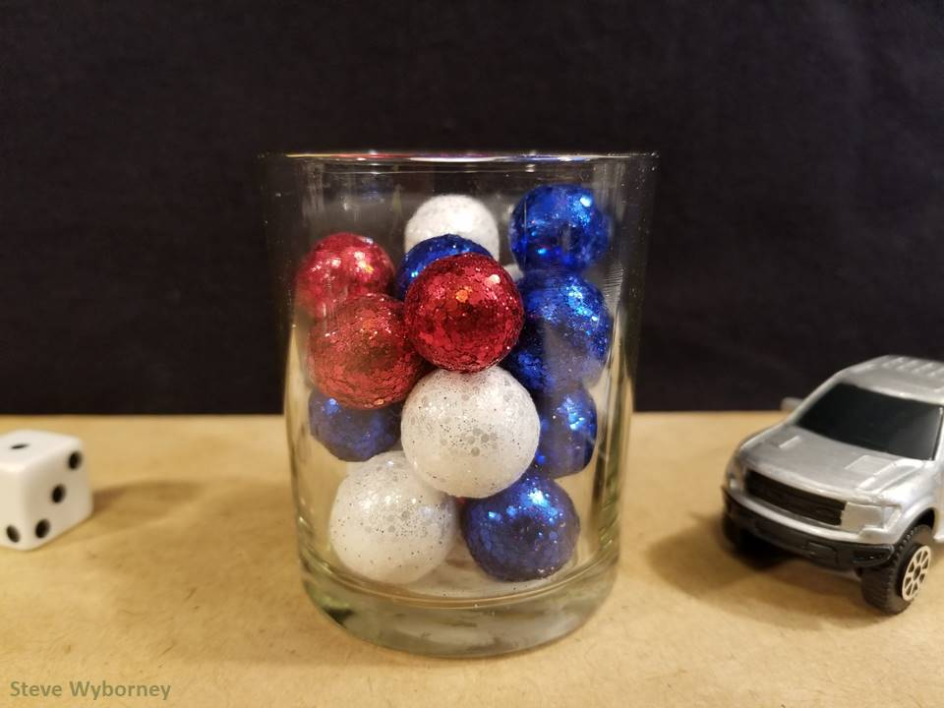
24 objects
11 objects
The Reveal
29 objects
The Reveal
17 objects
The Reveal
www.stevewyborney.com

Slide 11
May is the month of Mary
Why is Our Lady so important?
https://www.youtube.com/watch?v=wyHesSI-J0o
Mary was the mother of Jesus. When Jesus died Mary helped and looked after the other disciples the way our mothers look after us.
Mary wants to be our mother too and we can ask for her help, just as we would ask our own mother’s for help.
We can pray to Our Lady by saying The Rosary. We began to do this together in school last term.

Slide 12
The Rosary
You will find a guide to the rosary here:
https://childrensrosary.org/?page_id=2049&lang=en
You will find hymns to Mary here:
https://www.youtube.com/watch?v=KLpIexoF-1A
https://www.youtube.com/watch?v=GaDeqSotwoc
You may want to listen to these after you pray the rosary.
Praying brings us all together.
You could try saying a decade a day throughout May, with your family.

Slide 13
Leave a comment on the blog about what you learned today. Enjoy the rest of your day Primary 1!

