Slide 1
Thursday 7th of May Good Morning Primary 3!
Bonjour la class! Ca Va?
Aujourd’hui c’est (J……..) 7th (M…….) 2020.
In class, we got really good at our French colours.
Watch this short video to refresh your memory:
https://www.youtube.com/watch?v=zduapTwsSwA

Slide 2
Reading Comprehension
LI: We are learning to read fluently and answer simple questions about what we have read.
I have attached the reading comprehension worksheets to this blog post. You can look at them online or print them off. In the worksheet, there are 3 reading activities.
Please choose the actvity which is best suited to your child. If you look at the bottom of each page, there are stars.
1 Star = easy, 2 Stars = medium, 3 Stars = tricky.
Activities
Read through the chosen activity together.
Are there any words that you don’t know the meaning of? How could you find out what they mean?
Answer the questions at the bottom of the sheet. You can do this orally or write the answers in your jotter (the answers are also attached to this worksheet).

Slide 3
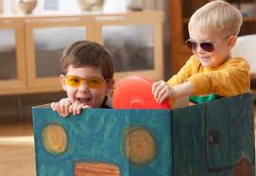
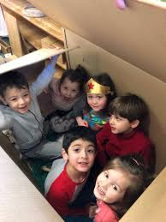
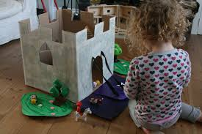
Literacy - Writing
We are learning to write an imaginary story about your new toy.
What did your box become?
Today you are going to write an imaginative story about an adventure you had with your new toy.
Helpful reminders
Think about WHO WHAT WHERE WHEN WHY when composing your story.
Share YOUR IDEAS before you start.
Get help with tricky words but DON’T WORRY give the words a go!
Remember CAPITAL LETTERS, FULL STOPS AND FINGER SPACES

Slide 4
Story
Todays story is all about another inventor
Violet the Pilot
Written by Steve Breen
https://www.youtube.com/watch?v=GxHwWqcoomo

Slide 5
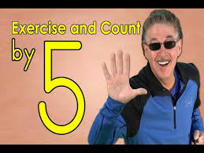
Numeracy – Warm Up
LI: We are revising counting in 5s and keeping active.
Jack Hartmann - Exercise and Count By 5
https://www.youtube.com/watch?v=amxVL9KUmq8

Slide 6
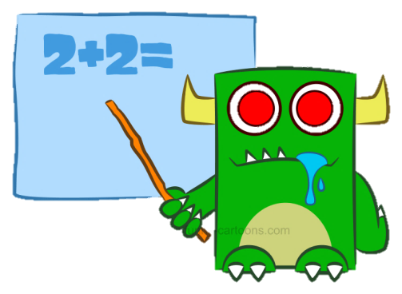
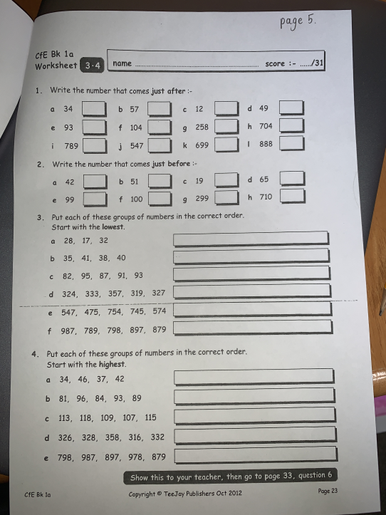
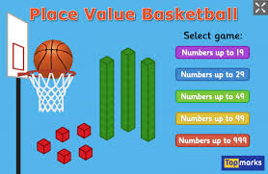
Numeracy Activities
LI: We are learning to understand place value.
Number and Place Value Workbook
Page 5
Topmarks – Place Value Basket Ball
https://www.topmarks.co.uk/place-value/place-value-charts

Slide 7
May is the month of Mary
Why is Our Lady so important?
https://www.youtube.com/watch?v=wyHesSI-J0o
Mary was the mother of Jesus. When Jesus died Mary helped and looked after the other disciples the way our mothers look after us.
Mary wants to be our mother too and we can ask for her help, just as we would ask our own mother’s for help.
We can pray to Our Lady by saying The Rosary. We began to do this together in school last term.

Slide 8
The Rosary
You will find a guide to the rosary here:
https://childrensrosary.org/?page_id=2049&lang=en
You will find hymns to Mary here:
https://www.youtube.com/watch?v=KLpIexoF-1A
https://www.youtube.com/watch?v=GaDeqSotwoc
You may want to listen to these after you pray the rosary.
Praying brings us all together.
You could try saying a decade a day throughout May, with your family.

Slide 9
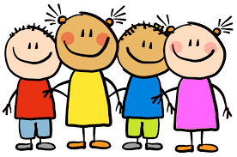
Well done for working super hard! Enjoy the rest of your day Primary 3!

