Slide 1
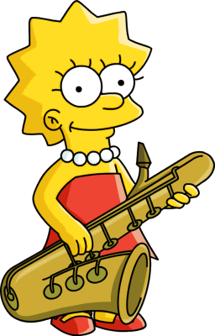
Thursday 7-5-20
Good Morning Everyone!

Slide 2
Today’s Timetable
Morning Exercise
French
Morning Starter
Maths Lesson
Writing Task
Health and Wellbeing
French Main Lesson
Topic
Prayer

Slide 3
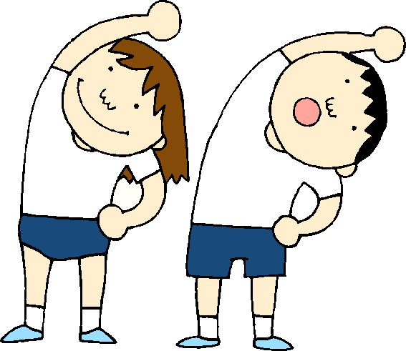
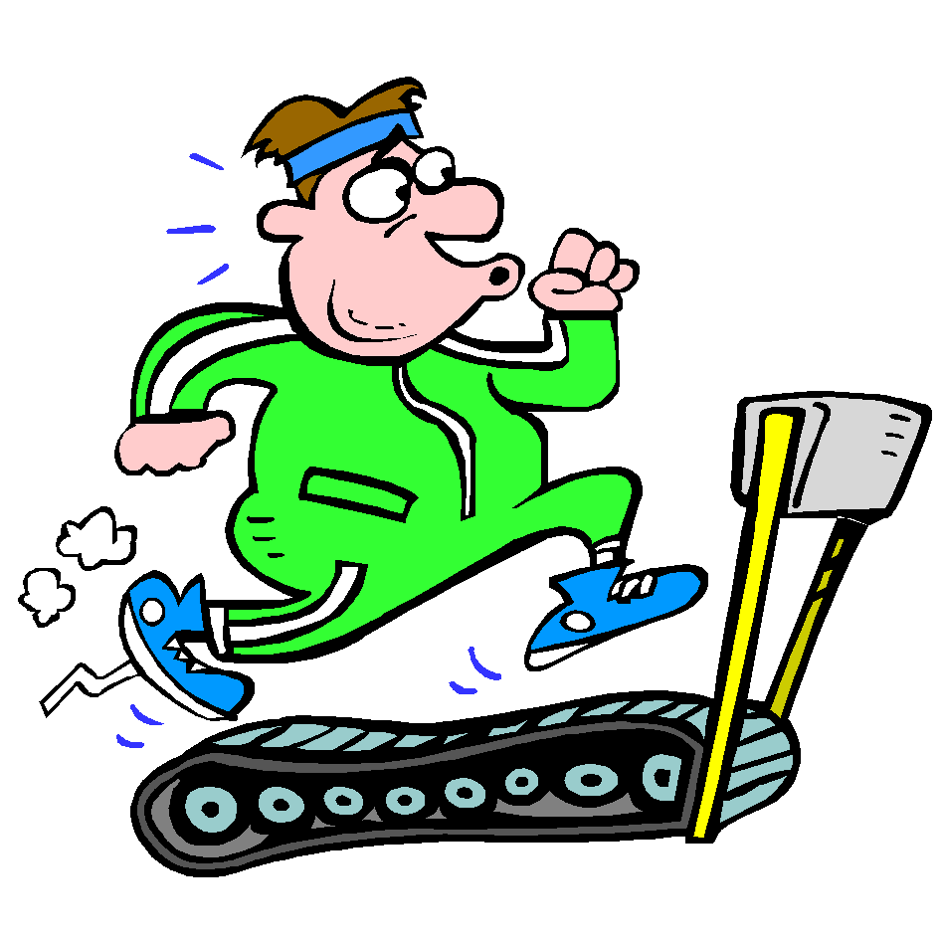
Daily Exercise
Try to do some form of exercise to start the day. This could be a walk or run with a family member or a workout in the house. Check with your parents that it is ok for you to do this.
Why not try a 5minute workout with the Body Coach this morning :-
https://www.youtube.com/watch?v=d3LPrhI0v-w

Slide 4
A little bit of French to start the day
Quelle est la date aujourd’hui? Comment a va?
e.g. C’est mercredi six mai Je suis content(e)
Je ne suis pas content(e)
Quel temps fait-il? Qu’est ce-que tu veux pour le
e.g. Il y a du soleil dejeuner? eg.
Il pleut / Il fait beau/ Il fait froid/ Je voudrais un sandwich au thon
Il fait mauvais/ Il y a des nuages/ Je voudrais un sandwich au fromage
Il y a du soleil/ Il fait du vent Je voudrais un sandwich au jambon
Je voudrais un sandwich aux oeufs

Slide 5
Morning Starter
Today, everyone’s morning starter is 15-20 minutes on
Hit the Button
Please choose a times table that you are not so good at. Please also work on square numbers.
If you normally do IDL Maths, please do this also for 15-20mins.

Slide 6
Maths Lesson
As part of the Maths curriculum we have to learn about the impact Maths has had in the world. Today we are learning about the Mayan number system.
S.C.- To be able to identify the symbols of the Mayan
number system.
- To be able to appreciate that humans have used
Maths for thousands of years
- To be able to complete the activity sheet.
Task:- Please watch the powerpoint on the Mayan number system attached to the blog and then complete the first activity sheet All groups can do this task.
Extra:- If you would like an extra challenge, please try the additional worksheets.
The Mayans were an ancient civilisation from an area called Mesoamerica which is modern day Mexico and Central America.
If you want to find out more about them please click on the link
https://www.youtube.com/watch?v=Q7llX0YGlsw

Slide 7
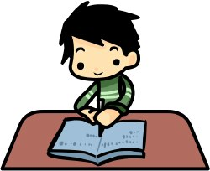
Writing
Task:- Your task is to continue your story about your secret, magical powers. Following on from last time, you should now have a title, a picture and an introductory paragraph.
Your task today is to work on the plot of your story. Remember to use lots of describing words and make it exciting for the reader. Please don’t finish your story today. We will work on the ending of your story next week.
If you missed the last lesson or would like to watch Cressida Cowell again, please click on the link:-
https://www.scottishbooktrust.com/authors-live-on-demand/cressida-cowell
I have attached some word lists to help you as well as a narrative checklist.

Slide 8
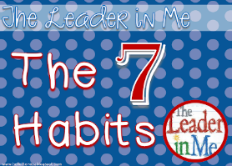
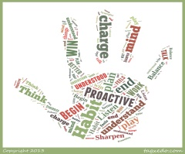
Health and Wellbeing
Today we are going to learn about habit 2.
This video gives some examples of how you can ‘begin with the end in mind’:-
https://www.youtube.com/watch?v=8KHH-6vwl-I
Task:- Look back at your learning goals you made a couple of weeks ago. Have you stuck to the plan or do you need to make new plans? There is no written task today.

Slide 9
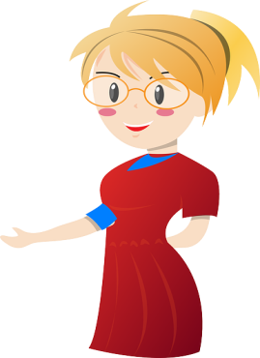
French
Today we’re going to revise the vocabulary associated with members of our family. To do that we’re going to use linguascope again.
https://www.linguascope.com/
I have sent you the log-in details on Teams again in case you didn’t get it last week. Please take s note of the log-in details for future use.
L.I. – To be able to talk about members of our family
S.C. – To be able to know how to say the words for brother,
sister, mum, dad, grandmother, grandfather.
- To be able to read these words in french
- To be able to play some games & complete the
worksheet.
Task 1:- When you have logged in to Linguascope, click on the french flag in the
Beginner section, then click on ‘Moi et ma famille’ then ‘Les membres
de ma famille’. Click on ‘Presentation’ first then choose any of the
activities on the page. Please do ‘controle final’ to test your knowledge.
Task 2:- Go to the page entitled ‘Freres et soeurs’ in your St Kent’s Transition
Booklet and complete section C question1 & 2 only.

Slide 10
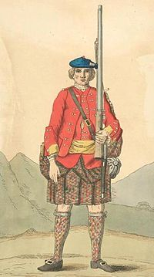
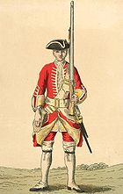
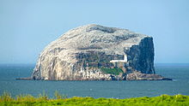
The Bass Rock
Have you ever been to North Berwick? If you have, you will have seen the big rock out at sea which you can see from the beach- it is called The Bass Rock
The Bass Rock is famous for its lighthouse and the seabirds [gannets] which live on the rock. However, did you know that there used to be a prison on the rock? At one point the prison held Jacobite soldiers.
Task: - Your task is attached to the blog

Slide 11
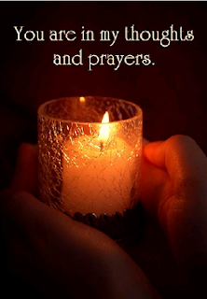
A prayer to end our day
Take a few moments to say a short prayer for all the key workers who are keeping all our vital services going.

Slide 12
Well done!
Well done for working hard today!

