Slide 1
Thursday the 7th of May
Good morning primary 2!
Bonjour les enfants! Ca va?
Can you remember asking our ages in French. Let’s practise again today.
Watch- https://www.youtube.com/watch?v=4WksvcV6vU0
L.I - We are learning to say our age in French
Quel age a tu?
J’ai ______ans.

Slide 2
Reading- Common Words
These are some common words you had at the beginning of
P.2. Can you remember them?
Yellow grow again food
Blue best number other
Choose a book, a comic , a newspaper etc
To see if you can find them in the text.
Using one of your favourite books think about these questions and try and answer them. Don’t worry just tell someone the answers.
Do you know the name of the Author?
Do you know the name of the illustrator?
What did you like about the book?
Is there anything you didn’t like about the book?
What was your favourite part?

Slide 3
Today’s story – is all about another inventor. https://www.youtube.com/watch?v=GxHwWqcoomo

Slide 4
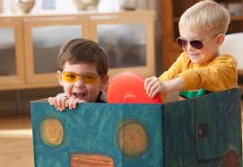
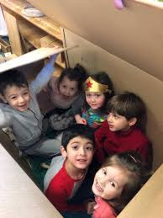
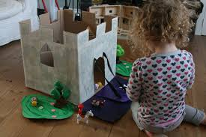
Writing – My Incredible New Toy
L.I- To write an imaginary story about your new toy
What did your box become?
Today you are going to write an imaginative story about an adventure you had with your new toy .
Helpful reminders
Think about WHO WHAT WHERE WHEN WHY when composing your story.
Share YOUR IDEAS before you start.
Get help with tricky words but DON’T WORRY give the words a go!
Remember CAPITAL LETTERS, FULL STOPS AND FINGER SPACES

Slide 5
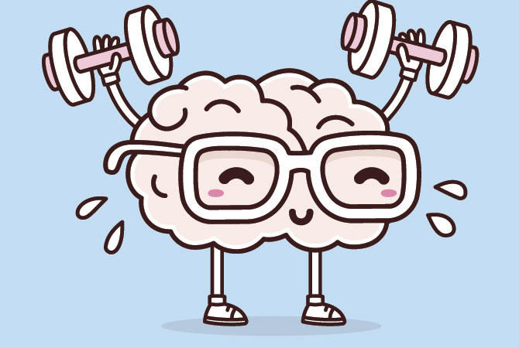
Mathematics Number Talk
Estimation- On the next couple of slides you are to estimate (sensibly guess) how many balls are in the glass.
As it is a number talk, tell your adult why you think it is the number that you are guessing each time.

Slide 6
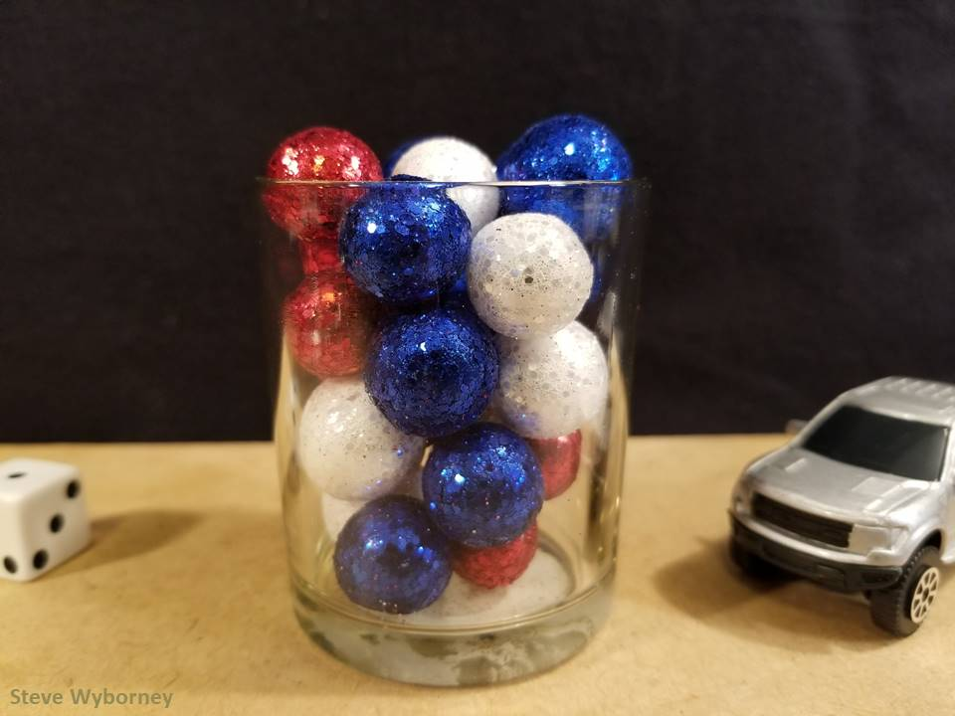
How many objects are in the container?
The Reveal
24 objects
www.stevewyborney.com

Slide 7
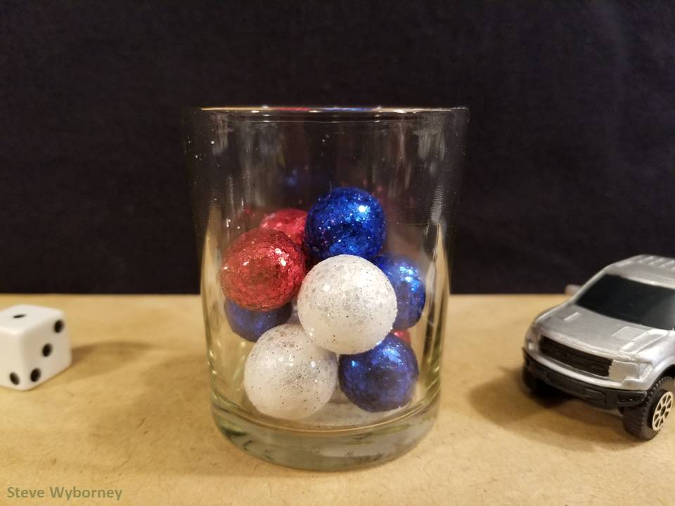
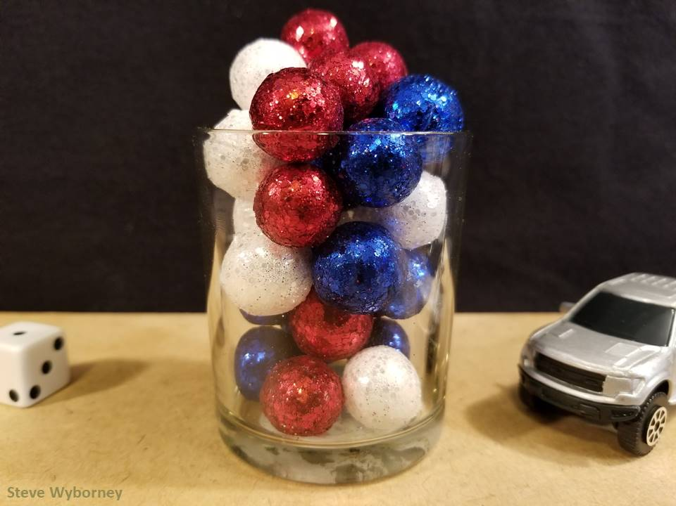
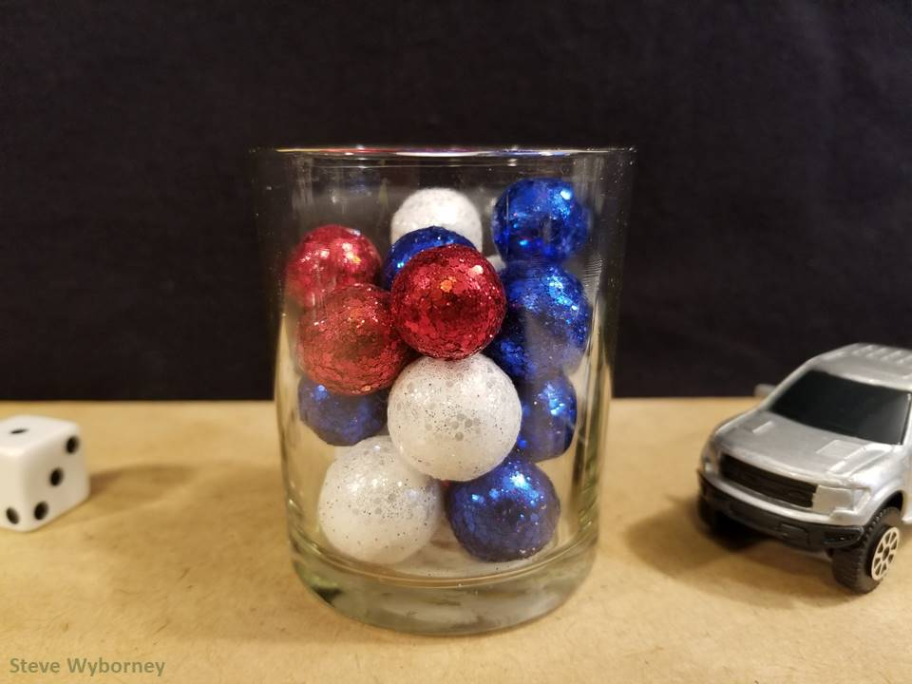
24 objects
11 objects
The Reveal
29 objects
The Reveal
17 objects
The Reveal
www.stevewyborney.com

Slide 8
How many objects are in the container?
The Reveal
24 objects
www.stevewyborney.com

Slide 9
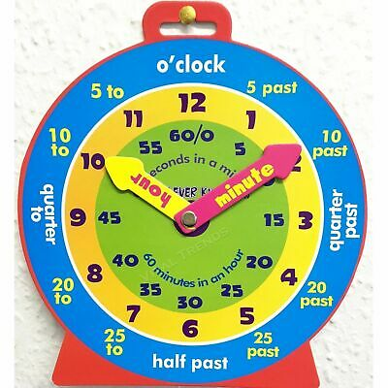
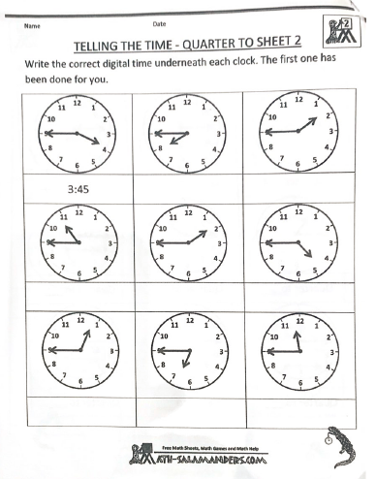
Maths Activities - Time
LI: To tell the time on an analogue and digital clock using the terms half past, quarter past/to and o’clock.
Time workbook
Complete this workbook page
found in your home learning pack.
Quarter to Sheet 2
Play
On time- set the clock to the correct time
https://www.sheppardsoftware.com/mathgames/earlymath/on_time_game1.htm

Slide 10
May is the month of Mary
Why is Our Lady so important?
https://www.youtube.com/watch?v=wyHesSI-J0o
Mary was the mother of Jesus. When Jesus died Mary helped and looked after the other disciples the way our mothers look after us.
Mary wants to be our mother too and we can ask for her help, just as we would ask our own mother’s for help.
We can pray to Our Lady by saying The Rosary. We began to do this together in school last term.

Slide 11
The Rosary
You will find a guide to the rosary here:
https://childrensrosary.org/?page_id=2049&lang=en
You will find hymns to Mary here:
https://www.youtube.com/watch?v=KLpIexoF-1A
https://www.youtube.com/watch?v=GaDeqSotwoc
You may want to listen to these after you pray the rosary.
Praying brings us all together.
You could try saying a decade a day throughout May, with your family.

Slide 12
I hope you’ve all had a good time with your learning. Now it’s time to have some play.

