Slide 1
Thursday 7th of May
Good Morning Primary 2/3!
French: Bonjour la class! Ca Va?
Quelle est la date aujourd’hui?
Aujourd’hui cest J____ 7th M____2020
Can you remember how to sing Heads Shoulders Knees and Toes in French?
Try and see if you can remember the names for these body parts from last week.

Slide 2
Reading Comprehension
Today’s reading is all about spring. You will need to do this with an adult as some of the words may be tricky to read.
There are two comprehensions attached to today’s blog. You can choose which your child does based on their own ability. One is multiple choice, the other requires written answers.
You can complete there either orally or written.

Slide 3
Literacy-Writing
LI: To write an imaginary story about your new toy
What did your Box become?
Helpful Reminders
Think about: Who, what, where, when, why when composing your story.
Share your ideas before you start
Get help with tricky words, but don’t worry, just give them a go!
Success Criteria
Capital Letters, Full Stops, Finger Spaces.
Take a new line for each new word.

Slide 4
Story time-click the picture

Slide 5
Numeracy – Warm Up
LI: We are learning to count in multiples
Get yourself workout ready as we do Workout & Count
https://www.youtube.com/watch?v=q_yUC1NCFkE

Slide 6
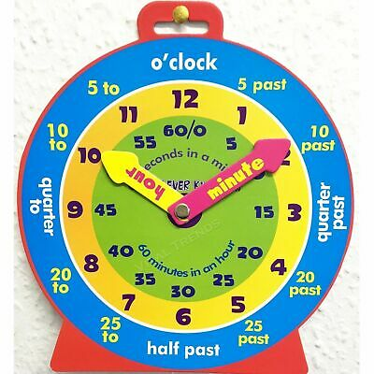
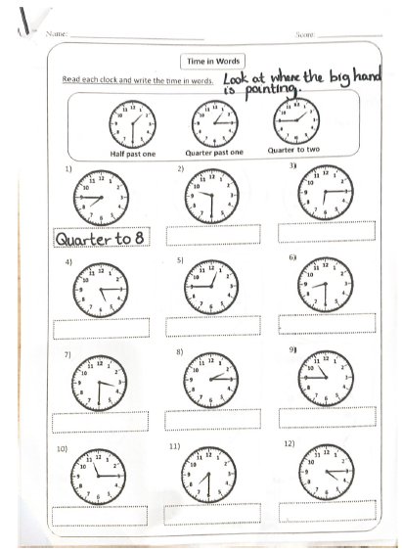
P2 Maths Activities
LI: To tell the time on an analogue and digital clock using the terms half past, quarter past and o’clock.
Time workbook
Complete this workbook page
found in your home learning pack.
2. Greg Tang Math- Numtanga Junior
https://www.gregtangmath.com/numtanga

Slide 7
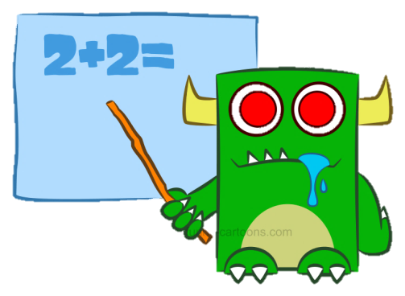
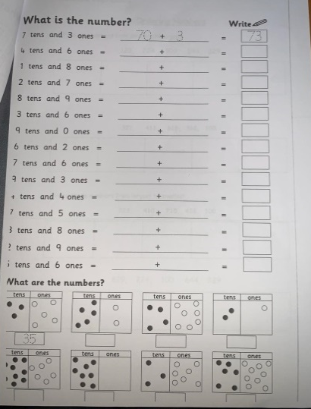
P3 Numeracy Activities
LI: To understand the value of each digit in a number.
Place Value Workbook
Please do the third page
2. Play- Post a letter - 0-1000
http://www.ictgames.com/postAletter/index.html

Slide 8
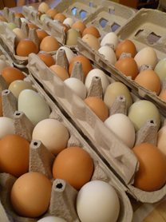
Health and Wellbeing
LI: To know and understand where my food comes from and how it gets to me.
Watch: Excellent Eggs
https://www.youtube.com/watch?v=_kIc5baCEoQ
Have a look at an egg and see if you can spot the stamps on it. Try and find out what farm your egg is from by typing in the number here:
http://lioneggfarms.co.uk/

Slide 9
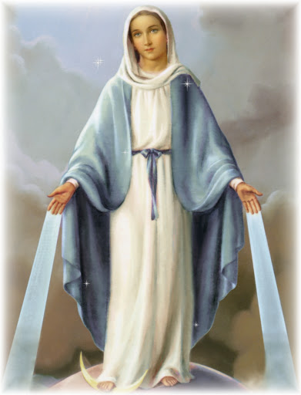
May is the month of Mary
Why is Our Lady so important?
https://www.youtube.com/watch?v=wyHesSI-J0o
Mary was the mother of Jesus. When Jesus died Mary helped and looked after the other disciples the way our mothers look after us.
Mary wants to be our mother too and we can ask for her help, just as we would ask our own mother’s for help.
We can pray to Our Lady by saying The Rosary. We began to do this together in school last term.

Slide 10
The Rosary
You will find a guide to the rosary here:
https://childrensrosary.org/?page_id=2049&lang=en
You will find hymns to Mary here:
https://www.youtube.com/watch?v=KLpIexoF-1A
https://www.youtube.com/watch?v=GaDeqSotwoc
You may want to listen to these after you pray the rosary.
Praying brings us all together.
You could try saying a decade a day throughout May, with your family.

Slide 11
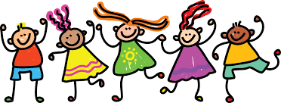
Leave a comment on the blog about what you learned today. Enjoy the rest of your day Primary 2/3!

