Slide 1
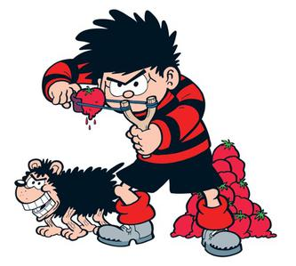
Wednesday 6-5-20
Good Morning Everyone!

Slide 2
Today’s Timetable
Morning Exercise
French
Morning Starter
Maths Lesson
Literacy Task
R.E.
Topic
P.E.
Prayer

Slide 3
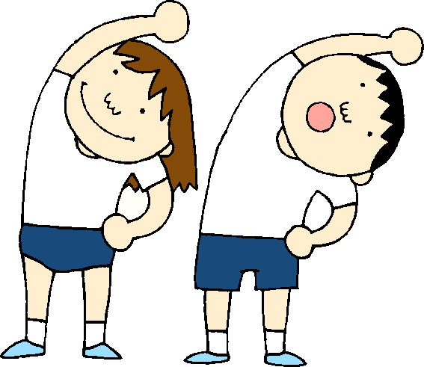
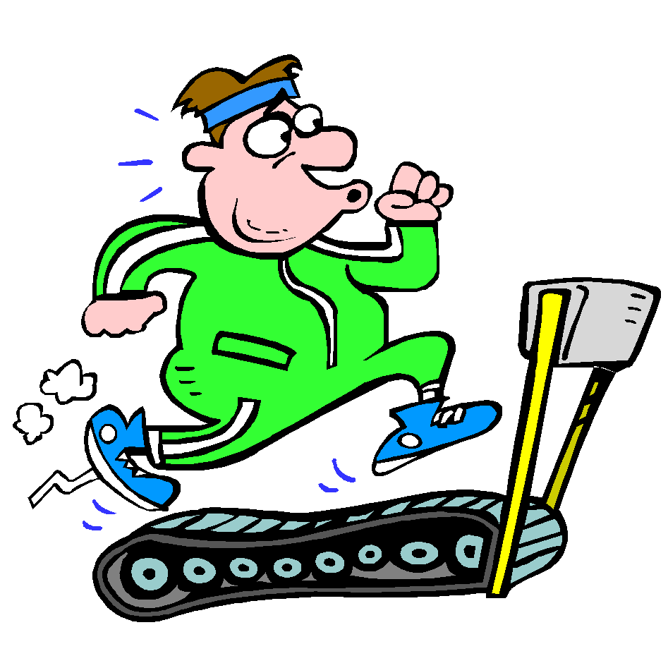
Daily Exercise
Try to do some form of exercise to start the day. This could be a walk or run with a family member or a workout in the house. Check with your parents that it is ok for you to do this.
Why not try this workout :-
https://www.youtube.com/watch?v=pLuM18p9zbM
Or join the Body Coach at 9am

Slide 4
A little bit of French to start the day
Quelle est la date aujourd’hui? Comment ca va?
e.g. C’est lundi quatre mai Je suis content(e)
Je ne suis pas content(e)
Quel temps fait-il? Qu’est ce-que tu veux pour le
e.g. Il y a du soleil dejeuner? eg.
Il pleut / Il fait beau/ Il fait froid/ Je voudrais un sandwich au thon
Il fait mauvais/ Il y a des nuages/ Je voudrais un sandwich au fromage
Il y a du soleil/ Il fait du vent Je voudrais un sandwich au jambon
Je voudrais un sandwich aux oeufs

Slide 5
Morning Starter
Today, everyone’s morning starter is 15-20 minutes on
Times TablesRockstars
If you normally do IDL Maths, please do this also for 15-20mins.

Slide 6
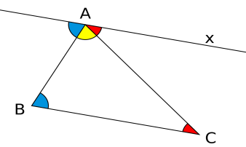
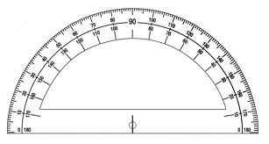
Maths Lesson
L.I. - We are learning about circles.
S.C. – To understand what is meant by the radius,
diameter and circumference
- To be able to calculate the radius from the
diameter and vice versa.
- To be able to complete the written task.
Watch the video up to 3mins 12secs. [Again please ignore the American spelling] Feel free to watch until the end of the video however this additional learning is not required for 2nd level Maths:-
https://www.youtube.com/watch?v=cC0fZ_lkFpQ
Task :- Please see the attached sheet for your task. Question 5 requires you to use a set of compasses. If you do not have any please skip this question.

Slide 7
Literacy Lesson
Today, we’re going to listen to the next 3 chapters of Wonder – ‘Paging Mr Tushman’, ‘Nice Mrs Garcia’
and ‘Jack Will, Julian and Charlotte’.
https://www.youtube.com/watch?v=WzEU-fsQXdM
In this Chapters August visits his new school and meets Mr Tushman, Mrs Garcia and 3 pupils .
Green/Blue Group Task:- Your task is to answer comprehension questions on 3 pages of the text. Please find the task attached to the blog.
Red Group: - Your task is to think of 6 describing words to describe how August is feeling during his visit to the school. Please also do 20mins on IDL.

Slide 8
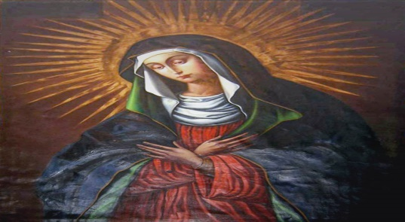
R.E.
Today we are going to learn about how important Our Lady is in the Catholic faith.
Our Lady is so important in our faith that she has 2 months of the year dedicated to her, May and October, as well as many feast days. These feast days include ‘ The Annunciation [25th March], The Assumption [15th August].
Task:- Draw a picture of Our Lady and make a list of at least 6 feast days of Our Lady.

Slide 9
The Jacobites
L.I. – To learn about The Act of Union.
S.C. – To understand why the Act of Union
was signed.
- To understand that the Act of Union
was unpopular in Scotland and increased
support for The Jacobites.
- To be able to draw a Jacobite broadsword.
You will find the powerpoint on the blog. The task is on the last slide of the blog.

Slide 10
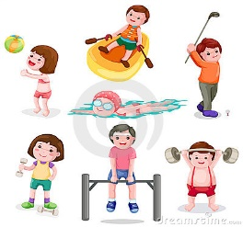
P.E.
You may wish to do some exercise outside with members of your family. However if this not possible perhaps you can persuade them to join you for a workout with the Body Coach. Click on the link below:-
https://www.youtube.com/watch?v=4OT0feX8ld8

Slide 11
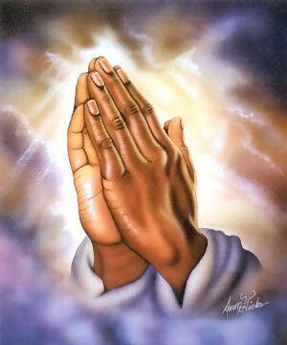
A prayer to end our day
Take a few moments to say a short prayer, thinking of those older members of our community who are anxious and worried at this time.

Slide 12
Well done!
Well done for working hard today!

