Slide 1
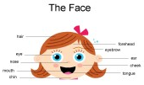
Wednesday 6th of May
Good Morning Primary 2/3!
French: Bonjour la class! Ca Va?
Aujourd’hui cest M____ 6th ____ 2020
L.I- To name parts of my face in French
Please use the Login to access this wonderful French Resource we have access to.
Login: stanthonys
Password: stant123
Go to Beginner section and click the French flag circle
Click the tab “Moi et Ma famille” and then “Le Visage“ square
Click the first option “Presentation” to learn some of the vocabulary then choose an activity to test your learning.
https://www.linguascope.com/secure/students/beginner/html5/bin/main.php?language=french&topic=face&activity=introduction

Slide 2


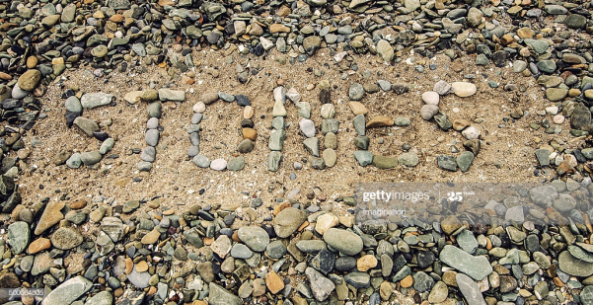
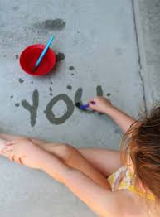
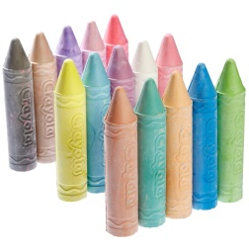
Literacy: Stage 2
LI: To recognise, read and make words containing the phoneme Magic e
As it is a short week this week we are going to do a revision of the magic e we have covered so far and we will do a new sound next week.
Magic e Song- https://www.youtube.com/watch?v=bZhl6YcrxZQ
Here are some words that you can add Magic e to.
cap can man tap rid tim pin fin not rod cod
3. Go outside and write your words with water, chalk or stones.

Slide 3

Literacy: Stage 3
LI: To recognise, read and make words containing the phoneme ‘ough’’
As it is a short week this week we are going to continue to revise the sounds we have covered so far and we will do a new sound next week.
Alphabetical order game-
https://www.roythezebra.com/reading-games/alphabetical-order-1.html
2. Look over your previous word list for the ie, oe and ough sounds and read each of the words aloud.
3. Go outside and write your words with water, chalk or stones.

Slide 4


Reading
https://www.oxfordowl.co.uk/?sellanguage=en&mode=hub
username: stantsps
password:homelearning
Choose a new book from your colour band to read this week.

Slide 5

Todays story. Interesting Fact- a few years ago when we were at the Book Festival in Edinburgh we were able to hear all about Louis and his sister before it had been published. Look out for all the inventions.
https://www.youtube.com/watch?v=wzEcFHjmv3g

Slide 6
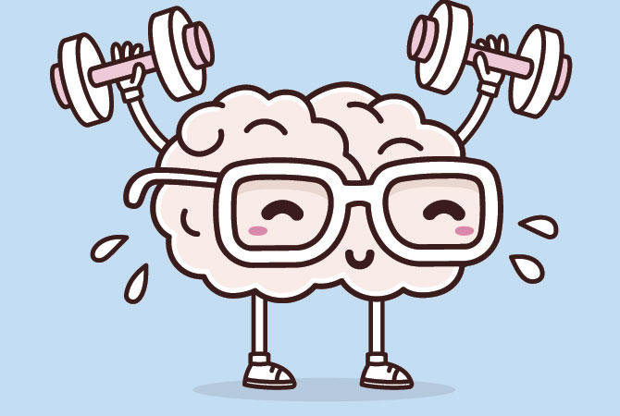

Mathematics
Number Talk
Estimation- On the next couple of slides you are to estimate (sensibly guess) how many balls are in the glass.
As it is a number talk, tell your adult why you think it is the number that you are guessing each time.

Slide 7
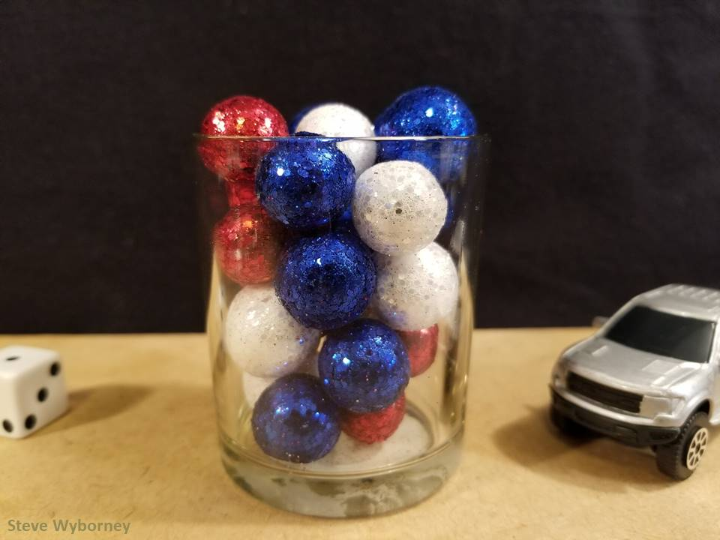
How many objects are in the container?
The Reveal
24 objects
www.stevewyborney.com

Slide 8
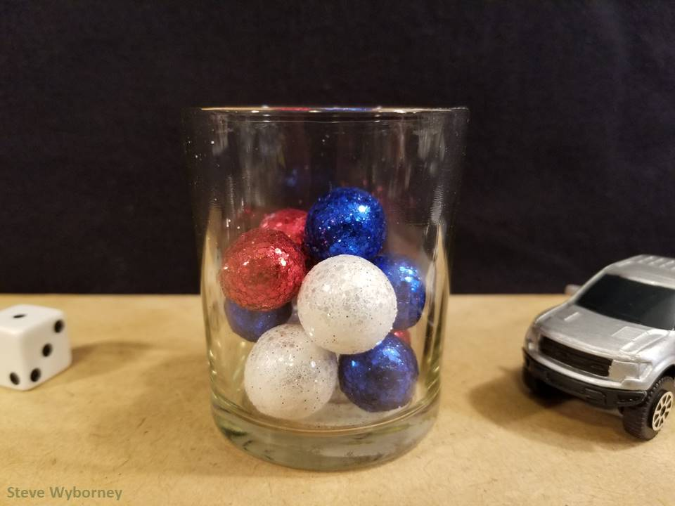
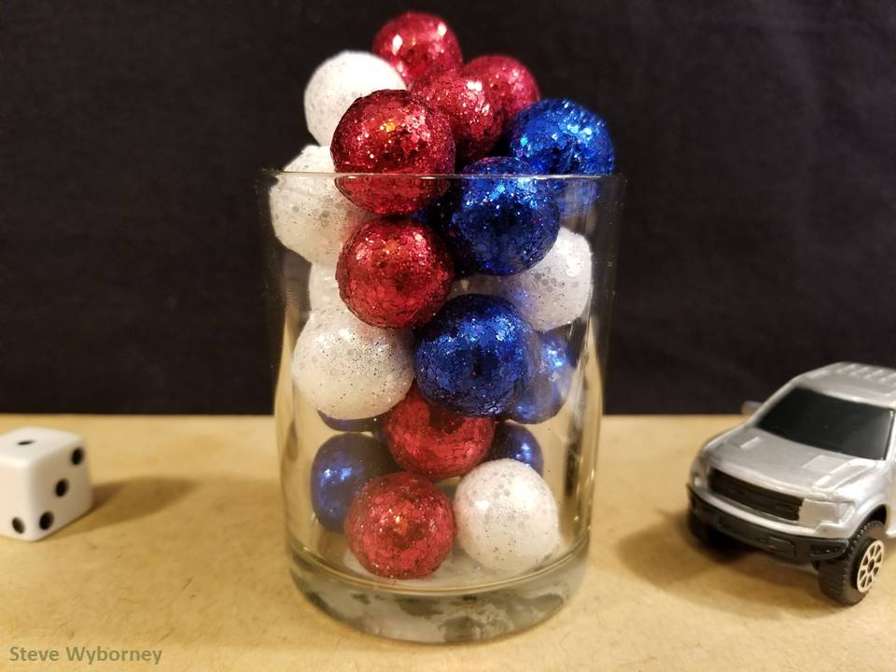
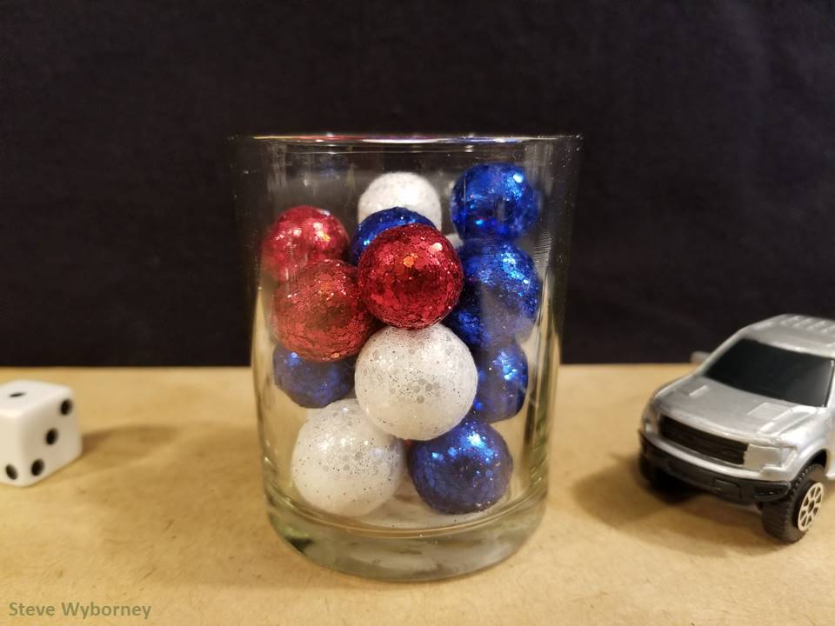
24 objects
11 objects
The Reveal
29 objects
The Reveal
17 objects
The Reveal
www.stevewyborney.com

Slide 9
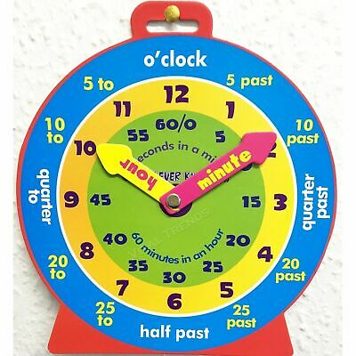
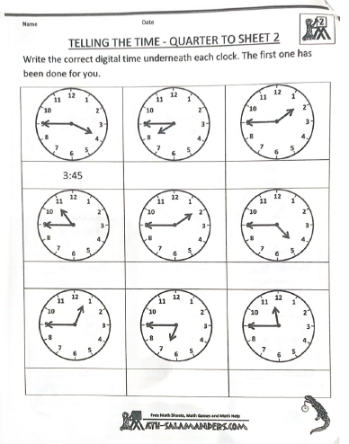
P2 Maths Activities
LI: To tell the time on an analogue and digital clock using the terms half past, quarter past/to and o’clock.
Time workbook
Complete this workbook page
found in your home learning pack.
Quarter to Sheet 2
Play
On time- set the clock to the correct time
https://www.sheppardsoftware.com/mathgames/earlymath/on_time_game1.htm

Slide 10
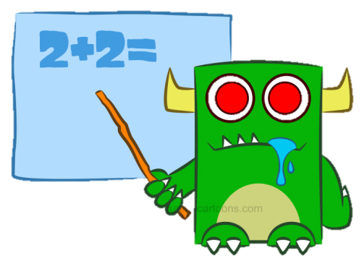
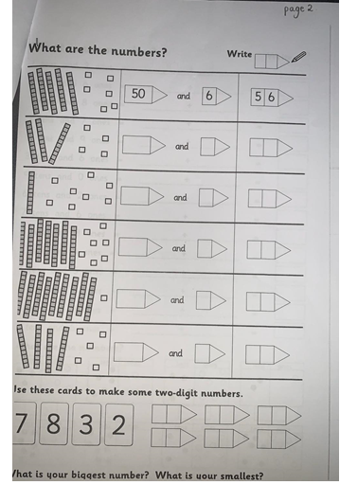
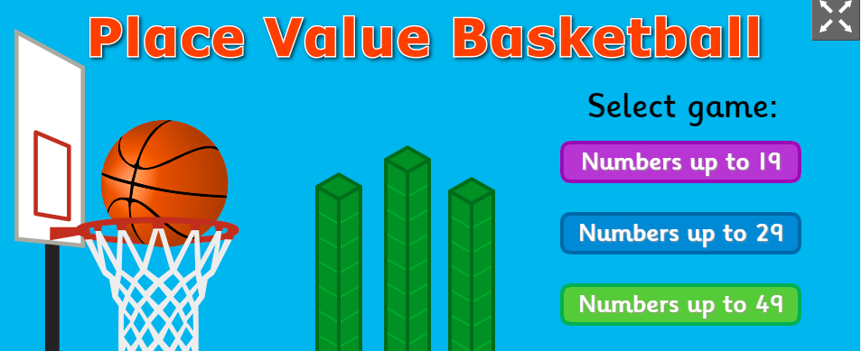
P3 Numeracy Activities
LI: To develop multiplication strategies
Place Value Workbook
Please do this page 2 of your
place value workbook.
2. Play: Place Value Basketball
https://www.topmarks.co.uk/learning-to-count/place-value-basketball

Slide 11
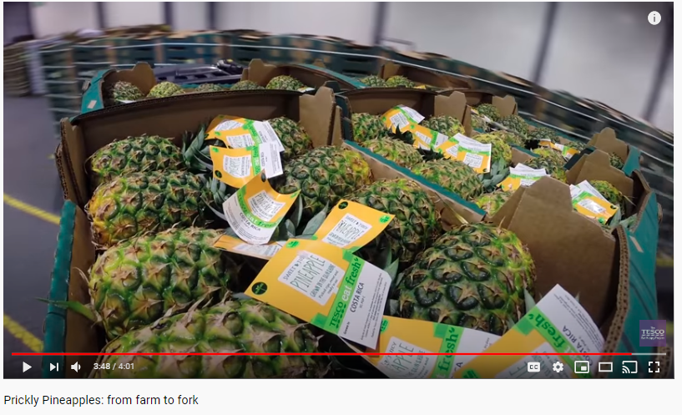
Health and Wellbeing
LI: To know and understand where my food comes from and how it gets to me- Pineapples
Watch- Prickly Pineapples from farm to fork
https://www.youtube.com/watch?v=UVL8NXigTkI
Have a look in your kitchen and see if you can find where 3 items of fruit and veg you have comes from. Are they local or have they been imported like these pineapples have?

Slide 12
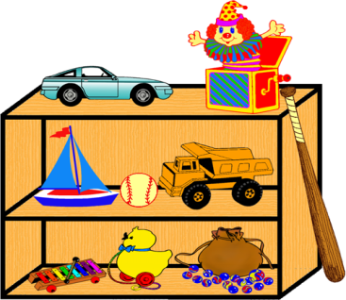

Topic - Toys
Today we are going to look at a toy that I loved when I was small. It could be changed into so many different things. Are you beginning to wonder what it is?
Let’s find out!!!!!

Slide 13
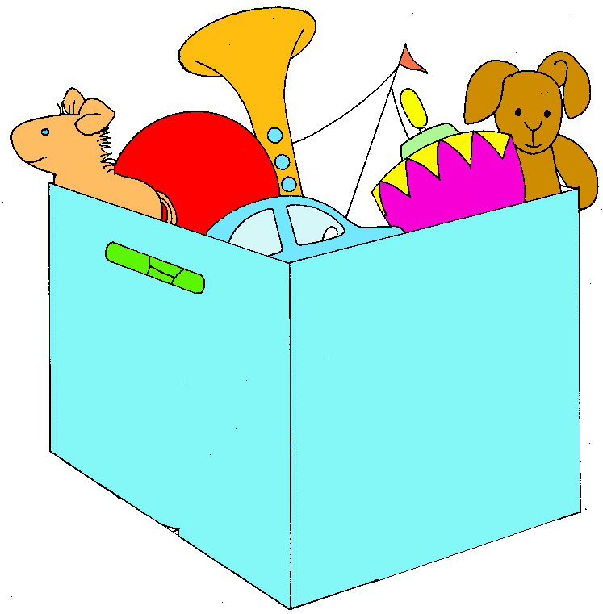
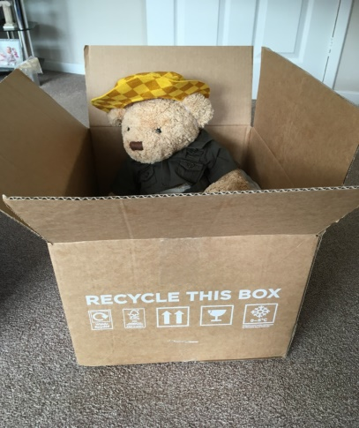
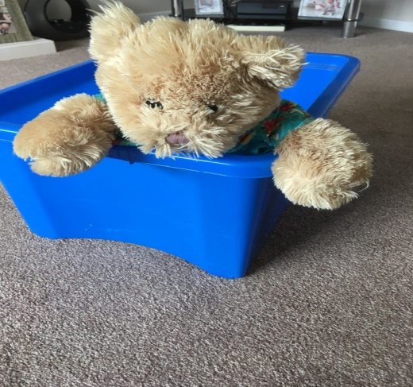
Topic –Toys 2
Yes – it is a box!! Today you are going to use your imagination and see what your box becomes.
You can use a cardboard box , a toy box or an imaginary box.
You can add things to it. You could draw it.
Or just imagine what it can be.
Once you have finished it you have to think of an adventure you could have in your magical box.
Hector and Hamish
can’t wait to start
and are already in their boxes

Slide 14

Leave a comment on the blog or upload a picture of what you have done or made today.
Enjoy the rest of your day Primary 2/3!

