Slide 1
Wednesday 6^{th of} May
Good morning primary 2!
How are you today?
We are going to have a bit of fun today with our Language warm up.
Read these words and translate them
cannae shuve whit dinna hawd een lugs aye
tatties blether mammie nae doun awfy
Which language is this?
Watch link below (fast forward 2mins.)
https://www.youtube.com/watch?v=vUbpCdbyXTc

Slide 2
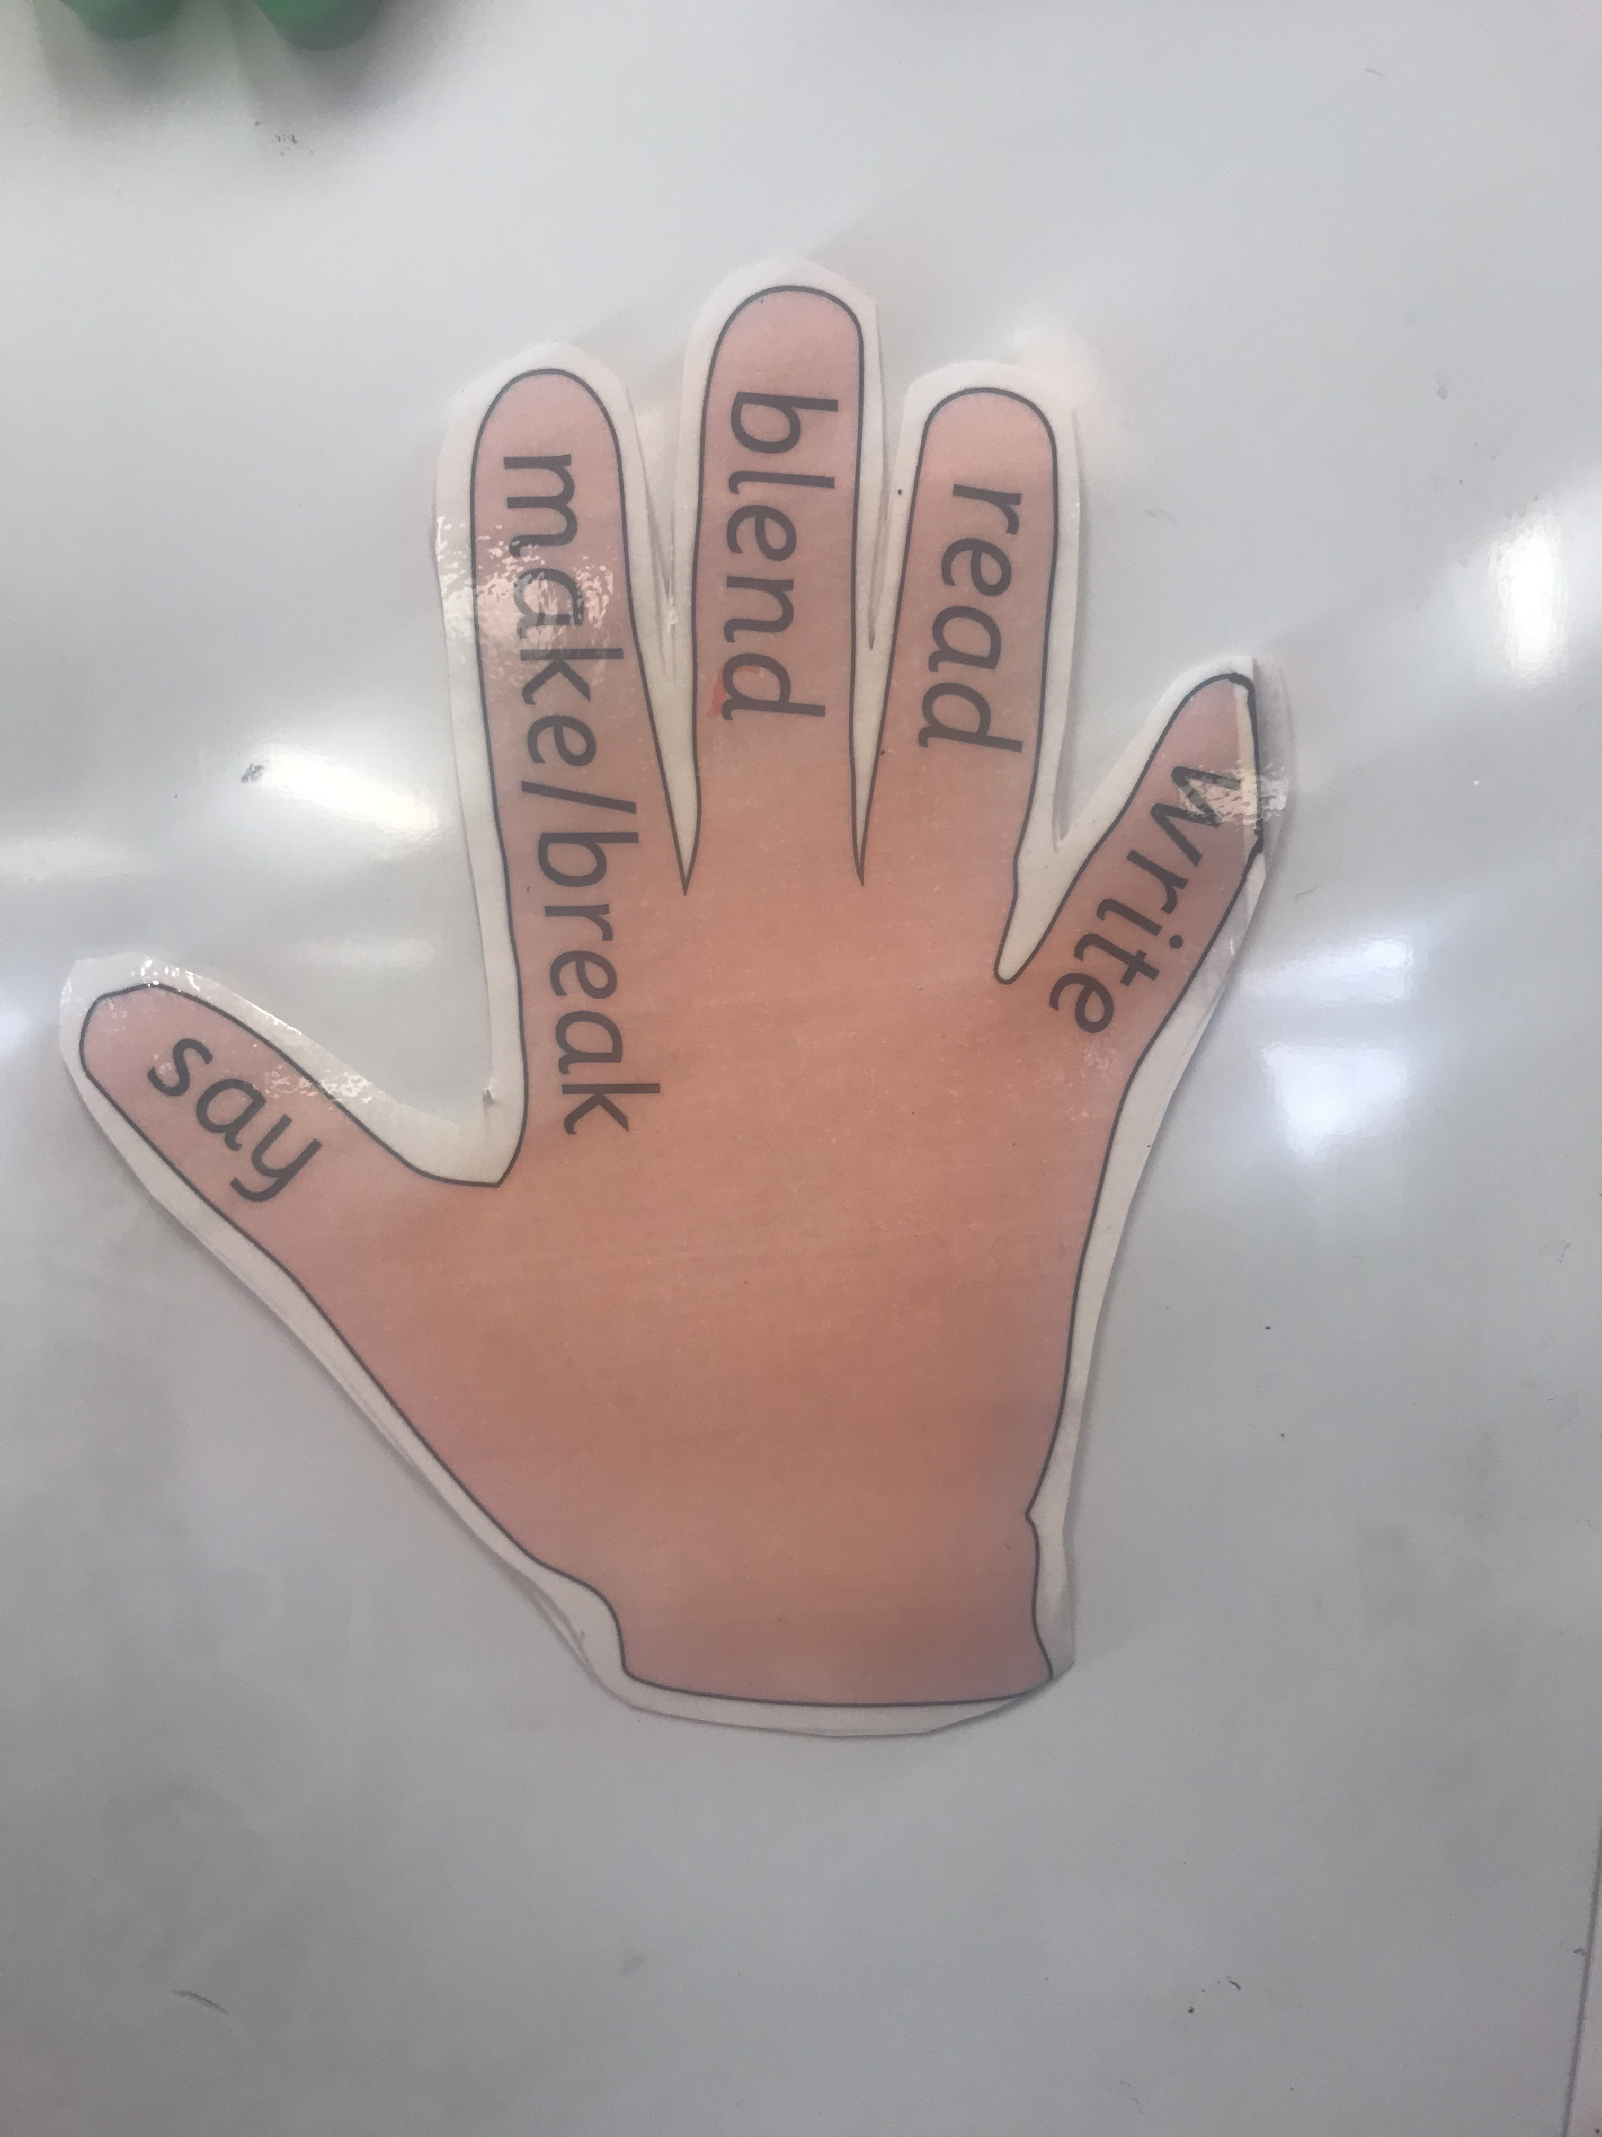
Literacy
L.I - I can recognise, read and make words containing the ‘Magic -e’ phoneme.
Revise initial sounds – https://www.youtube.com/watch?v=neItURLvyIQ
Watch - https://www.youtube.com/watch?v=bZhl6YcrxZQ
This week we are consolidating previous phonemes.
Here are some words that you can add Magic e to.
cap can man tap
rid tim pin fin
not rod cod con
Now you have made your new words why don’t you go outside and write them with chalk, water or stones.

Slide 3
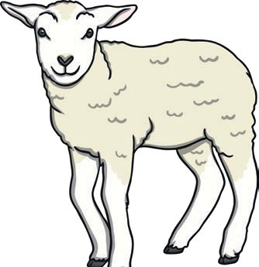
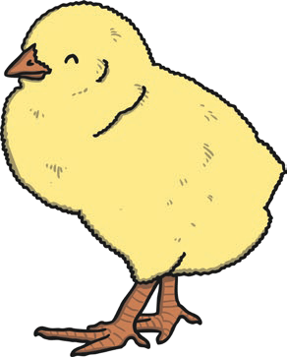
Reading Comprehension
Todays reading is a non- fiction text all about Spring. Some of the words will be tricky for you to read so please complete this task with an adult.
Activity 1 – (matching the word to the picture)
This will introduce some key words to you which will appear throughout the text.
Tip- You could write these words onto
flash cards and practise them with your child.

Slide 4
Reading Comprehension
Activity 2 – There are 2 reading comprehension activities with answers included.
Please choose the one which is most suitable for your child. (The second one is a bit trickier.)
When reading the passage can your child spot any words they can read?
Can they spot the words from the first activity? You could circle or highlight these as they find them.
You can complete these questions orally or attempt to write them down.
At this stage we would expect no more than one word answers or very short
sentences

Slide 5
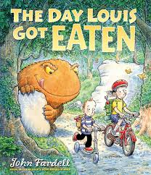
Todays story. Interesting Fact- a few years ago when we were at the Book Festival in Edinburgh we were able to hear all about Louis and his sister before it had been published. Look out for all the inventions.
https://www.youtube.com/watch?v=wzEcFHjmv3g

Slide 6
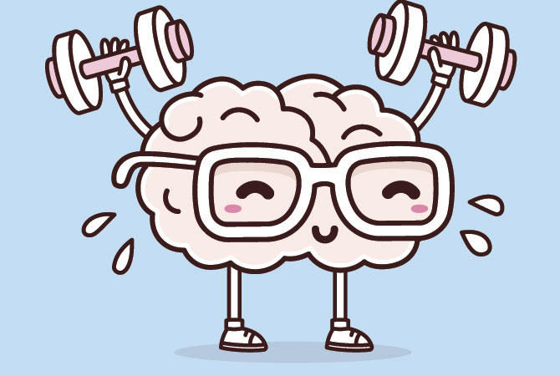
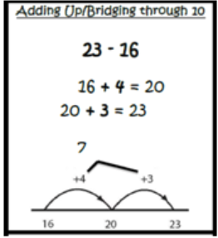
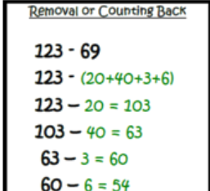
Mathematics Number Talk
Remember – number talks are all about how you solve a task, mentally. For this activity, don’t use anything to help you, just use your brain!
Look at each number sentence and share the strategy you used to get each answer with someone at home. Did they work it out the same way as you?
30 - 29
30 - 14
30 - 19
30 - 10

Slide 7
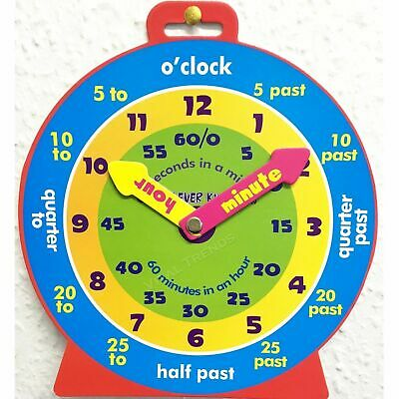
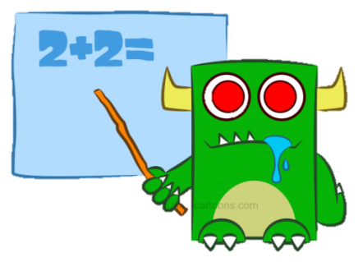
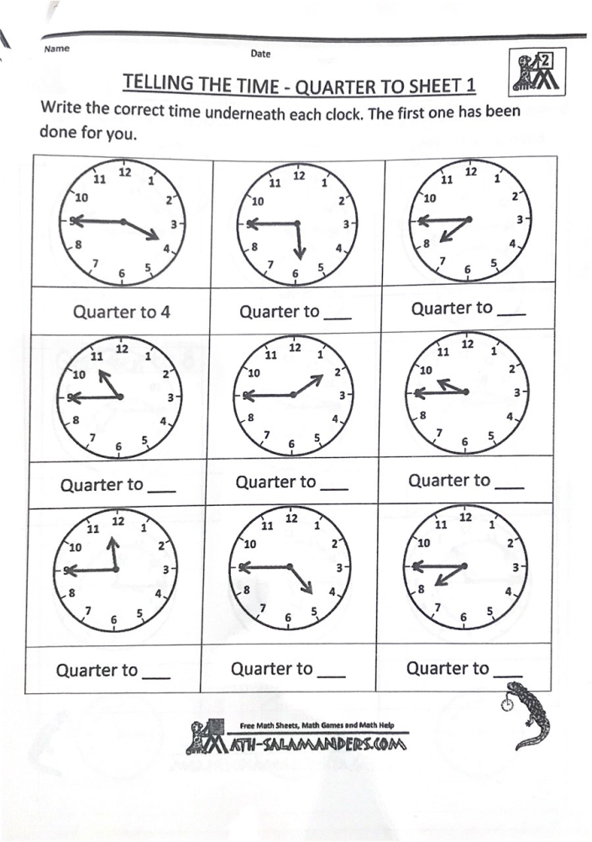
Mathematics
L.I – I can tell the time on an analogue and digital clock using the terms half past, quarter past, quarter to and o’clock.
Watch - https://www.youtube.com/watch?v=Pht7dTlM0VA&list=TLPQMDQwNTIwMjABUumjNn9OTQ&index=2
https://www.youtube.com/watch?v=h3EijzVNEmA&list=TLPQMDQwNTIwMjABUumjNn9OTQ&index=1
Time workbook – Complete this workbook
page found in your home
learning pack.
Challenge- During the day have a wee peek at
your clock in the house and see if you can spot
when it is at quarter to.

Slide 8
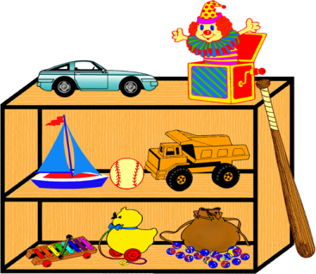
Topic - Toys
Today we are going to look at a toy that I loved when I was small. It could be changed into so many different things. Are you beginning to wonder what it is?
Let’s find out!!!!!

Slide 9
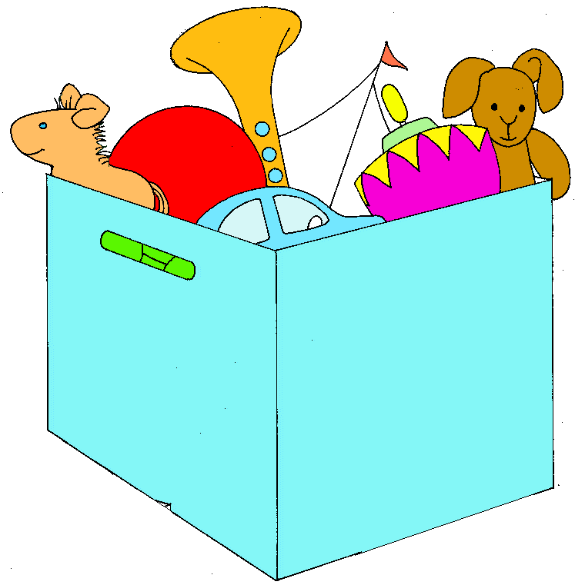
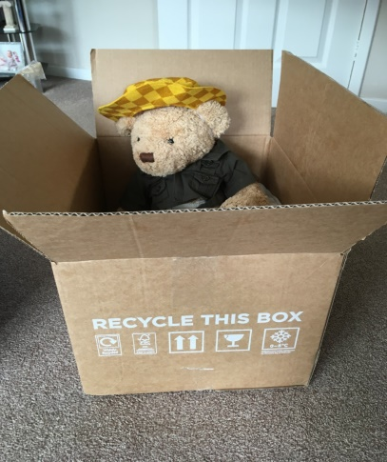
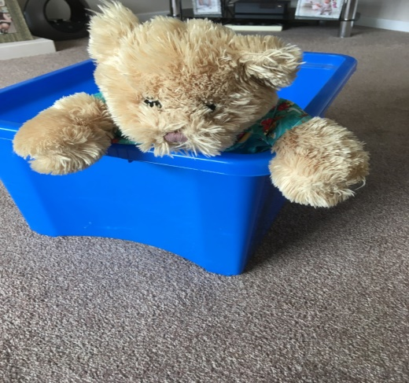
Topic –Toys 2
Yes – it is a box!! Today you are going to use your imagination and see what your box becomes.
You can use a cardboard box , a toy box or an imaginary box.
You can add things to it. You could draw it.
Or just imagine what it can be.
Once you have finished it you have to think of an adventure you could have in your magical box.
Hector and Hamish
can’t wait to start
and are already in their boxes

Slide 10
I hope you’ve all had a good time with your learning. Now it’s time to have some play.

