Slide 1
Friday 1st of May
Good Morning Primary 2/3!
French: Bonjour la class! Ca Va?
Quelle est la date aujourd’hui?
Aujourd’hui cest V______ 1st Mai 2020
Listen to this French body parts song
https://www.youtube.com/watch?v=bChrAwLzoSo

Slide 2
Literacy
LI: To use my phoneme and common word knowledge to spell accurately.
Sing ABC’s and abc’s songs
Day 5 activity: Sentence Dictation
Choose a dictation sentence from the list in the pack
Read aloud the sentence to your child first, for them to listen to it
in full.
Then re-read sentence again slowly, word by word(sounding out where necessary), allowing the child to write down each word independently.
Please encourage your child to:
- Have a go.
Think about what sounds can they hear in the word and chunk it into sounds they know.
Remember their core writing targets- full stops, capital letters, finger spaces.

Slide 3
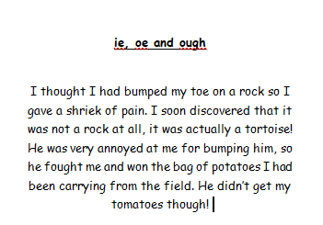
Read and Find your Phoneme Words

Slide 4
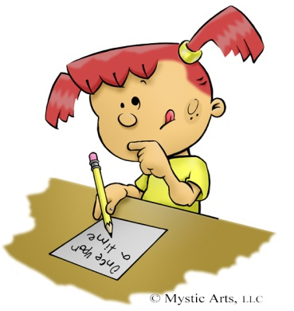
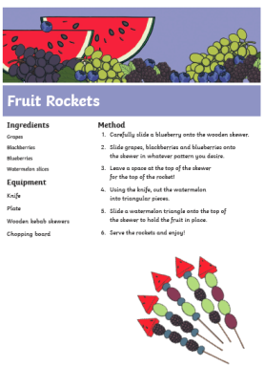
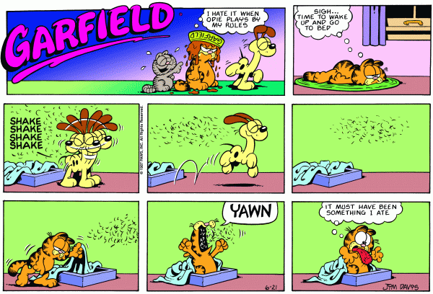
Literacy-Free Writing Friday
LI: To create a text of my choice
Set 15 minutes on a timer. Maybe your adult could do free writing at the same time as you?
Decide what type of writing you would like to do.
Collect all the writing tools you need to complete the task in time.
When the timer is up, share what you have done with each other.
Don’t forget you can send a picture of your work to our twitter! I would love you to share what you have written with me on our school twitter page!

Slide 5
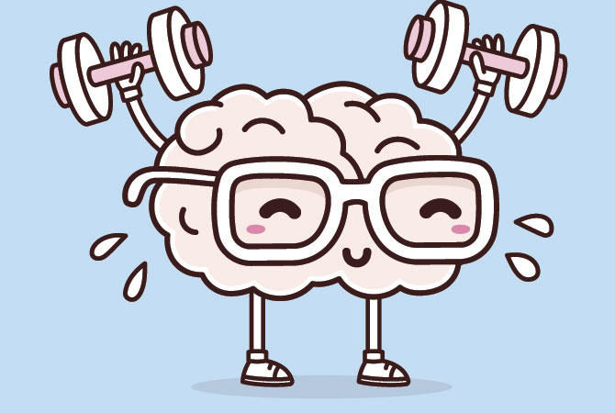
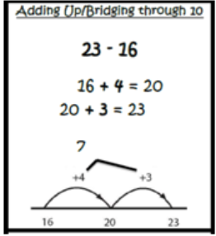
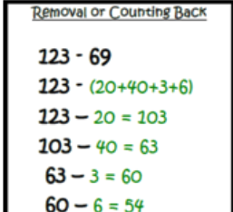
Mathematics Number Talk
Remember – number talks are all about how you solve a task, mentally. For this activity, don’t use anything to help you, just use your brain!
52 - 2
52 - 7
53 - 3
53 - 8

Slide 6
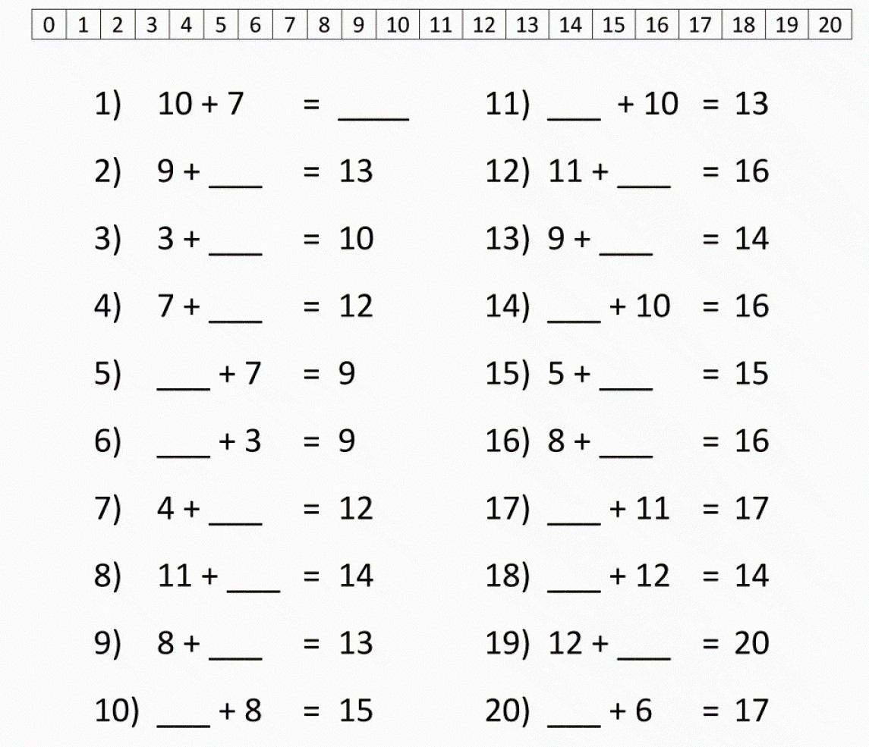
Can you complete these ‘Speedy sums’ in you jotter?

Slide 7
Topic
LI: To explore ways to design and construct models
Look at the Invention- Convention PowerPoint.
Read and complete the slide for Day 4 pictured below.

Slide 8
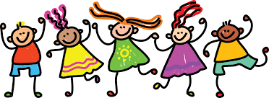
Well Done Primary 2/3 families! You have completed another week of online learning! You are doing so well during these tough times! Have a lovely longs weekend. I will be ready to welcome you back on Wednesday after your Monday and Tuesday off. Mrs Doghudje

