Slide 1
Friday 1st of May
Good Morning Primary 3!
Bonjour la class! Ca Va?
Aujourd’hui c’est (Friday) 1st (May) 2020
Now watch the counting to 20 in French song. Maybe ask some family members to join in, remember to show them your cool moves!
https://www.youtube.com/watch?v=UsEz58BblMY

Slide 2
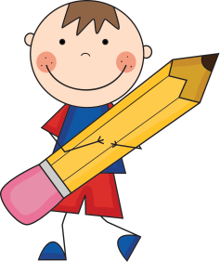
Literacy
LI: We are learning to spell our common words correctly.
Spelling Test
Since we have been practising your common words this week, why not complete a spelling test today!
You will need:
An adult or brother or sister
Copy of your common words
Paper/ Jotter
Pencil
Ask an adult/ brother/ sister to read aloud your common words whilst you write them down in your jotter.
Try your best you sound out each word.
Ask your adult to correct your words.
Good Luck P3!

Slide 3
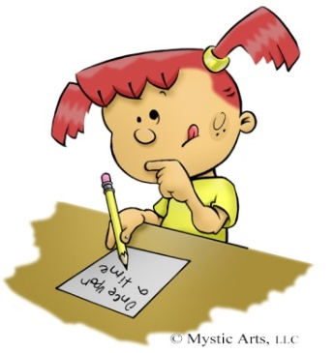
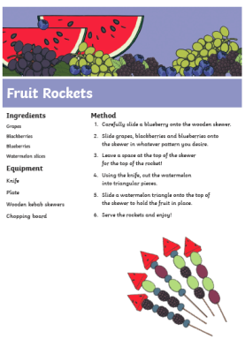
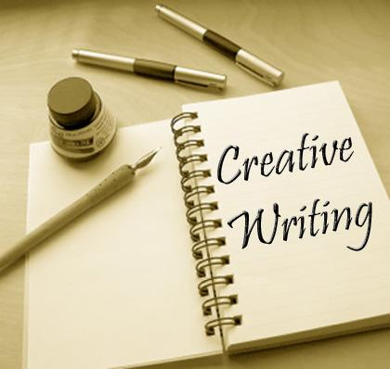
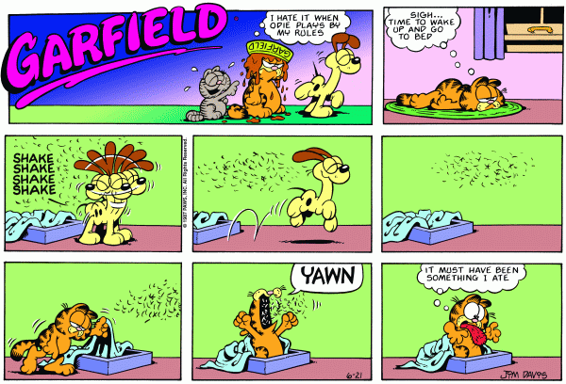
Free Writing Friday
LI: To create a text of my own choice.
On Fridays, we set aside a 15 minute timed session to do our “Free Writing” and during this time we select what type of writing we would like to do. It can be absolutely anything….. stories, poems, songs, recipes, fact files, comic strips, labelled diagrams…the list is endless.
Then at the end of the time, we share what we have created with each other.

Slide 4
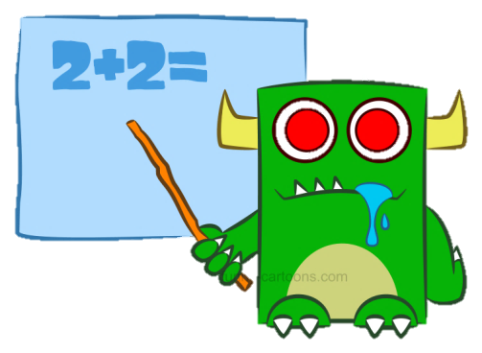
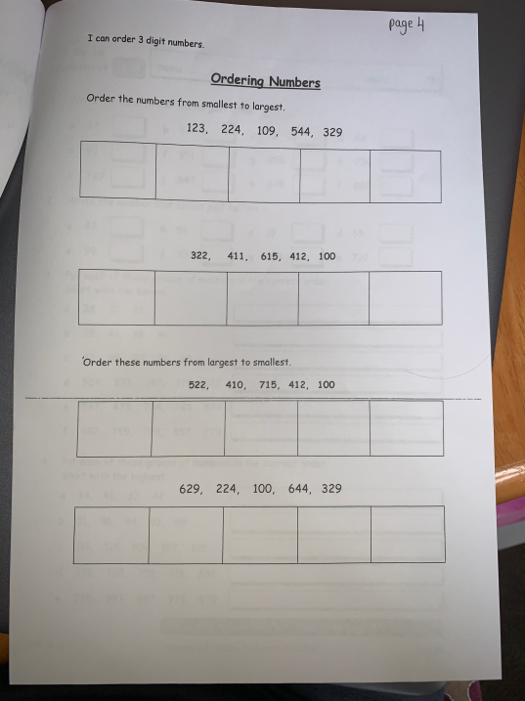
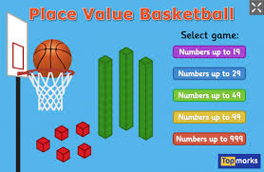
Numeracy
LI: We are learning to understand place value.
Place Value Work Booklet
Page 4
Place Value Basket Ball
https://www.topmarks.co.uk/learning-to-count/place-value-basketball

Slide 5
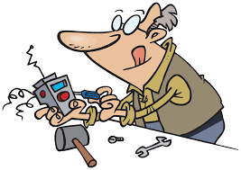
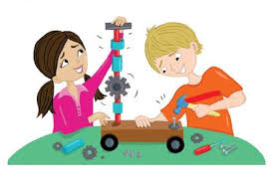
Invention
Today is our last day of the invention topic.
If you manage to complete your invention, be sure to post a picture (without your name) to our Twitter page. We are planning to make a PowerPoint of your final designs so you can all see each others hard work!
Have fun creating!

Slide 6
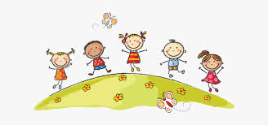
Well done Primary 3, you have completed your online learning for the week! We are off school on Monday and Tuesday so I will see you back here on Wednesday! Have fun and stay safe ☺

