Slide 1
Friday 1st May

Slide 2
Timetable
French Starter
Daily exercise
Reading
Maths Quiz
Topic

Slide 3
French
Quelle est la date aujourd’hui? e.g. C’est lundi vingt-sept avril | Comment a va? Je suis content(e) Je ne suis pas content(e)
Quel temps fait-il? e.g. Il y a du soleil Il pleut / Il fait beau/ Il fait froid/ Il fait mauvais/ Il y a des nuages/ Il y a du soleil/ Il fait du vent | Qu’est ce-que tu veux pour le dejeuner? eg. Je voudrais un sandwich au thon Je voudrais un sandwich au fromage Je voudrais un sandwich au jambon Je voudrais un sandwich aux oeufs

Slide 4
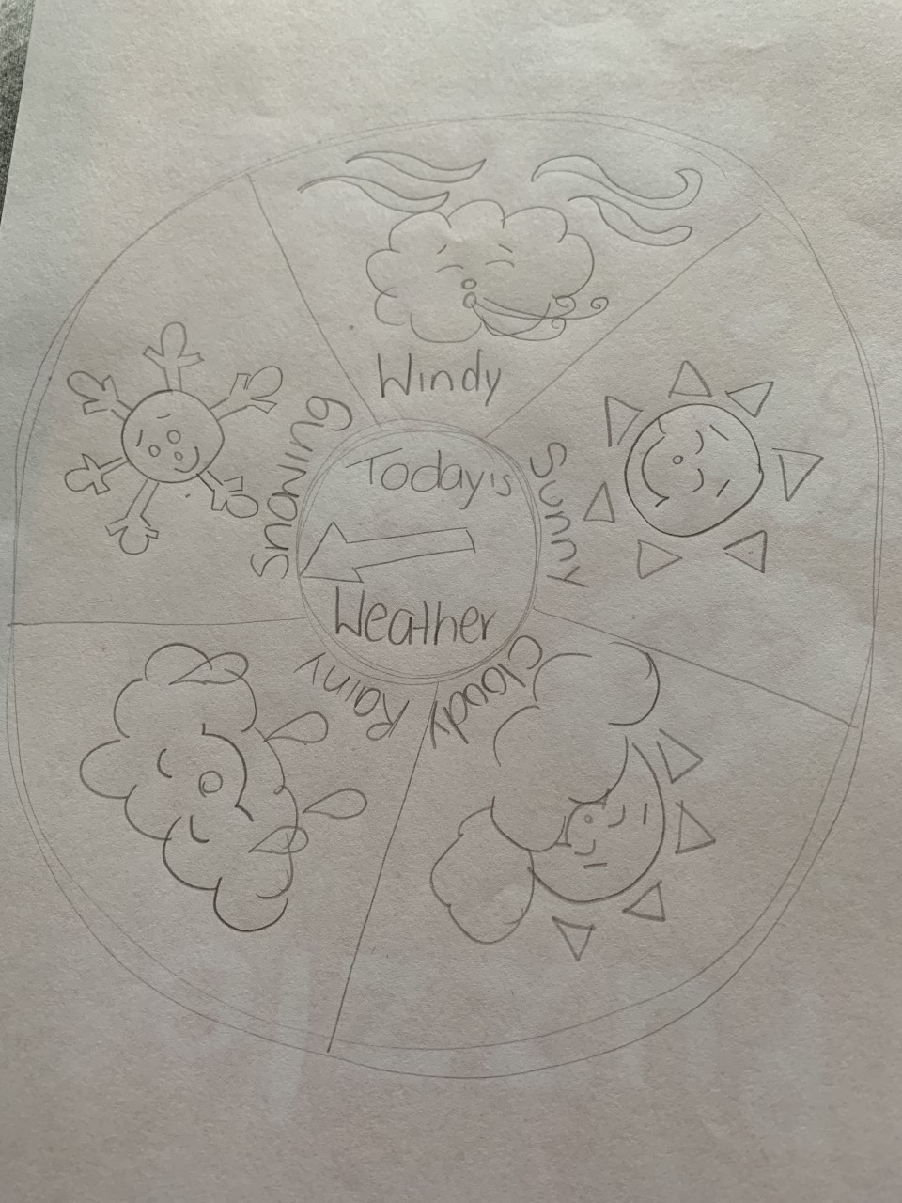
French
Listen again to the French weather song: https://www.youtube.com/watch?v=eBvJVOuBPXI
Then create your own weather dial –
something similar to this using
FRENCH weather words.

Slide 5
Reading
I can summarise the main points in the text using my own words.
Read the next chapter in your book from home. Summarise the main points of the text using your own words.

Slide 6
Maths Quiz
Maths quiz is on teams in the maths channel. To access it click on the word document and select one column to complete.

Slide 7
Topic
This week we have been looking at Blackness castle. We have looked at what is was used for and why it was positioned where it was.
If you were to design your own castle where would you place it and why?
What would be its main use?
Li – I am learning to design my own castle.

Slide 8
Topic Example Castle
Draw a picture of your castle and explain where you have placed it. This can be done over a couple of days.
I would place my castle on top of a hill. This would allow me to be able to see on coming ships or people coming from a far due to the height.
It’s main purpose would be to serve as an artillery base for ships as it is next to the sea.

Slide 9
End of Day
I will be practising my drawing skills this weekend and trying to get out for my daily exercise to look at all the new wildlife coming out because of Spring.
I hope you all have a fantastic weekend with your families and I can’t wait to hear what you have all been up to!

