Slide 1

Friday ^{1st} of May
Good Morning Primary 2!
Bonjour la class! Ca Va?

Slide 2
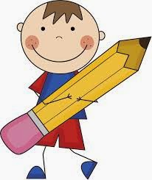
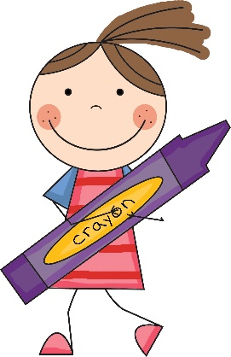
Literacy
L.I – We are learning to use our knowledge of common words and phonemes to spell, write and read words.
Watch - https://www.youtube.com/watch?v=c3oa4wfubak
Activity - Dictation
Choose a dictated sentence from list in the pack.
Read slowly to your child and encourage them to write it independently in their jotter.
Tip – Help them sound out the letters in each word.
Remember core writing targets!

Slide 3
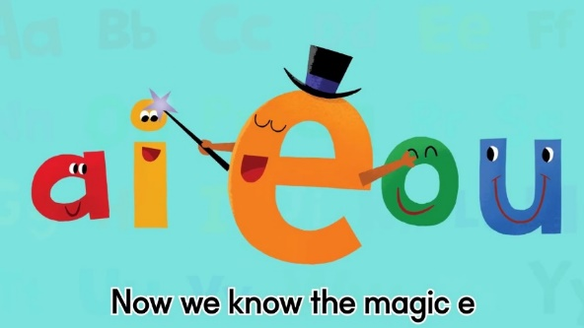
Literacy continued
https://www.ictgames.com/mobilePage/forestPhonics/index.html
Using the link above select the ‘a-e’ phoneme.
Read aloud the following and write down all the ‘a-e’ words you can find in your jotter.

Slide 4
Common words
Read aloud the following phoneme and common words.
Magic ‘e’ words –
slide white smile hide shine home rope stole
awoke hope smoke cake came spade brake name
Common words -
five time life line home more school Mrs take gave cold don’t

Slide 5
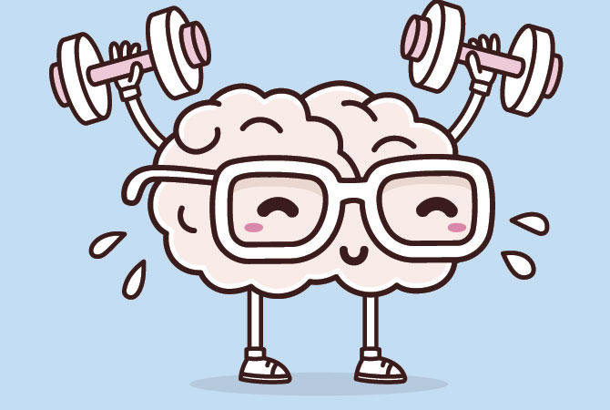

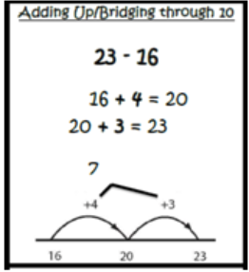
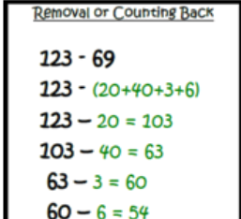
Mathematics
Number Talk
Remember – number talks are all about how you solve a task, mentally. For this activity, don’t use anything to help you, just use your brain!
52 - 2
52 - 7
53 - 3
53 - 8

Slide 6
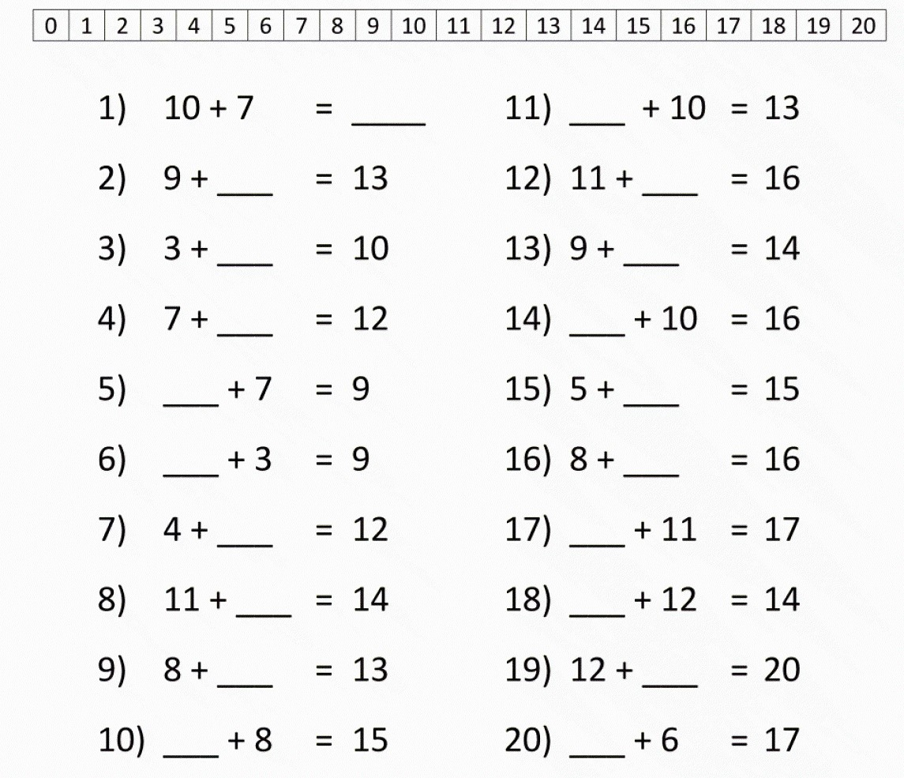
Can you complete these ‘Speedy sums’ in you jotter?

Slide 7
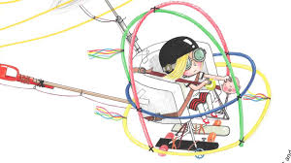
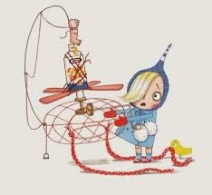
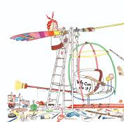
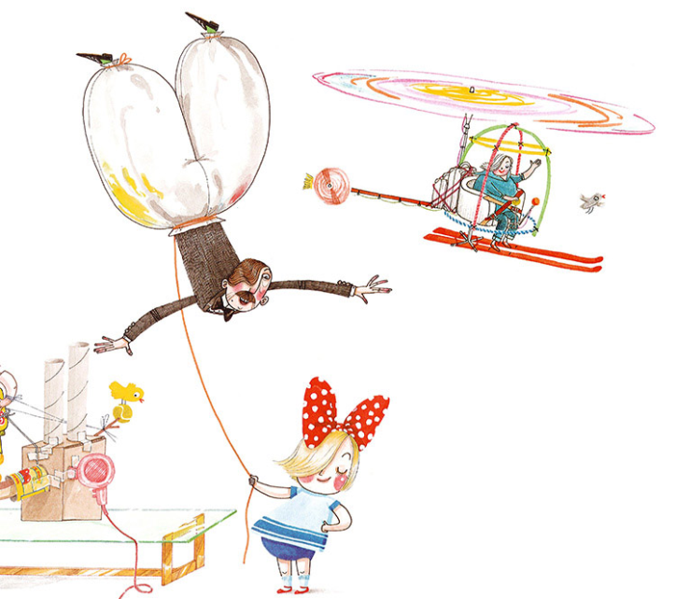
Invention convention
Day 4 – Building
Today we are engineers!
Start putting your invention together.
Good luck!

Slide 8
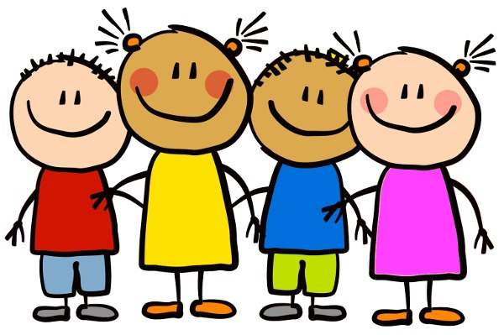
Have a lovely holiday weekend and we will be back with more activities and lessons on Wednesday.

