Slide 1
Thursday 30th April
Good Morning Primary 4!
French: Bonjour la class! Ca Va?
Quelle est la date aujourd’hui?
Aujourd’hui cest Jeudi 30th Avril 2020
Now watch the months of the year song in French :
https://www.youtube.com/watch?v=7_u2SigckNQ

Slide 2
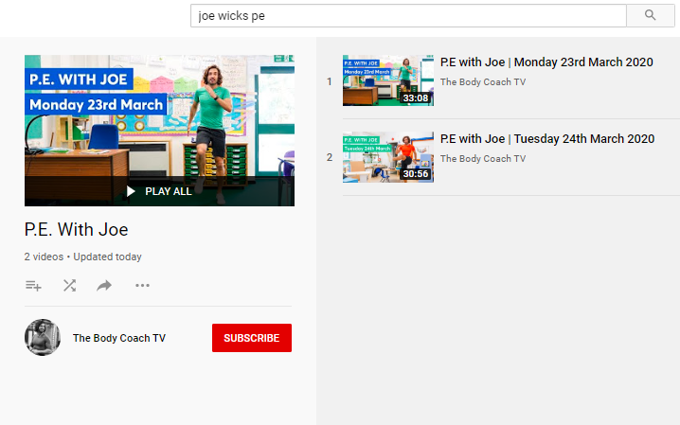
Health and Wellbeing
LI: We are learning to move our body well, exploring how to manage and control it, finding out how to use and share space.
P.E with Joe- Thursday 30th April Video
(he is nearly as fun as Mr Martin, not quite, but nearly)
https://www.youtube.com/playlist?list=PLyCLoPd4VxBvQafyve889qVcPxYEjdSTl

Slide 3
Reading
L.I I am using different reading strategies to help me understand my book
Reading:
David Walliams: Describe the setting
Roald Dahl: Chapter 8 -Inference
Tom Fletcher: Chapter 21 – A New Home
Book Review

Slide 4
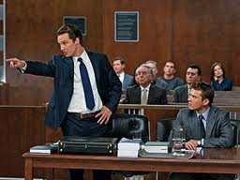
Writing (slide 1)
L.I I can write a persuasive exposition to argue my point
Sometimes, we need to persuade someone that our opinions correct. In other words, we have to convince them to believe what we say!
This is called persuasive writing.
Think of a courtroom lawyer.
Their job is to persuade people that someone is either guilty or innocent!

Slide 5
Writing (slide 2)
L.I I can write a persuasive exposition to argue my point
Today, I want you to be a lawyer!
Pretend that we are in court and that you have written a statement trying to persuade Mrs Gardner that either…
IMPORTANT: I want you to argue YOUR point of view – what do YOU think – should we be allowed to bring pets to school or not? What are your reasons!
Pets SHOULD be allowed in school
OR
Pets SHOULD NOT be allowed in school

Slide 6
Writing (slide 3)
L.I I can write a persuasive exposition to argue my point
The Success Criteria for this piece of writing will be on Teams and on the Blog.
Try and include as many of the Success Criteria as possible in your piece of writing!
See the next slide for a useful sheet full of persuasive language. Try and use language like this when you are writing your persuasive argument.
YOU NEED TO GIVE REASONS WHY YOU THINK PETS SHOULD / SHOULD NOT BE ALOWED IN SCHOOL!
The Success Criteria for today are highlighted in yellow.

Slide 7
Writing (slide 4)
L.I I can write a persuasive exposition to argue my point

Slide 8
Maths Activities
LI: I am practising my times tables
You’ve been working really hard on length and area – well done!
Today, I’d like you to spend some time practising your times tables.
This website has loads of fun games (‘Animal Rescue’ is my favourite!)
Enjoy!
https://www.timestables.co.uk/games/

Slide 9
Feel free to leave comments / questions on Teams throughout the day and I will try my best to get back to you. Enjoy your day, Primary 4!

