Slide 1
Thursday 30th of April
Good Morning Primary 3!
Bonjour la class! Ca Va?
Aujourd’hui c’est (Thursday) 30th (April) 2020.
In class, we got really good at our French colours.
Watch this short video to refresh your memory:
https://www.youtube.com/watch?v=zduapTwsSwA

Slide 2
Literacy – Reading
LI: We are learning to read fluently and answer simple questions about what we have read.
Oxford Owl Website – https://www.oxfordowl.co.uk/?sellanguage=en&mode=hub
Username – stantsps3
Password – primary3
Again, you can use a book you have at home also.
Here are some questions I would like you to answer about your book. You can write the answers in your jotter, or tell them to someone in your house.
What is the name of your book?
Who is the author?
Do you know the name of the illustrator?
What do you like about the book?
Is there anything you don’t like about the book?
Can you find one word in your book that you find tricky? What does this word mean?

Slide 3
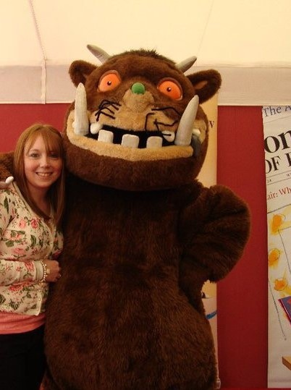
Literacy - Writing
We are learning to write a story using our imagination.
This is when Mrs Stanners’ daughter met the Gruffalo. She was very excited but a little bit frightened too. But it was okay as the Gruffalo was in a good mood and didn’t eat her.
Can you think of your favourite book character and imagine if you met them.
Where were you ?
Who else was there?
What happened?
When did it happen?
Why were they there?
How did you feel?
Use these questions to help you plan and write all aboutthe meeting. Your story can be a few sentences or as long as you like.

Slide 4
Story
Todays story is all about another inventor!
The Most Magnificent Thing
By Ashley Spires
https://www.youtube.com/watch?v=UM8oN4yzJqw

Slide 5
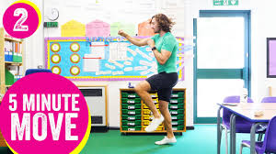
HWB
LI: We are learning to move our body well, exploring how to manage and control it.
5 minute Move – Joe Wicks
https://www.youtube.com/watch?v=SbFqQarDM50

Slide 6
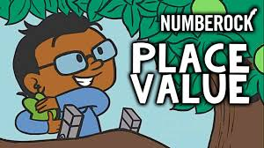
Numeracy – Warm Up
LI: We are learning to understand place value.
Watch the Place Value Song on YouTube
https://www.youtube.com/watch?v=a4FXl4zb3E4

Slide 7
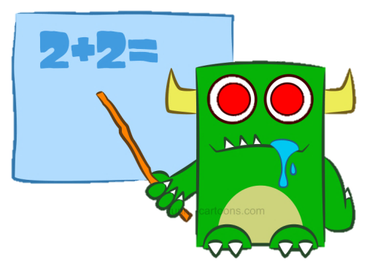
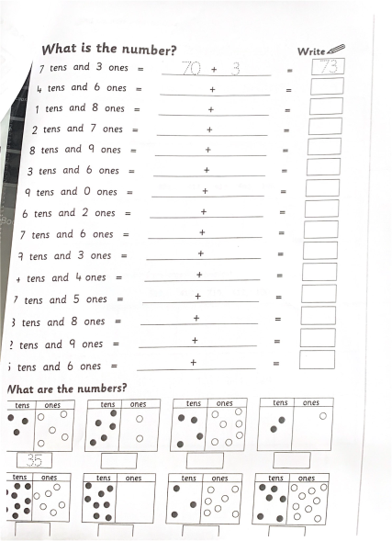
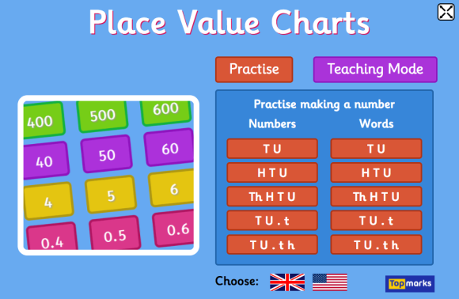
Numeracy Activities
LI: We are learning to partition numbers.
Number and Place Value Workbook
Page 3
Topmarks - Place Value Charts
https://www.topmarks.co.uk/place-value/place-value-charts

Slide 8
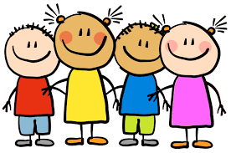
Well done for working super hard! Enjoy the rest of your day Primary 3!

