Slide 1
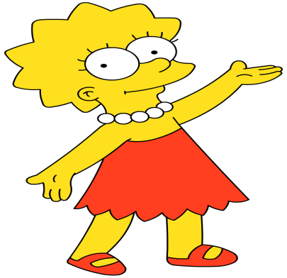
Wednesday 22-4-20
Good Morning Everyone!

Slide 2
Today’s Timetable
Morning Exercise
French
Morning Starter
Maths Lesson
Literacy Task
R.E.
Topic
P.E.
Prayer

Slide 3
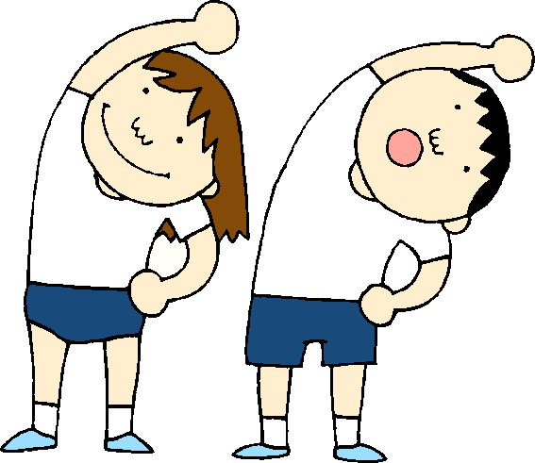
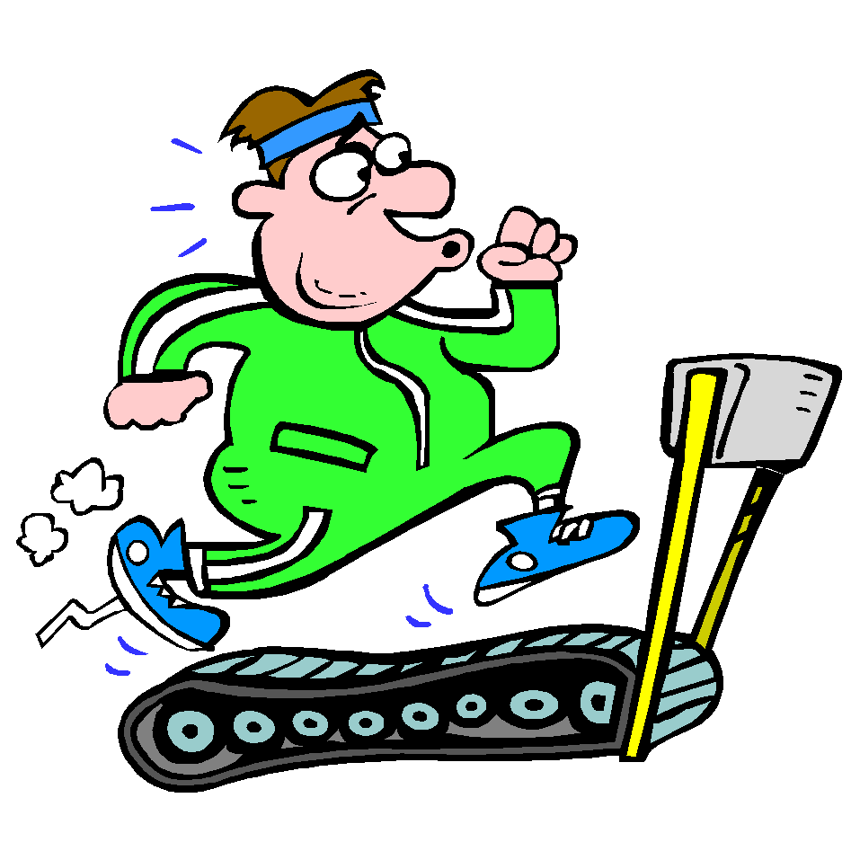
Daily Exercise
Try to do some form of exercise to start the day. This could be a walk or run with a family member or a workout in the house. Check with your parents that it is ok for you to do this.
Why not try this workout :-
https://www.youtube.com/watch?v=L_A_HjHZxfI
Or join the Body Coach at 9am

Slide 4
A little bit of French to start the day
Click on the link below to sing along to the number song in French?
https://www.youtube.com/watch?v=UsEz58BblMY
Can you write today’s date in French?
Quelle est la date aujourd’hui?
e.g. C’est lundi vingt avril
Can you also write today’s weather in French?
Quel temps fait-il?
Il pleut/ Il fait beau/ Il fait froid/ Il y a du vent/
Il fait mauvais/ Il y a des nuages/ Il y a du soleil

Slide 5
Morning Starter
You will find your Morning Starter sheet attached to the blog. Circles, you have a separate Morning Starter sheet.
I have also attached the answers so that you can self-assess your work.

Slide 6
Maths Lesson
Today we are continuing to work on multiplying and dividing decimals by 10,100 and 1000, building on the learning we have done on Monday and Tuesday. Please find your work as an attachment on the blog.
Remember to use ‘Sumdog’ and ‘Hit the Button’ to further improve your learning.
Please get in touch through Teams if you need me to help you. I’ll do my best to help.

Slide 7
Literacy Lesson
Today I would like you to watch ‘Authors Live’ on the BBC Scotland Channel [Channel 9] at 10:20. Authors Lauren St John and Elizabeth Laird will be reading and talking about their books and lives. If you miss this you can access it by clicking on the following link:-
https://www.bbc.co.uk/events/e984mb/play/ahqmn3/p07cf862
Task:- Take some notes about 2 environmental campaigns these authors are passionate about. Using bullet points, list at least 5 interesting facts about each [ If need be, you can research more about these online].

Slide 8
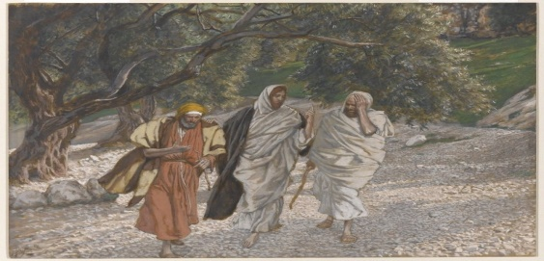
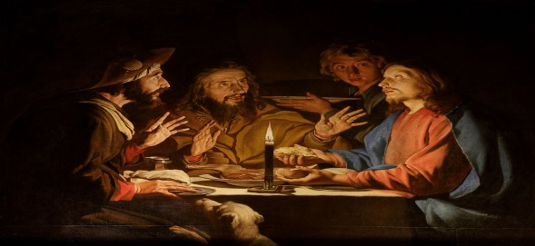
R.E.
Following on from our last lesson, today we are going to look at the connection between what happened on the Road to Emmaus and what we experience when we go to Mass.
Click on the link below
https://www.youtube.com/watch?v=OfLFH7JuQYo
Task:- Write 3 short paragraphs about the 3 main events which happened on the Road to Emmaus and how they can be linked to our experience at Mass.

Slide 9
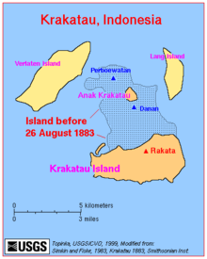
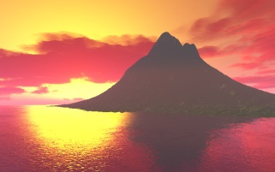
Krakatoa
This is the last lesson on Natural Disasters. Just over a week ago, on the 10th of April the volcano, Krakatoa, erupted. This was not a massive eruption but it shows that there is currently volcanic activity and pressure building below this famous volcano. A bigger eruption may be on the way. Watch the following clips to learn more about the most recent and earlier eruptions:-
https://www.youtube.com/watch?v=d-eUj2hxeBU
https://www.youtube.com/watch?v=6ZaBLzfTF3Q
https://www.youtube.com/watch?v=2Pp-W1Va5gE
Task:- Create a factfile on this famous volcano. Your factfile should include the location of Krakatoa, the type of volcano it is and details of previous eruptions.

Slide 10
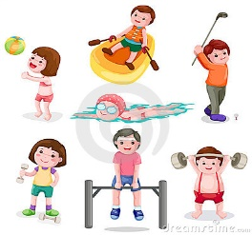
P.E.
You may wish to do some exercise outside with members of your family. However if this not possible perhaps you can persuade them to join you for a workout with the Body Coach. Click on the link below:-
https://www.youtube.com/watch?v=Uy1yab7jAcU

Slide 11
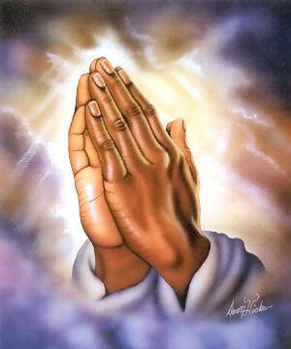
A prayer to end our day
Take a few moments to say a short prayer, thinking of those older members of our community who are anxious and worried at this time.

Slide 12
Well done!
Well done for working hard today!

