Slide 1
Wednesday 22nd of April
Good Morning Primary 2/3!
French: Bonjour la class! Ca Va?
Quelle est la date aujourd’hui?
Aujourd’hui cest M______ 22nd A____ 2020
Now watch the months of the year song in French :
https://www.youtube.com/watch?v=7_u2SigckNQ

Slide 2
Literacy: Stage 2
LI: To recognise, read and make words containing the phonemes
‘i-e & o-e’
Sing ABC, abc song.
Watch this…Magic ‘e’ song https://www.youtube.com/watch?v=bZhl6YcrxZQ
Magic ‘e’ fun.
Can you add magic ‘e’ to these words to make new ones?
fin hop con shin pop
min pin hid rid cop
Challenge** can you add your own magic e words to these?

Slide 3
Literacy: Stage 3
LI: To recognise, read and make words containing the phoneme ‘ough’’
Sing ABC, abc song.
Watch this… the many sounds of OUGH
https://www.youtube.com/watch?v=WGERKJYjkQI
Sorting ough
Can you sort the ough words into the ones that sound the same?
rough dough thought bought
cough though tough fought
Challenge ** See if you can add your own words to each list of ough words.

Slide 4
Reading
https://www.oxfordowl.co.uk/?sellanguage=en&mode=hub username: stantsps password:homelearning
Using your online reading book for the week can you complete the read to write task below in your jotter.

Slide 5
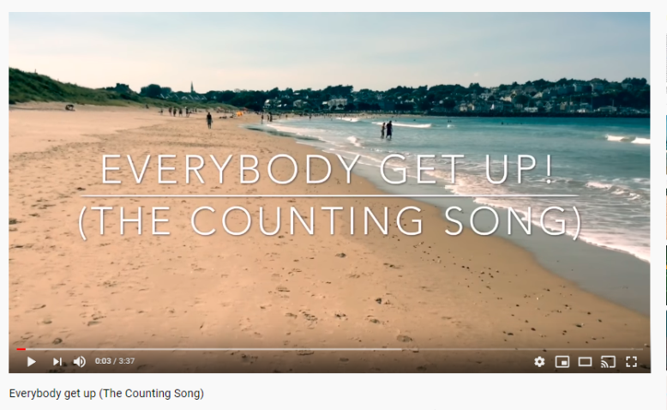
Numeracy – Warm Up
LI: We are learning to count in 1’s, 5’s, & 10’s
Get your dancing feet on, ready to sing and dance with Mr Mc to the counting song below.
It starts with counting in 1’s, then 5’s and finally 10’s.
https://www.youtube.com/watch?v=aKvgwVAGSgw

Slide 6
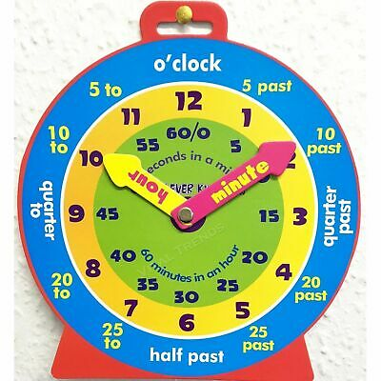
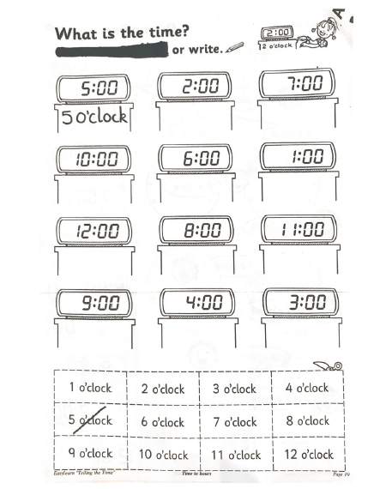
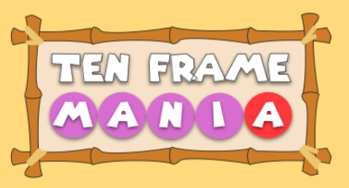
P2 Maths Activities
LI: To tell the time on an analogue and digital clock using the terms half past, quarter past and o’clock.
Time workbook
Complete this workbook page
found in your home learning pack.
2. Greg Tang Math- Ten Frame Mania
https://gregtangmath.com/tenframemania

Slide 7
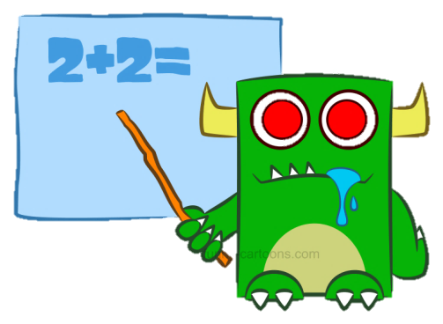
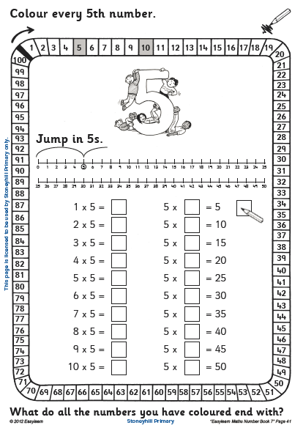
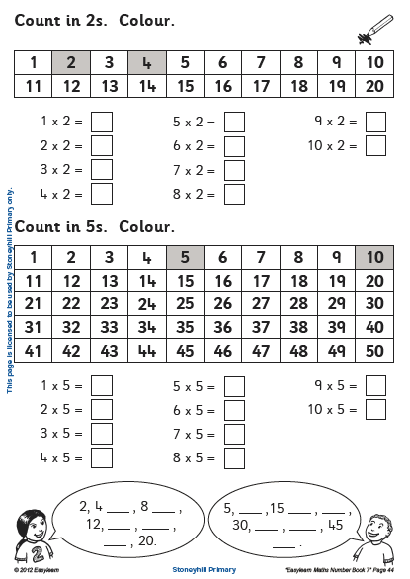
P3 Numeracy Activities
LI: To develop multiplication strategies
Multiplication Workbook
Please do these two pages
(41,44)
2. Greg Tang Math- Ten Frame Mania
https://gregtangmath.com/tenframemania

Slide 8
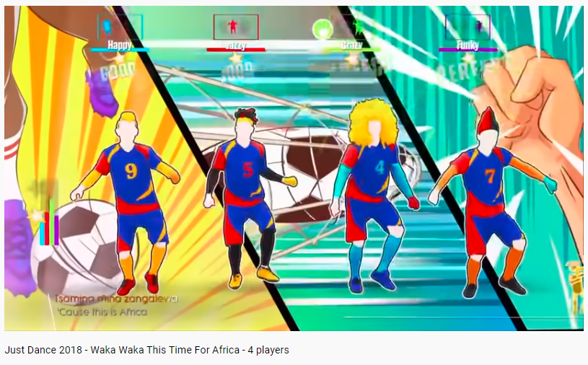
Health and Wellbeing
LI: To identify different features of dance and practise and perform steps and routines
Watch and Join In With
Waka Waka Just Dance Choreography
https://www.youtube.com/watch?v=gCzgc_RelBA

Slide 9
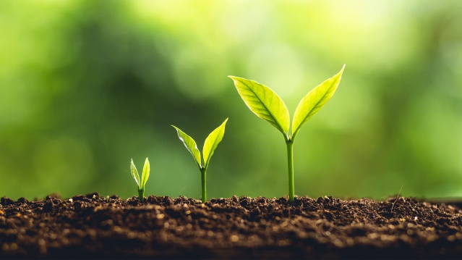
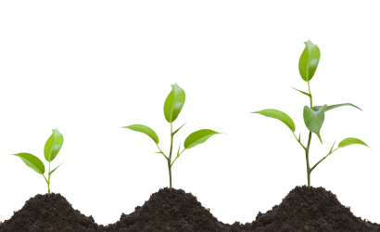
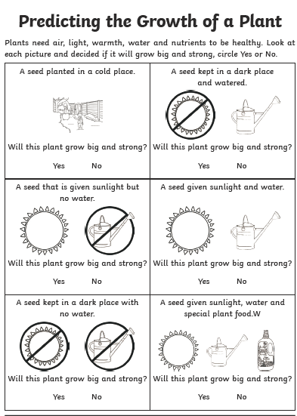
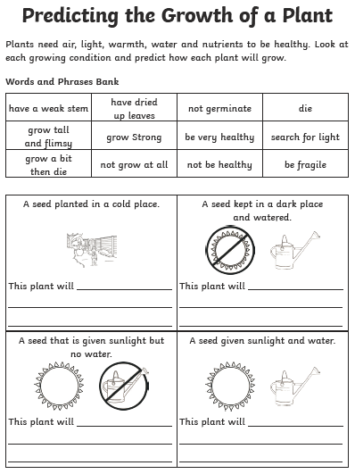
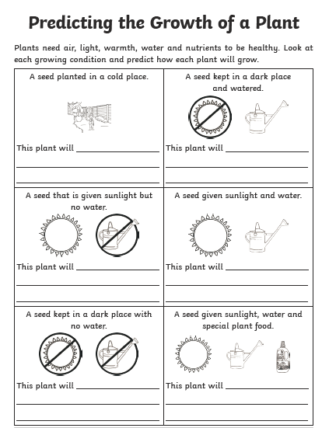
Topic
LI: To predict the growth of a plant
Using the powerpoint and worksheet attached to the blog post, you are to investigate what a plant needs to grow and then use the sheet predict what will happen to the seed when given different environments to live in.
(There are 3 ability level sheets in the document, ranging from simple to more complex, you can pick which sheet you wish to complete)

Slide 10
Leave a comment on the blog about what you have been up to today. Enjoy the rest of your day Primary 2/3!

